Slide 1
UNIT II
b) Bioenergetics
Presented By: Miss. Sampada L. Deshmukh

Slide 2
Bioenergetics
Bioenergetics or biochemical thermodynamics deals with the study of energy changes (transfer and utilization) in biochemical reactions.
The reactions are broadly classified as exergonic (energy releasing) and endergonic (energy consuming).
Bioenergetics or biochemical thermodynamics is the study of energy changes accompanying biochemical reaction or in biological system.

Slide 3
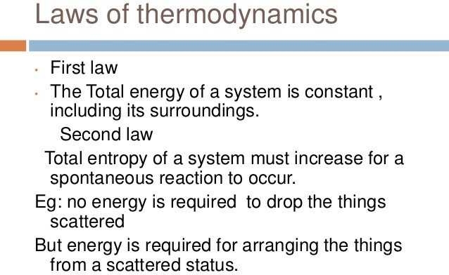

Slide 4
Free Energy
The energy actually available to do work
(utilizable) is known as free energy.
Changes in the free energy (∆G) are valuable in predicting the feasibility of chemical reactions. The reactions can occur spontaneously if they are accompanied by decrease in free energy.
During a chemical reaction, heat may be released or absorbed.

Slide 5
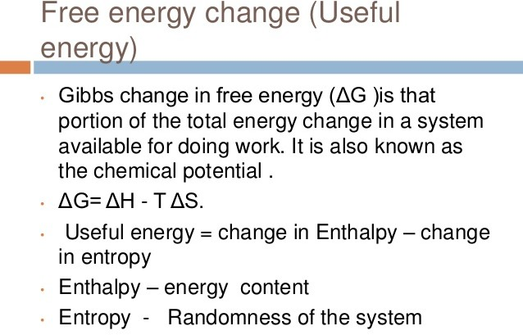

Slide 6
Enthalpy (∆H) is a measure of the change in heat content of the reactants, compared to products.
Entropy (∆S) represents a change in the randomness or disorder of reactants and products.
The term standard free energy represented by
∆G° (note the superscript°) is often used. It indicates the free energy change when the reactants or products are at a concentration of 1 mol/l at pH 7.0.

Slide 7
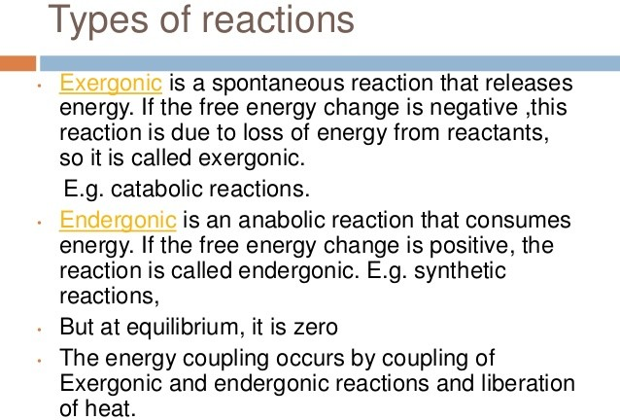

Slide 8
Negative & Positive ∆G
If free energy change (∆G) is represented by a negative sign, there is a loss of free energy. The reaction is said to be exergonic, and proceeds spontaneously.
On the other hand, a positive ∆G indicates that energy must be supplied to the reactants. The reaction cannot proceed spon-taneously and is endergonic in character.
The free energy change becomes zero (∆G = 0)
when a reaction is at equilibrium.

Slide 9
At a constant temperature and pressure, ∆G is dependent on the actual concentration of reactants and products. For the conversion of reactant A to product B (A o B), the following mathematical relation can be derived
∆G = ∆G° + RT In^{[B]/}[A]
where ∆G° = Standard free energy change R = Gas constant (1.987 Cal/mol)
T= Absolute temperature (273 + °C)
In = Natural logarithm
[B]= Concentration of product [A]= Concentration of reactant.

Slide 10
∆G° is related to equilibrium constant (Keq)
When a reaction A B is at equilibrium (eq), the free energy change is zero. The above equation may be written as
∆G = 0 = ∆G° + RT In [B] eq./[A] eq.
Hence ∆G° = – RT In Keq.

Slide 11
High energy compounds
Certain compounds are encountered in the biological system which, on hydrolysis, yield energy.
The term high-energy compounds or energy rich compounds is usually applied to substances which possess sufficient free energy to liberate at least 7 Cal/mol at pH 7.0
Certain other compounds which liberate less than
7.0 Cal/mol (lower than ATP hydrolysis to ADP + Pi) are referred to as low-energy compounds.

Slide 12
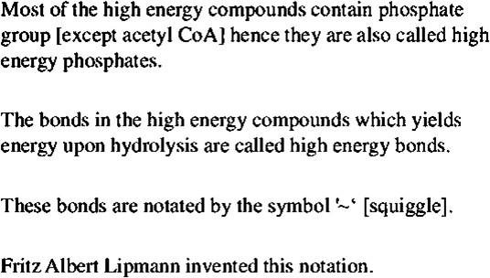

Slide 13
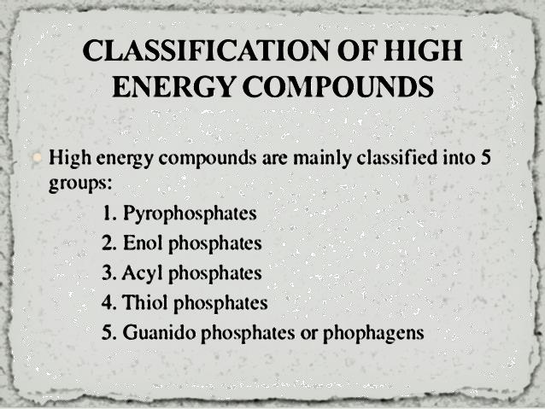

Slide 14
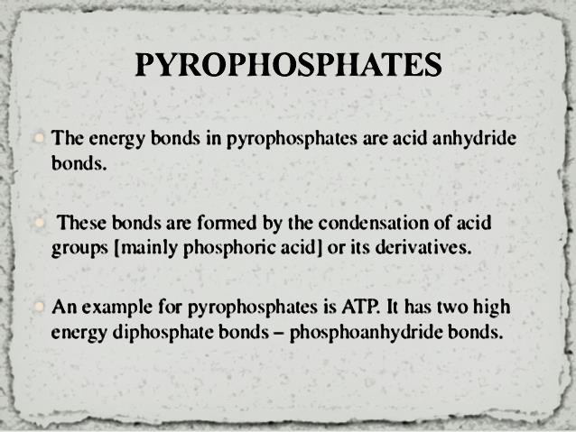

Slide 15
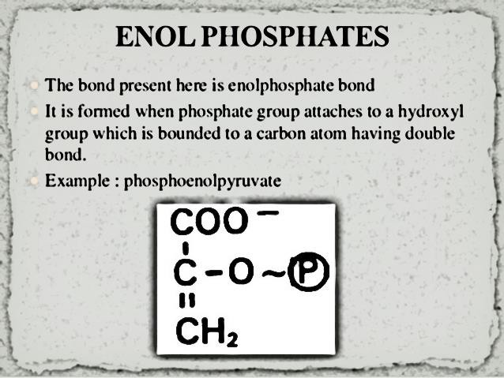

Slide 16
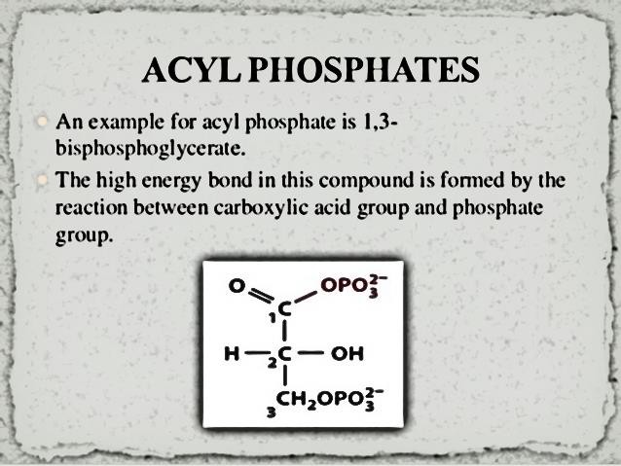

Slide 17
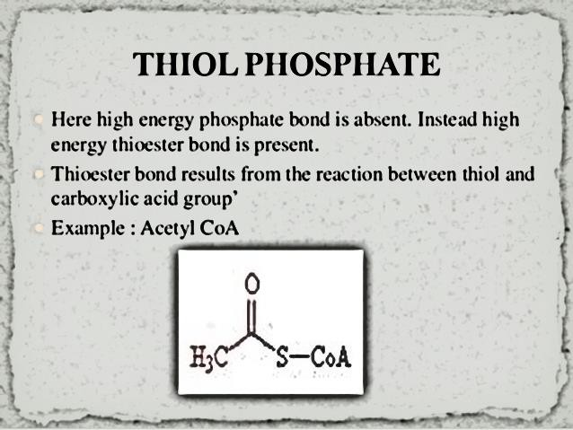

Slide 18
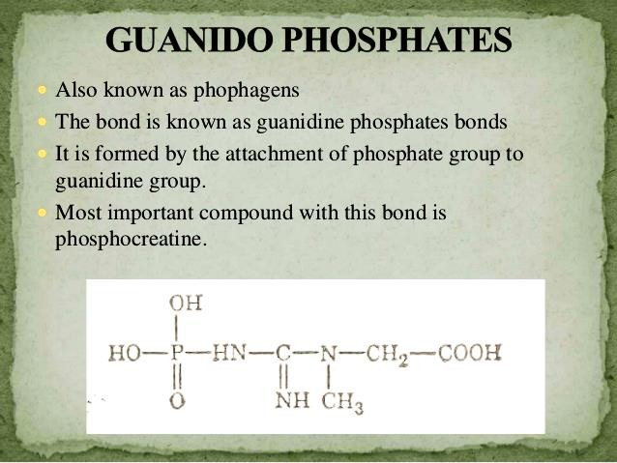

Slide 19
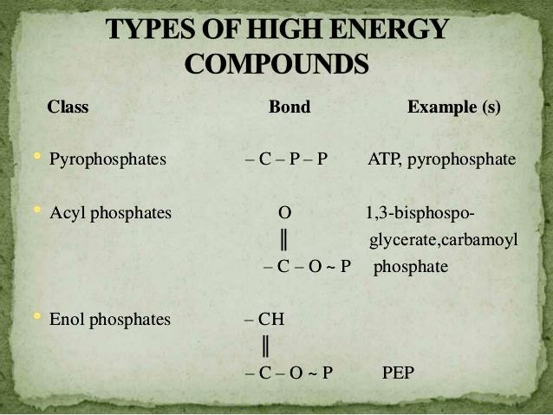

Slide 20
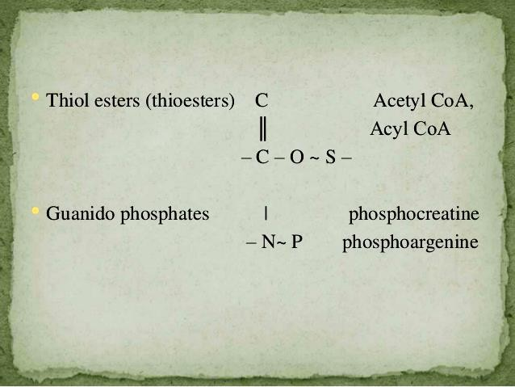

Slide 21
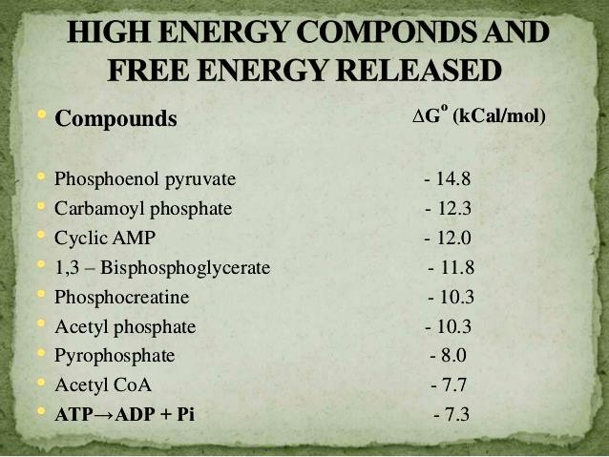

Slide 22
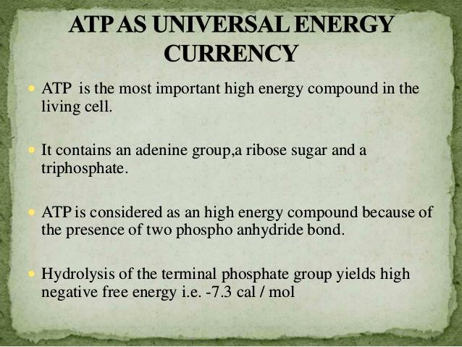

Slide 23
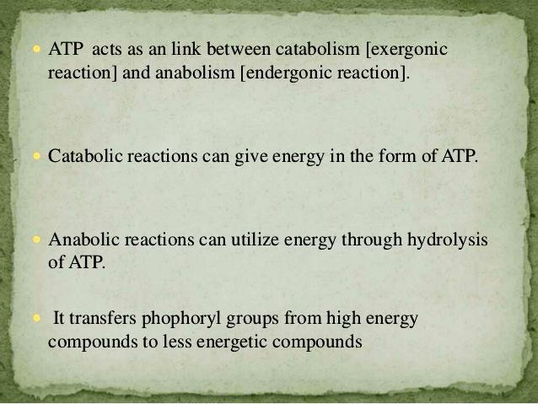

Slide 24
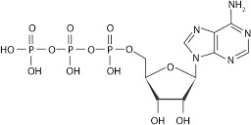
Structure of ATP

Slide 25
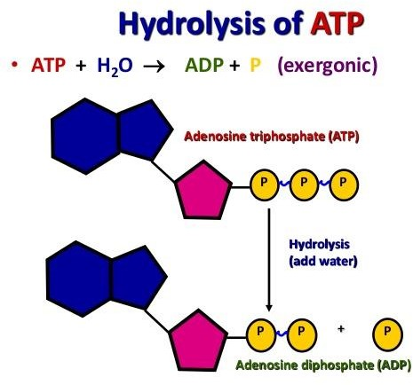

Slide 26
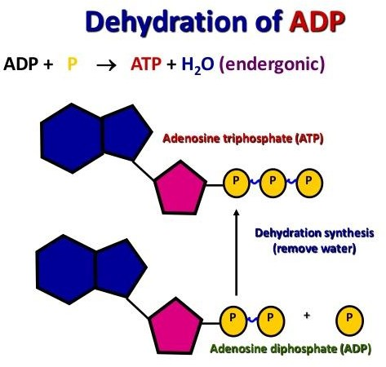

Slide 27
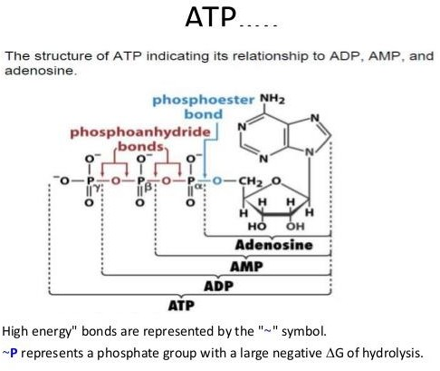

Slide 28
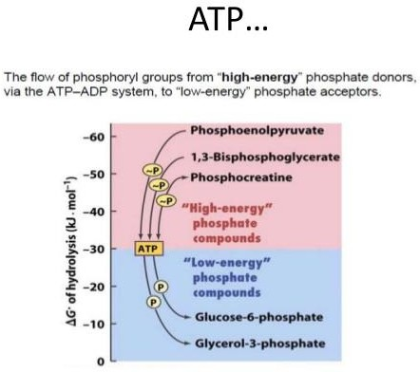

Slide 29
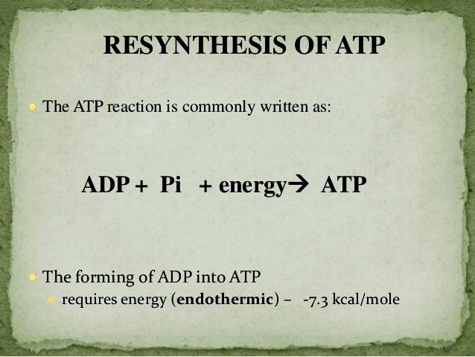

Slide 30
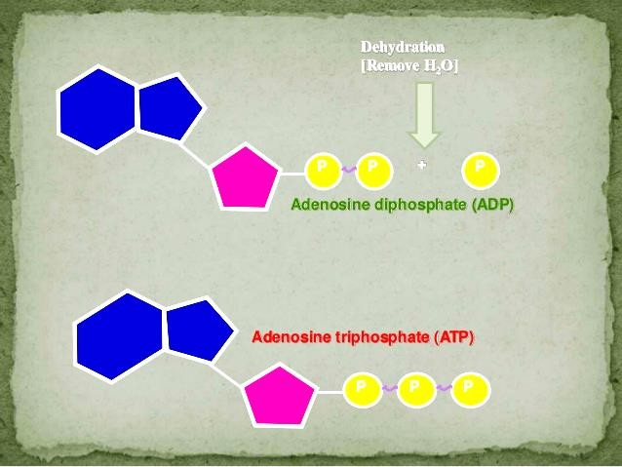

Slide 31
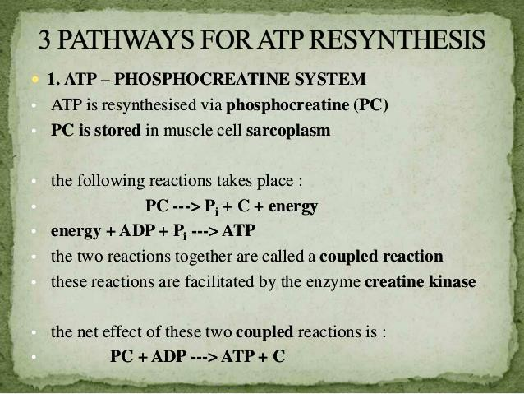

Slide 32
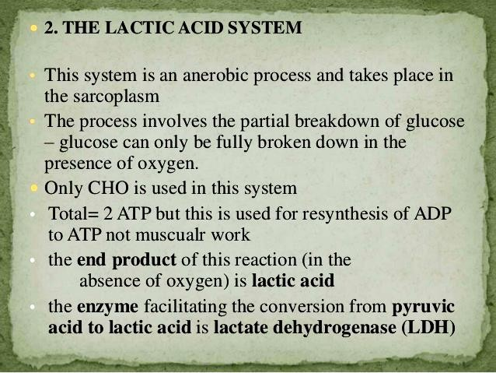

Slide 33
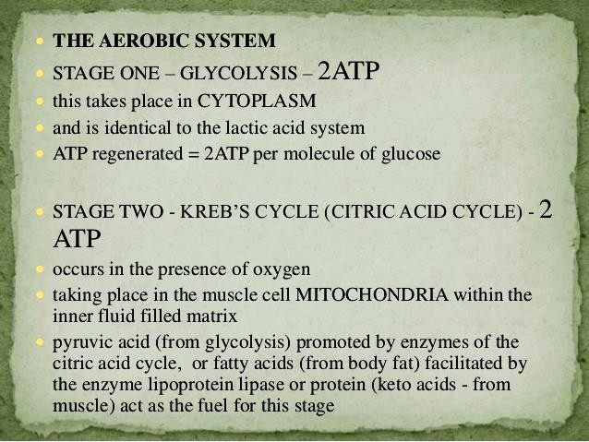

Slide 34
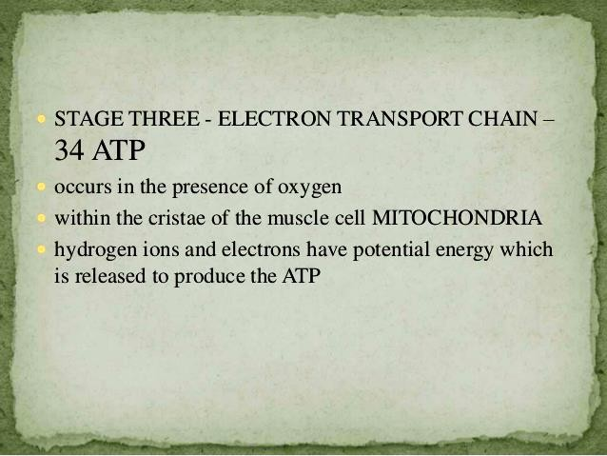

Slide 35
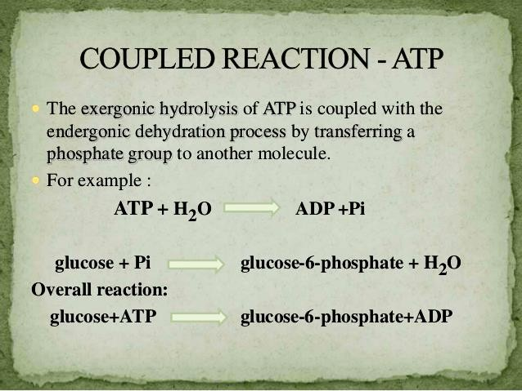

Slide 36
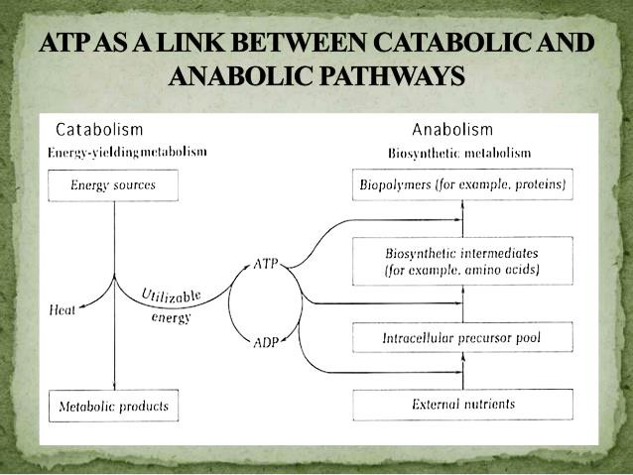

Slide 37
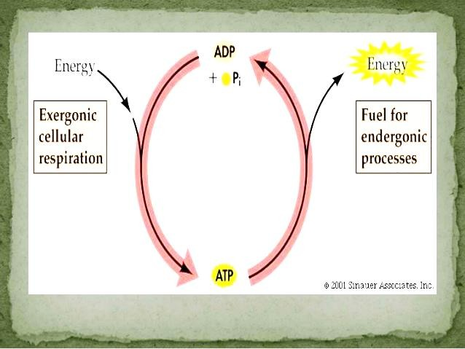

Slide 38
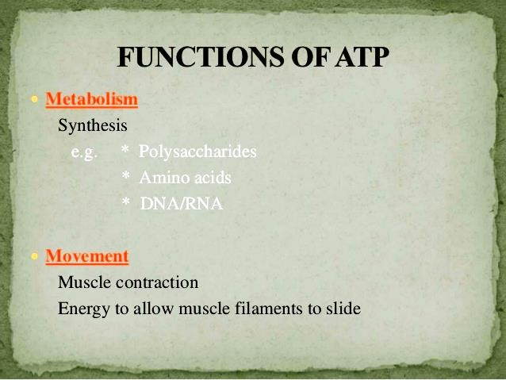

Slide 39
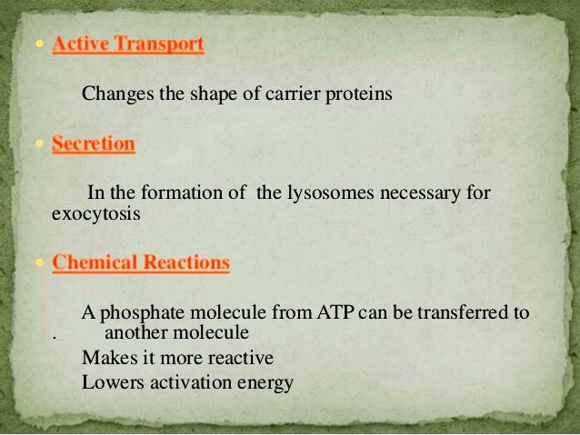

Slide 40
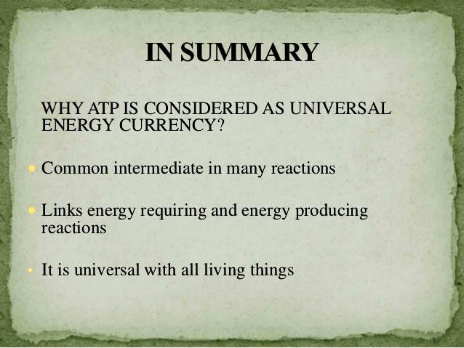

Slide 41
