Slide 1
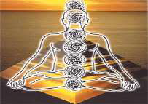
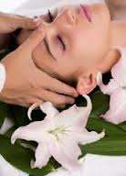
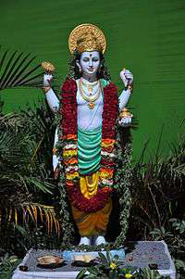
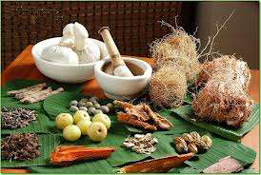

TRADITIONAL SYSTEM OF MEDICINE
Mrs. Bharati M. Sonawane
Department of Pharmacognosy
Loknete Dr. J. D. Pawar College of Pharmacy, Manur. Kalwan.

Slide 2
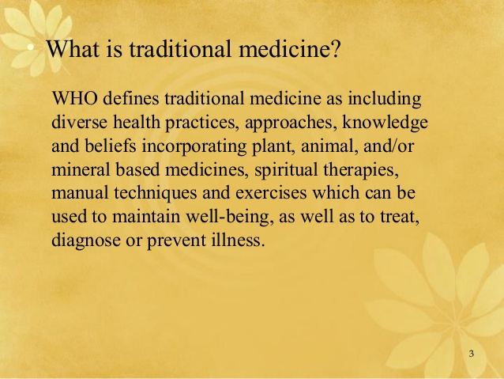

Slide 3
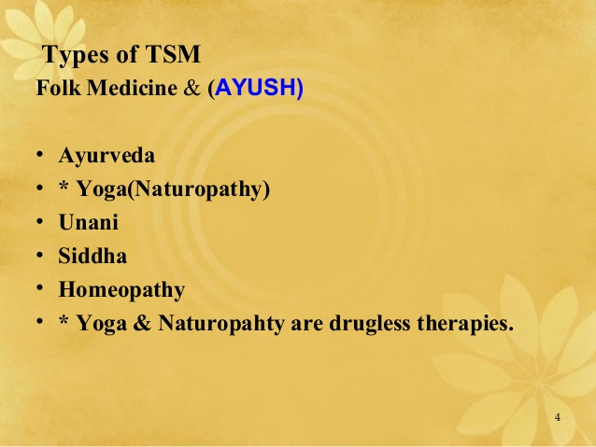

Slide 4
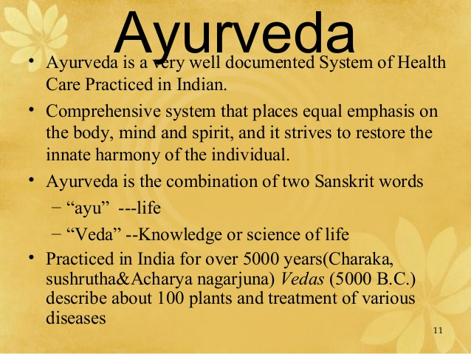

Slide 5
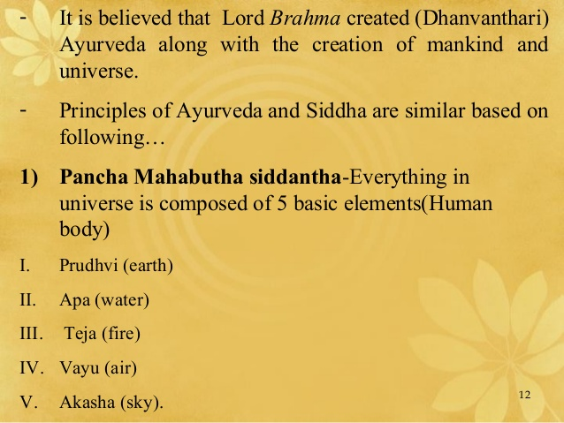

Slide 6
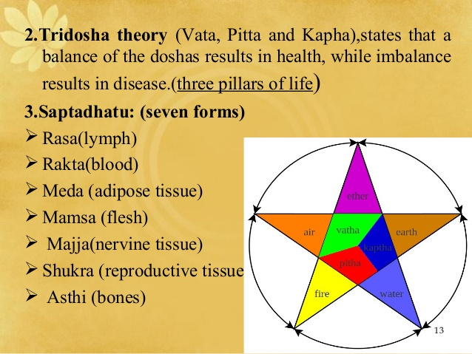

Slide 7
AYURVEDA –FUNDAMENTAL PRINCIPLES THRIDOSHA THEORY
VATHA – AKASA(SPACE) + VAYU(AIR)
PITHA – AGNI(FIRE) + APA(WATER)
KAPHA – AP(WATER) + PRITHVI (EARTH)

Slide 8
MOVENMENT
Vata Dosha’ – is the bodily wind principle
It can be translated as movement. That which moves is termed as ‘Vata’.
It supports the two other Dosha.
It also governs our sensory and mental balance and promotes mental adaptability and understanding.
Vata controls the movement of blood in the circulatory system, air in the respiratory system, and excretions out of our body.
It controls the nervous system and moves nutrients to cells and tissues for metabolism.
It controls the thoughts and the activities of the mind.
The intestines are the seat of Vata.
Its qualities are dry, cold, subtle, light, mobile, rough, erratic, clear, fast, mobile, bitter, astringent, and pungent.

Slide 9
TRANSFORMATION
‘Pitta Dosha’ – is translated as Body ‘Fire’ and that which digests
things.
 It is responsible for all chemical and metabolic transformations in
the body.
 It also governs our mental digestion and our capacity to perceive
reality and understand things.
 The small intestine, stomach, sweat glands, blood, fat, eyes and
skin are the seats of Pitta.
 Its qualities are hot, oily, light, intense, fluid, sharp, soft, smooth,
sour, pungent, and salty.

Slide 10
STABILITY & FLEXIBILITY
‘Kapha Dosha’ – is biological ‘Water’ and that which holds things
together.
 It provides body and substance and gives support.
 It provides emotional support in life and governs such positive
emotional traits as love, compassion, modesty, patience and
forgiveness.
 It fills spaces in the body, giving biological strength, vigor and
vitality.
 The chest is the seat of Kapha. Its qualities are oily, cool, heavy,
stable, dense, smooth, dull, wet, slow, cloudy, sweet, sour, and
salty.

Slide 11
 | VATA
Basic Function | Governs bodily functions concerned with movement
Qualities | Moving quick, light, cold, minutes, rough dry, leads the order doshas.
Results of Balance | Mental alertness Proper formation of body tissues Normal alimentation Strong immunity Sound sleep Sense of exhilaration
Results of Imbalance | Dry or Rough Skin Constipation Common fatigue ( non-specific cause ) Tension headaches Underweight Insomnia Intolerance of cold Anxiety, worry

Slide 12
 | Pitta
Basic Function | Governs bodily functions concerned with heat, metabolism, and energy production
Qualities | Hot, sharp, light, acidic, slightly, oily.
Results of Balance | Normal heat and thirst mechanism Strong digestion Sharp intellect Lustrous complexion contentment
Results of Imbalance | Rashes, skin inflammations Heartburn Premature graying, baldness Hostility, irritability Visual problems Excessive body heat

Slide 13
 | Kapha
Basic Function | Governs bodily functions concerned with physical structure , and fluid balance
Qualities | Heavy, oily, slow, cold, steady, solid, dull.
Results of Balance | Muscular strength Strong immunity Affection, generosity, courage, dignity Healthy, Normal, Joints Vitality and stamina Stability of mind
Results of Imbalance | Oily skin Sinus congestion Obesity Slow digestion Nasal allergies Lethargy, dullness

Slide 14
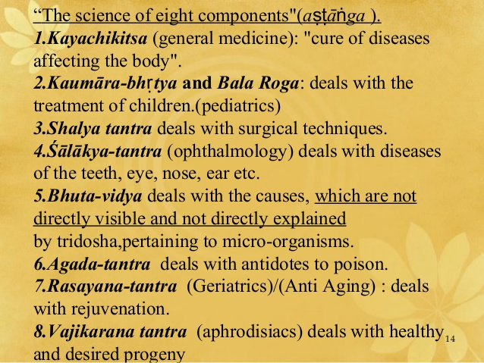

Slide 15
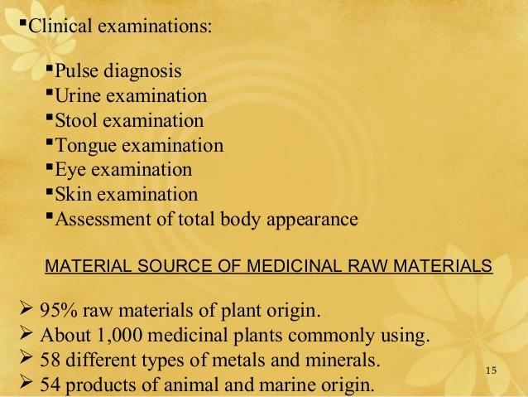

Slide 16
TRADITIONAL SYSTEM OF MEDICINE
Mrs. Bharati M. Sonawane
Department of Pharmacognosy
Loknete Dr. J. D. Pawar College of Pharmacy, Manur. Kalwan.

Slide 17
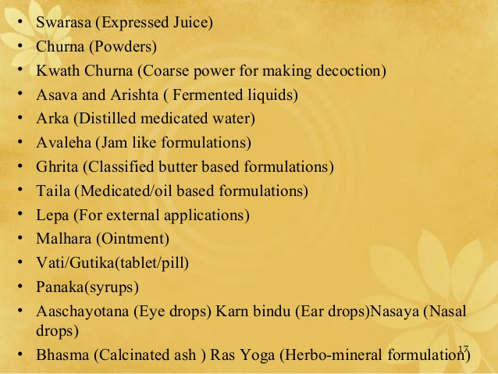

Slide 18
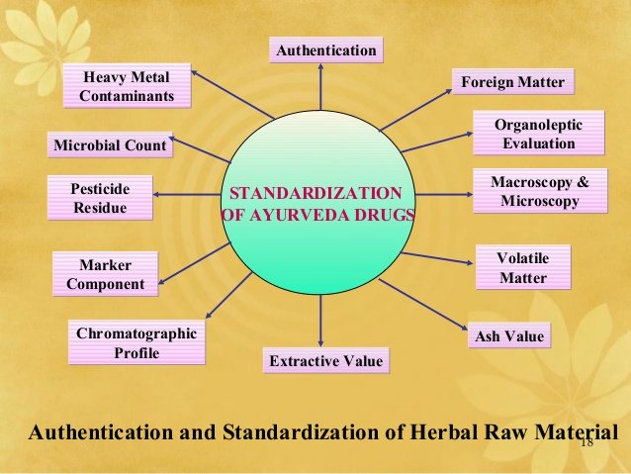

Slide 19
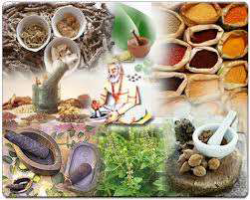
Unani
• As the name indicates, Unani system originated in Greece.
• The foundation of Unani system was laid by
Hippocrates.
• It was introduced in India by the Arabs and Persians
sometime around the eleventh century.
• During 13th and 17th century A.D. Unani Medicine
had its hey-day in India.

Slide 20
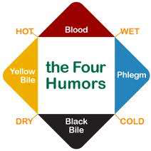
The basic theory of Unani system is based upon the well- known four- humour theory of Hippocrates.

Slide 21
• The human body is considered to be made up of the following seven components are:
o Arkan (Elements)
o Mizaj (Temperament)
o Akhlat (Humors)
o Aaza (Organs)
o Arwah (Spirits or vital breaths)
o Quwa (energy)
o Afaal (Functions)

Slide 22
• Unani system of Medicine has been found to be efficacious in conditions like
o Rheumatoid Arthritis,
o Jaundice,
o Nervous Debility,
o Skin Diseases like Vitiligo & Eczema,
o Sinusitis and Bronchial Asthma.

Slide 23
• For the prevention of disease and promotion of health, the Unani System emphasizes six essentials
(Asbab-e-Sitta Zarooria):-
a) pure air
b) food and water
c) physical movement and rest
d) psychic movement and rest
e) sleep and wakefulness and
f) retention of useful materials and evacuation of waste
materials from the body.

Slide 24
• There are four forms of treatment in Unani medicine
o Ilaj bid Dawa (Pharmacotherapy),
o Ilaj bil Ghiza (Deitotherapy),
o Ilaj Bid Tadbir (Regimenal Therapy) and
o Ilaj bil Jarahat (Surgery).

Slide 25
• Regimenal Therapy is a special technique/ physical method of treatment to improve the constitution of body by removing waste materials and improving the defense mechanism of the body and protect health.
• Some of the special techniques are
o Fasd (Blood-letting)- Withdrawal of often little quantities of blood from a patient to cure or prevent illness and disease.
o Dalk (Massage)
o Riyazat (Exercise)

Slide 26
o Hijama (Cupping)- A partial vacuum is created in cups placed on the skin either by means of heat or suction. This draws up the underlying tissues. When the cup is left in place on the skin for a few minutes, blood stasis is formed and localized healing takes place.
o Taleeq-e-Alaq (Leeching)- application of a living leech to the skin in order to initiate blood flow or deplete blood from a localized area of the body.
o Hammame- Har (Turkish Bath)
o Amal-e- Kai (Cauterization).

Slide 27
Surgery:
Treatment is divided into 3 parts:
Izalae sabab (remove cause of ailment)
Tadeele akhlat (strengthening natural defense mechanism)
Tadeele aza (normalization of tissues/organ)

Slide 28
TRADITIONAL SYSTEM OF MEDICINE
Mrs. Bharati M. Sonawane
Department of Pharmacognosy
Loknete Dr. J. D. Pawar College of Pharmacy, Manur. Kalwan.

Slide 29
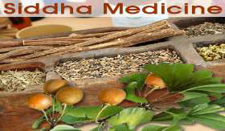
Siddha
• The Siddha System of medicine is one of the ancient systems of medicine in India having its close bend with Dravidian culture.
• The term Siddha means achievements and Siddhars are those who have achieved results in medicine.
• The Siddha system of Medicine emphasizes on the patient, environment, age, sex, race, habits, mental frame work, habitat, diet, appetite, physical condition, physiological constitution of the diseases for its treatment which is individualistic in nature.

Slide 30
• Diagnosis of diseases are done through examination of pulse, urine, eyes, study of voice, colour of body, tongue and status of the digestion of individual patients.
• System has unique treasure for the conversion of metals and minerals as drugs and many infective diseases are treated with the medicines containing specially processed mercury, silver, arsenic, lead and sulphur without any side effects.

Slide 31
The strength of the Siddha system lies in providing very effective therapy in the case of-
o Psoriasis,
o Rheumatic disorders,
o Chronic liver disorders,
o Benign prostate hypertrophy,
o Bleeding piles,
o Peptic ulcer
o Various kinds of Dermatological disorders of non psoriatic
nature.

Slide 32
Diagnosis and Treatment:
Examination is done by eight features which are evaluated on the basis of three humors:
Nadi Pariksha
Urine Test
Test of fecal matter
Study of pallor of the Skin
Examination of tongue
Examination of eyes
Examination of voice
Feeling the patient

Slide 33
Treatment divided into three categories:
Divine method
Rational method
Surgical method
Drugs of siddha system is divided into three group:
Thavarum (herbal drugs)
Thathu (inorganic substances)
Jangamam (animal products)
Thavarum:
Use herbs in preparation of medicine

Slide 34
Thathu:
Classified as:
1. Uppu- water soluble inorganic substances that give out vapour when put on fire.
2. Pashanam- drugs not dissolve in water but melt when put on fire.
3. Uparasam- similar to pashanam but differ in action.
4. Loham- not dissolve in water but melt when put on fire.
5. Rasam- contains drugs which are not soft.
6. Gandhagam- drugs are insoluble in water.

Slide 35
Jangamam :
Animal products used as medicine.
Eg. Peranda bhasma (made of human skull bones or skull of dogs)
Drugs of siddha system are classified on the basis of five properties:
1. Suvai (taste)
2. Guna (character)
3. Veerya (potency)
4. Pirivu (class)
5. Mahimai (action)

Slide 36
According to mode of application medicine are divided into two class:
1.Internal medicine:
used through oral route and further classified into 32 categories based on their form, method of preparation, shelf life, etc.
2. External medicine:
contains applications like- nasal, eye and ear drops and also certain producers like leech application.

Slide 37
Homoeopathy
• The Physicians from the time of Hippocrates (around 400 B.C.) have observed that certain substances could produce symptoms of a disease in healthy people similar to those of people suffering from the disease.
• Dr. Christian Friedrich Samuel Hahnemann, a German physician, scientifically examined this phenomenon and codified the fundamental principles of Homoeopathy.
• Homoeopathy was brought into India around 1810 A.D. by European missionaries and received official recognition in 1948 by the Parliament.

Slide 38
First principle of Homoeopathy ‘Similia Similibus Curentur’- a medicine which could induce a set of symptoms in healthy human beings would be capable of curing a similar set of symptoms in human beings actually suffering from the disease.
• Second principle of ‘Single Medicine’- Single medicine should be administered at a time to a particular patient during the treatment.
• Third principle of ‘Minimum Dose’ - bare minimum dose of a drug which would induce a curative action without any adverse effect should be administered.

Slide 39
• Homoeopathy is based on the assumption that the causation of a disease mainly depends upon the susceptibility or proneness of an individual to the incidence of the particular disease in addition to the action of external agents like bacteria, viruses, etc.
• Homoeopathic medicines are prepared mainly from natural substances such as plant products, minerals and from animal sources.
• Homoeopathy has its own areas of strength in therapeutics and it is particularly useful in treatment for allergies, autoimmune disorders and viral infections.

Slide 40
• Many surgical, gynaecological and obstetrical and paediatric conditions and ailments affecting the eyes, nose, ear, teeth, skin, sexual organs etc. are amenable to homoeopathic treatment.
• Behavioral disorders, neurological problems and metabolic diseases can also be successfully treated by Homoeopathy.
• Apart from the curative aspects, Homoeopathic medicines are also used in preventive and promotive health care.

Slide 41
system is based on the following three Principle Energies –
o Lung (wind)
o manifests the nature of Air element.
o It is characterised as rough, light, cold, subtle, hard and mobile.
o It is responsible for the physical and mental activities, respiration, expulsion of urine, faces, foetus, menstruation, spitting, burping, speech, gives clarity to sense organs, sustains life by means of acting as a medium between mind and body.

Slide 42
mKhris-pa (Bile)
o Basically it has the nature of fire. It is characterised as oily, sharp, hot, light, fetid, purgative and fluidity.
o mKhris-pa is responsible for hunger, thirst, digestion and assimilation, maintains body heat, gives lustre to body complexion and provides courage and determination.

Slide 43
Bad-kan (Phlegm)
o It is cold in nature and is characterized as oily, cool, heavy, blunt, smooth, firm and sticky.
o Bad-kan is responsible for firmness of the body, stability of mind, induces sleep, connects joints, generates tolerance and lubricates the body.

Slide 44
• The diagnostic techniques include:
o visual observation (tongue & urine analysis),
o touch (pulse, temp., smoothness etc.) and
o interrogation.
• The treatment has 4 major sections:
o diet,
o behavior,
o medicine &
o accessory/ external therapies.

Slide 45
• Minor ailments can be treated with proper regulation of diet & behavior only.
• A patient with medium state of condition can be treated with medicine like decoction, powder, pills, purgatives, emetics etc.
• In advanced stage diseases can be cured by application of accessory/ external therapies like venesection, massage, surgery etc.

Slide 46
TRADITIONAL SYSTEM OF MEDICINE
Mrs. Bharati M. Sonawane
Department of Pharmacognosy
Loknete Dr. J. D. Pawar College of Pharmacy, Manur. Kalwan.

Slide 47
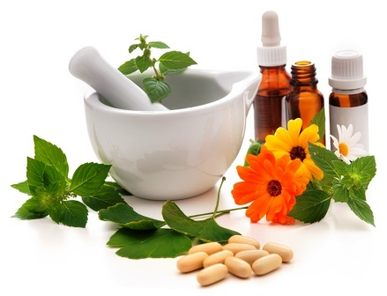
Ayurvedic dosage forms

Slide 48
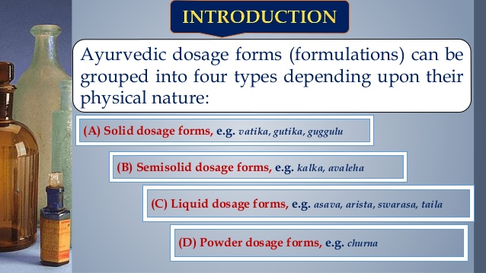

Slide 49
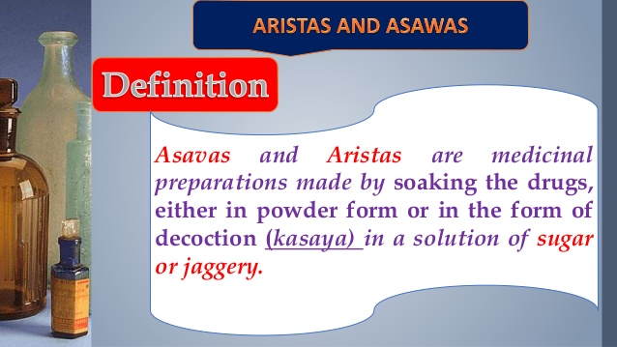

Slide 50
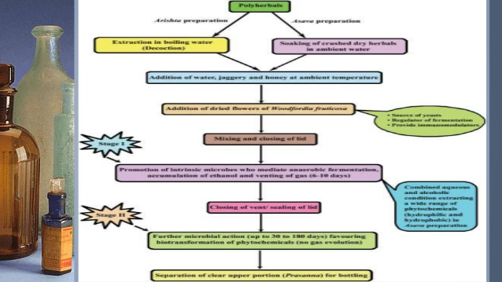

Slide 51
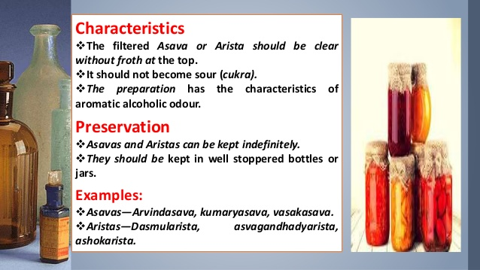

Slide 52
Ayurvedic dosage forms

Slide 53
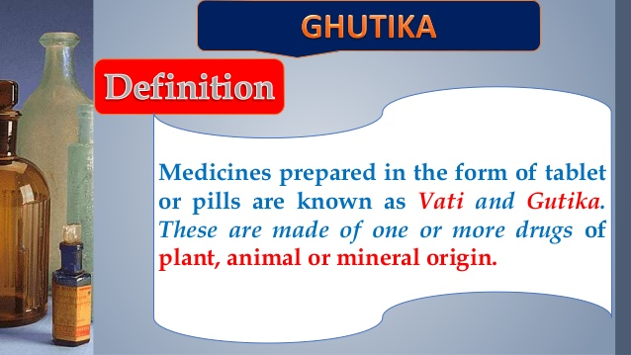

Slide 54
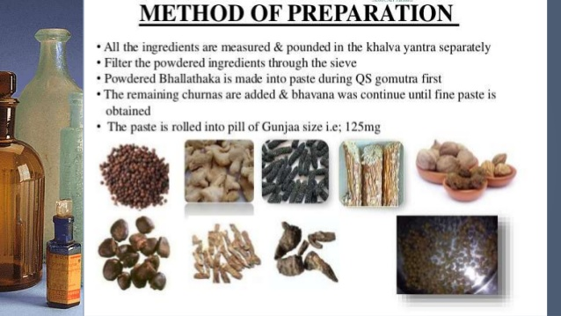

Slide 55
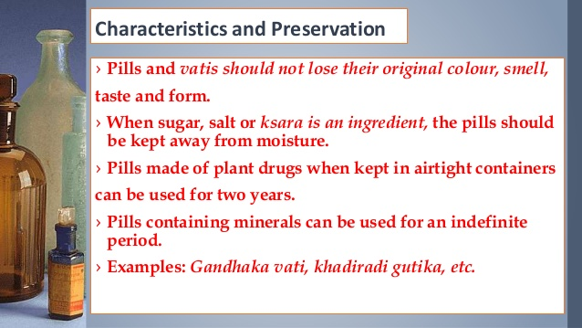

Slide 56
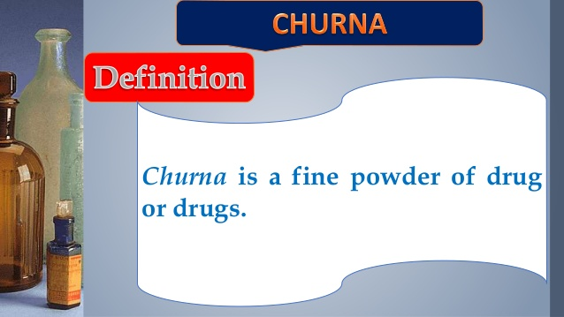

Slide 57
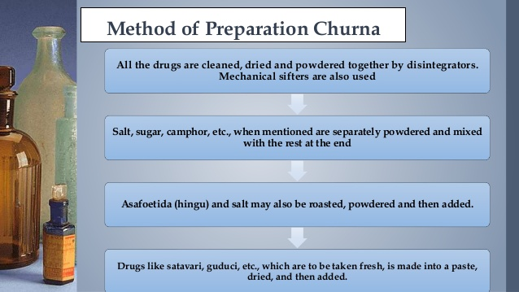

Slide 58
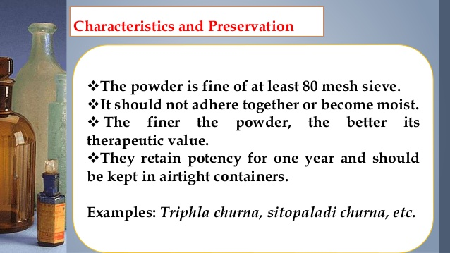

Slide 59
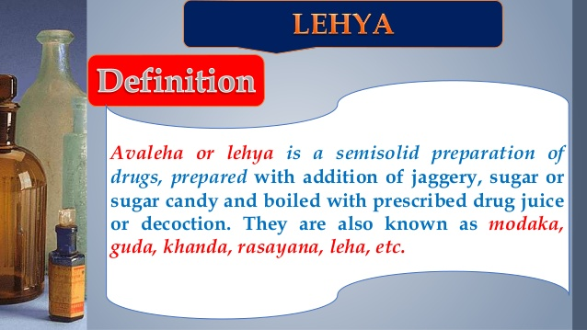

Slide 60
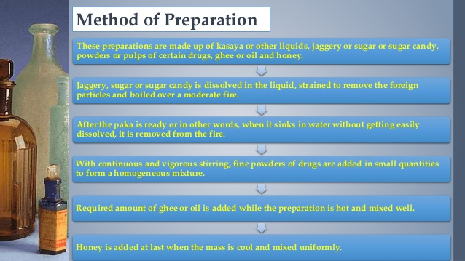

Slide 61
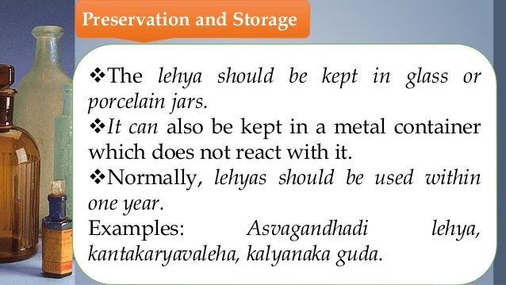

Slide 62
TRADITIONAL SYSTEM OF MEDICINE
Mrs. Bharati M. Sonawane
Department of Pharmacognosy
Loknete Dr. J. D. Pawar College of Pharmacy, Manur. Kalwan.

Slide 63
Ayurvedic dosage forms

Slide 64
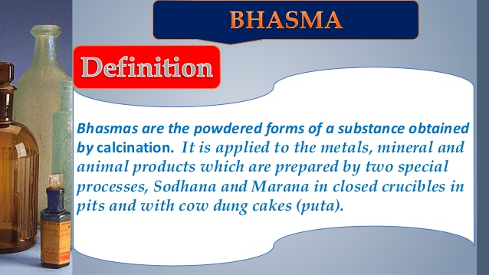

Slide 65
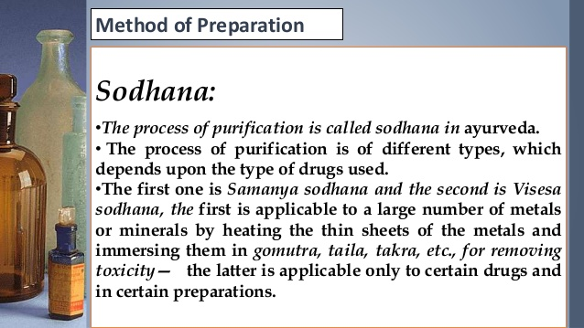

Slide 66
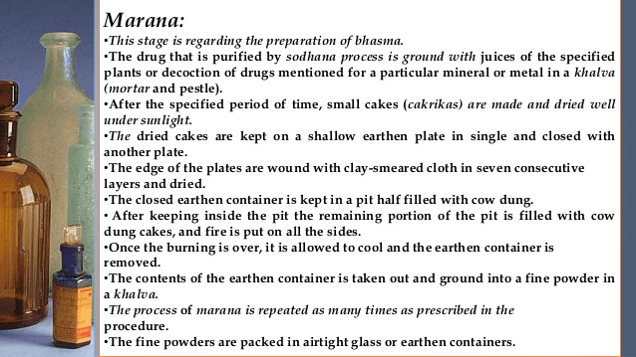

Slide 67
Chalan:
Process of stirring during heating of metal is chalan. Stirring is carried out either with iron rod or stick made from specific plant.
Dhavan:
Several water washes are given to the product obtained in previous stage to remove excess amount of agents used in shodhan or maran stage.

Slide 68
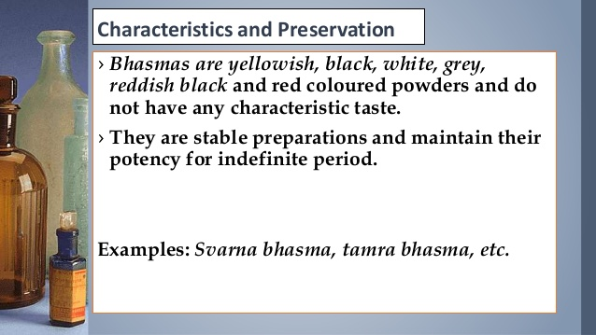

Slide 69
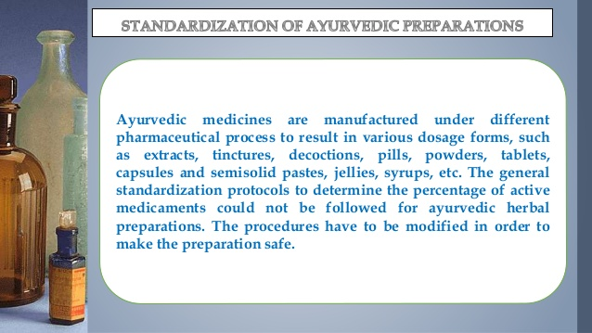

Slide 70
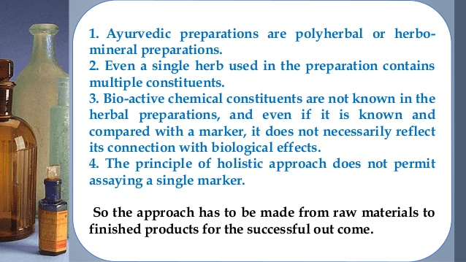

Slide 71
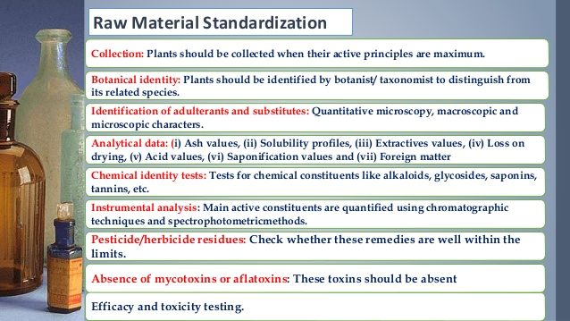

Slide 72
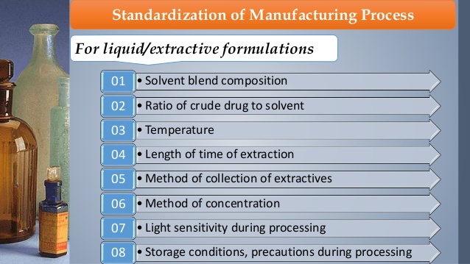

Slide 73
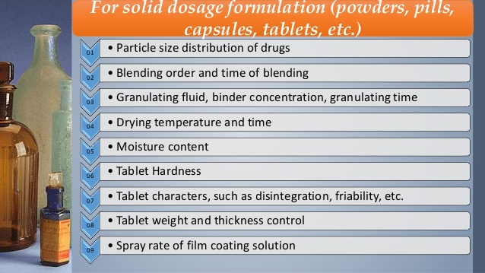

Slide 74
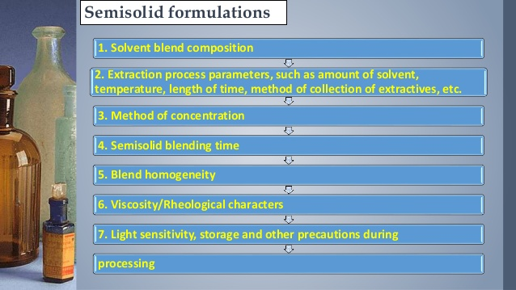

Slide 75
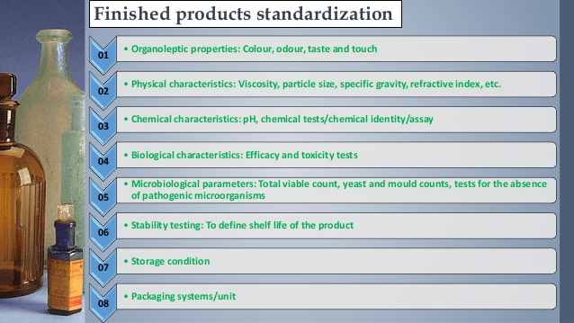

Slide 76
Evaluation Parameters for Ayurvedic Formulation:
Solid Formulations:
Vatika/Gutika:
pH
LOD
Ash Value
Total Ash Value
Acid Insoluble Ash Value
        Extractive Value
        - Water soluble extractive value
        Alcohol soluble extractive value
        Determination of microbial content
        Hardness
        Friability
        Weight variation test
        Disintegration test

Slide 77
Bhasma/ Churna
TLC
pH
Moisture content
Ash Value
Total Ash Value
Acid Insoluble Ash Value
        Extractive Value
        - Water soluble extractive value
        Alcohol soluble extractive value

Slide 78
Asava & Arishtha
pH
Viscosity
Specific Gravity
Total solid content
Alcohol content
Phytochemical test

Slide 79
Leha/ Avleha
TLC
pH
Ash Value
Total Ash Value
Acid Insoluble Ash Value
        Extractive Value
        - Water soluble extractive value
        - Alcohol soluble extractive value

Slide 80


