Slide 1
PHARMACEUTICAL ORGANIC CHEMISTRY - IV
UNIT – III : HETEROCYCLIC COMPOUNDS
Reaction, Synthesis and Medicinal Uses of THIOPHENE

Slide 2
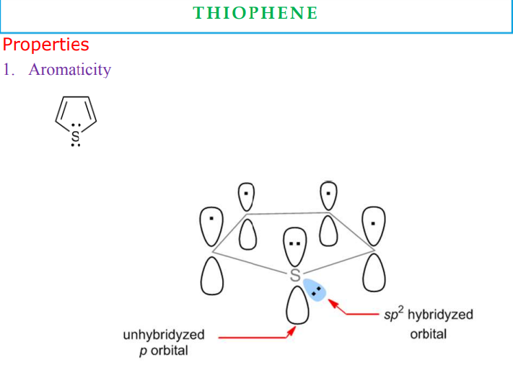

Slide 3
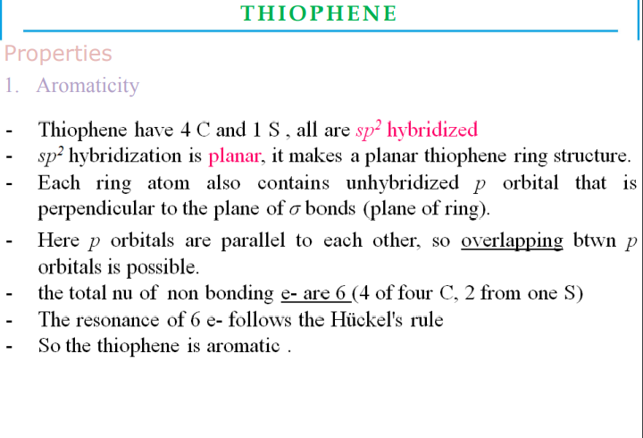

Slide 4
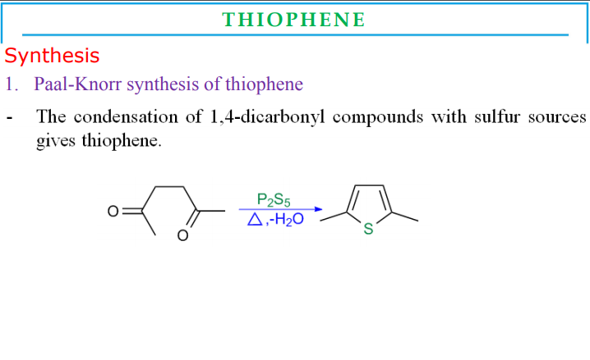

Slide 5
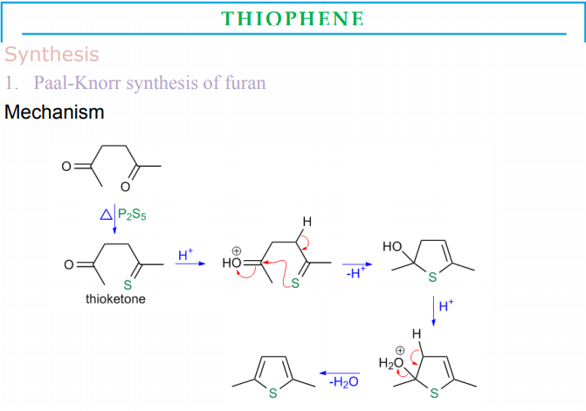

Slide 6
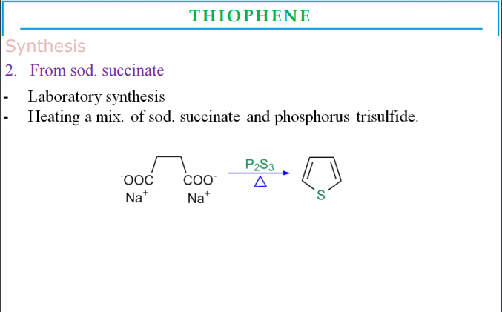

Slide 7
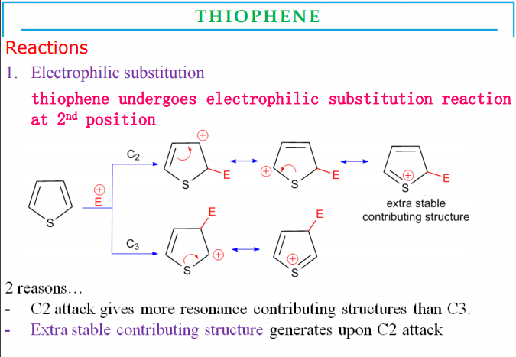

Slide 8
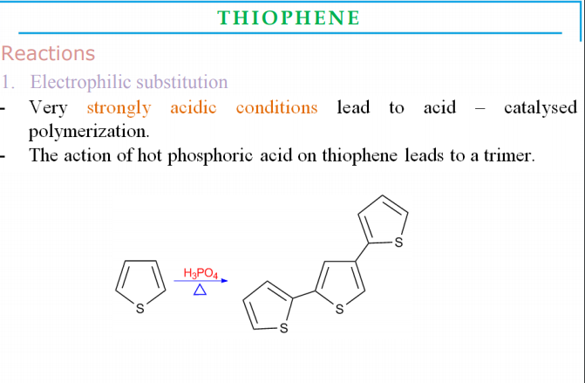

Slide 9
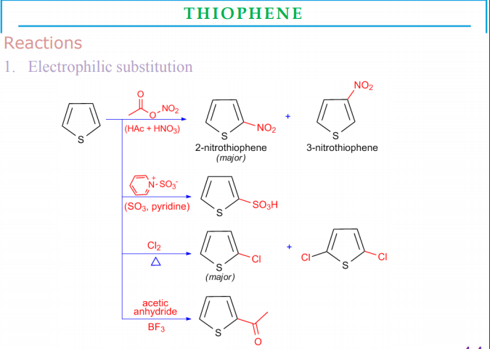

Slide 10
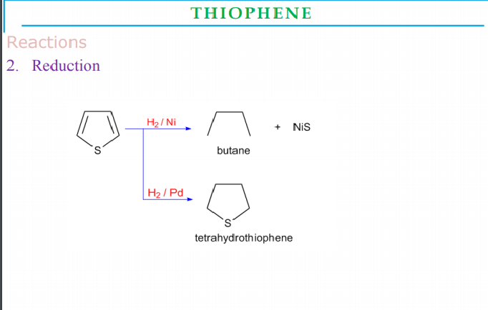

Slide 11
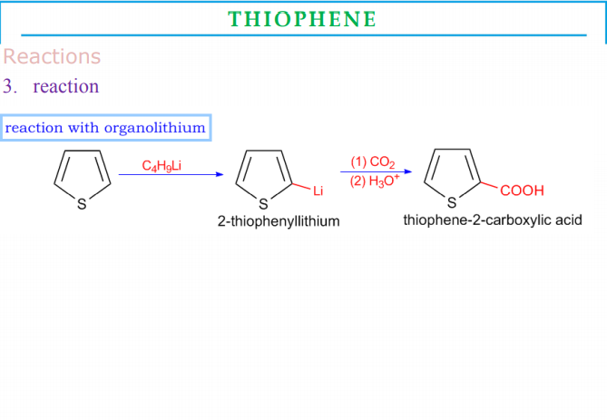

Slide 12
