Slide 1

Regulation & Patenting
Mrs. Bharati M. Sonawane
Department of Pharmacognosy
Loknete Dr. J. D. Pawar College of Pharmacy, Manur. Kalwan.

Slide 2
a. Regulations
i. Licensing requirements for production and scale of herbal drugs in India

Slide 3
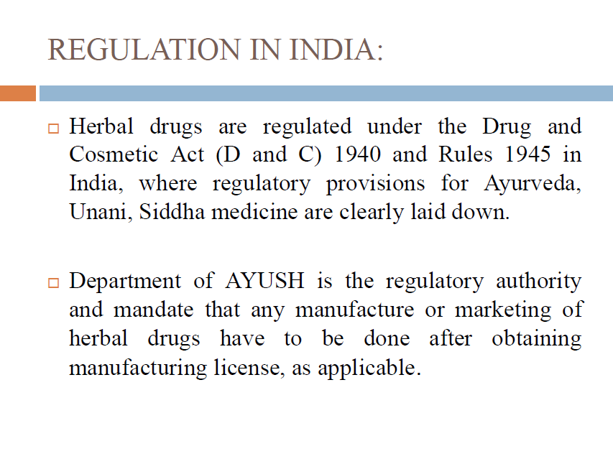

Slide 4
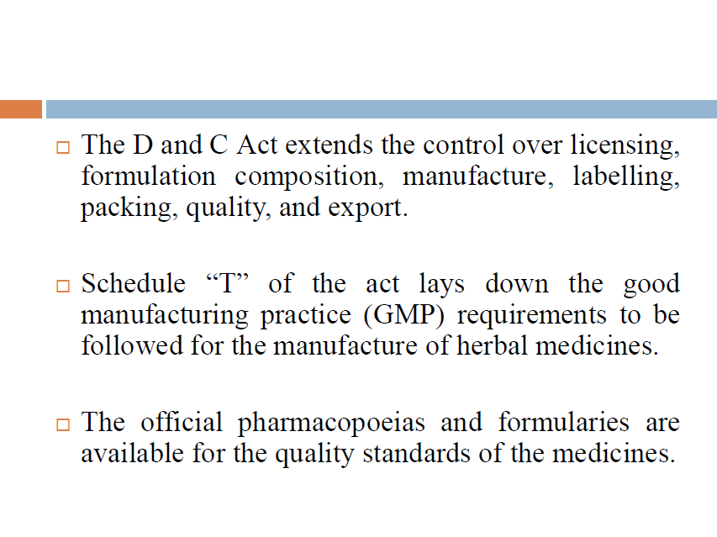

Slide 5
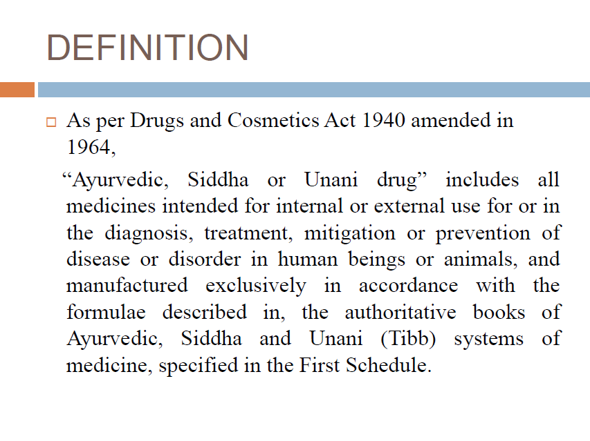

Slide 6
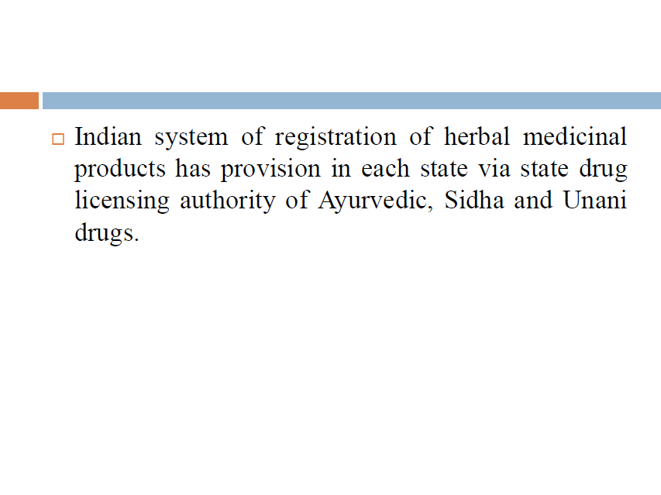

Slide 7
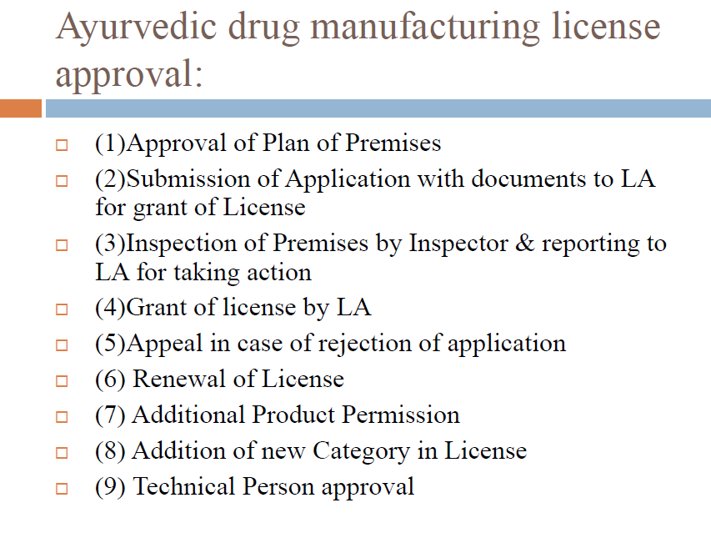

Slide 8
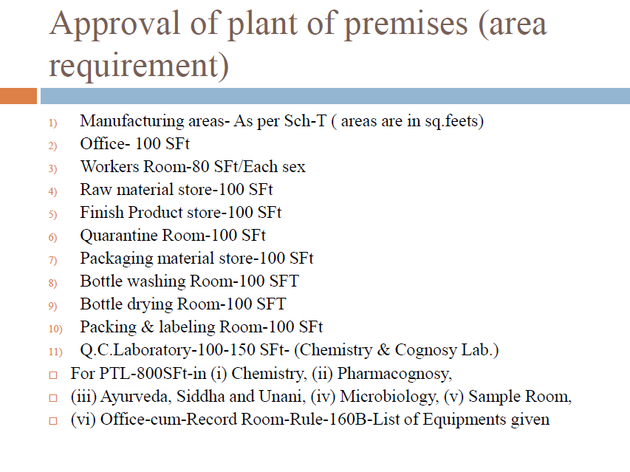

Slide 9
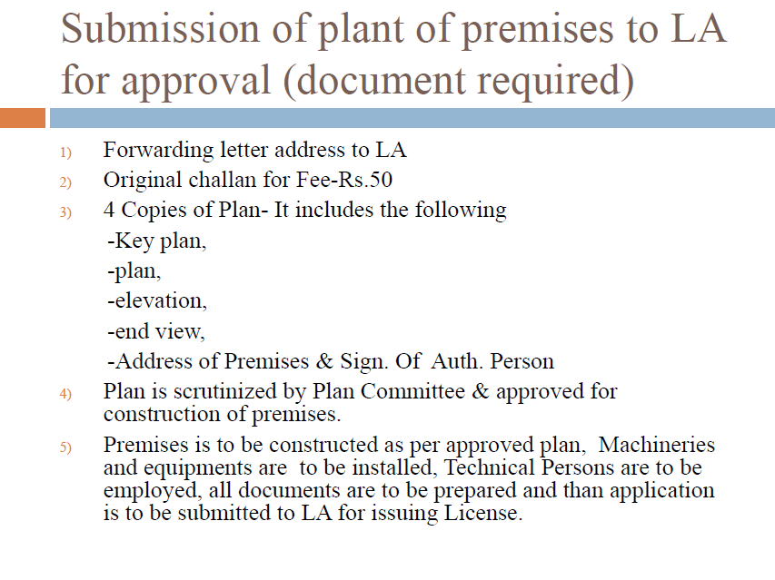

Slide 10
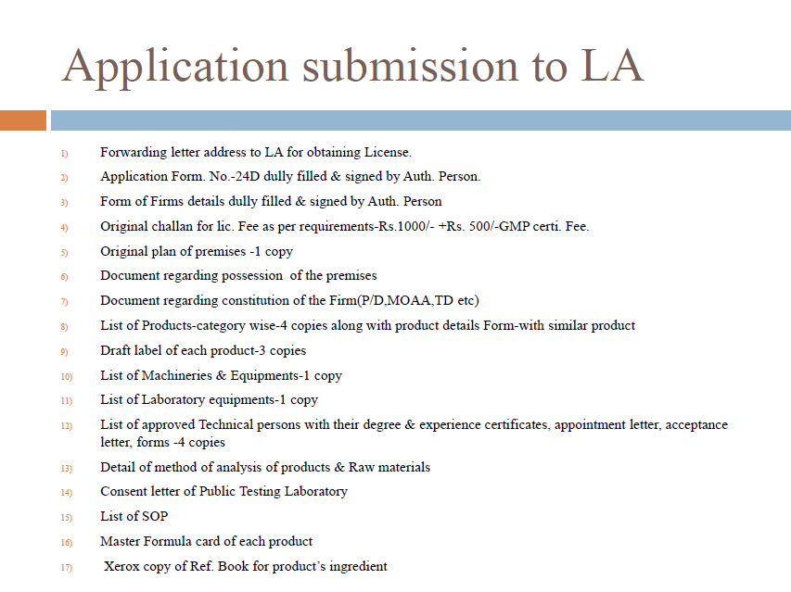

Slide 11
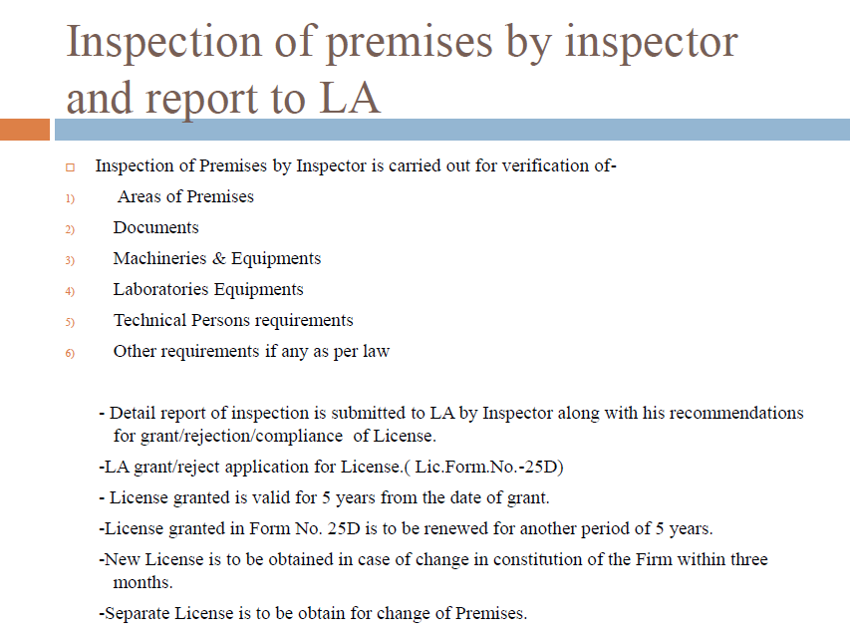

Slide 12
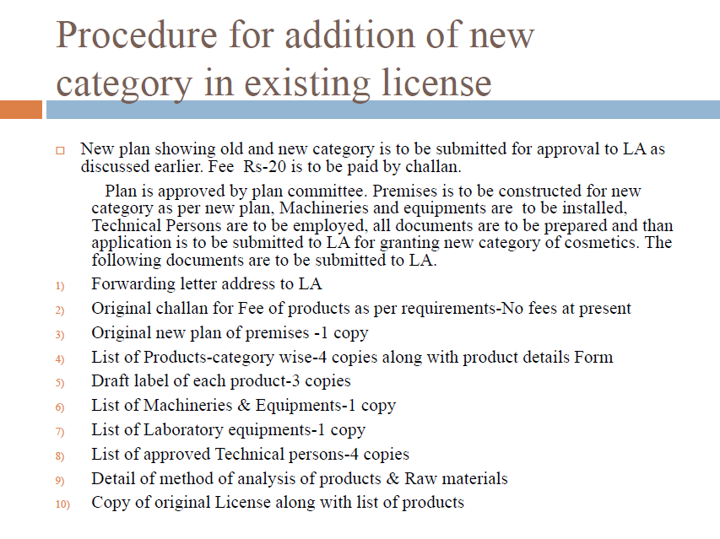

Slide 13
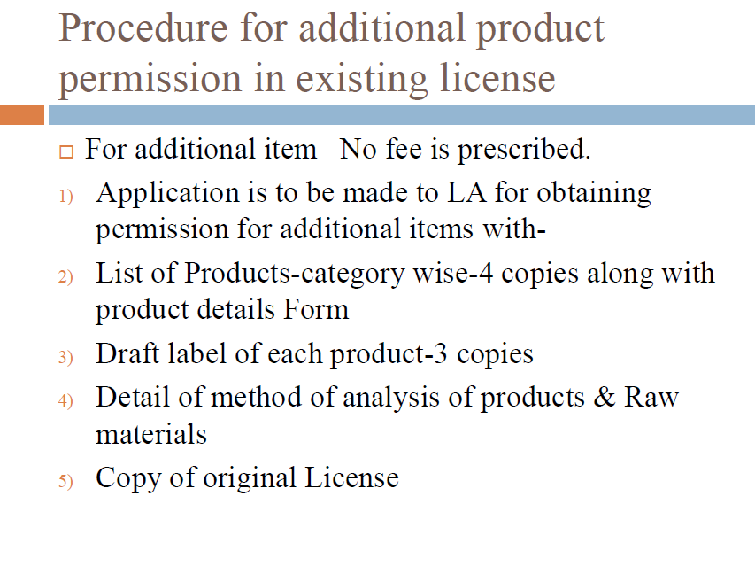

Slide 14
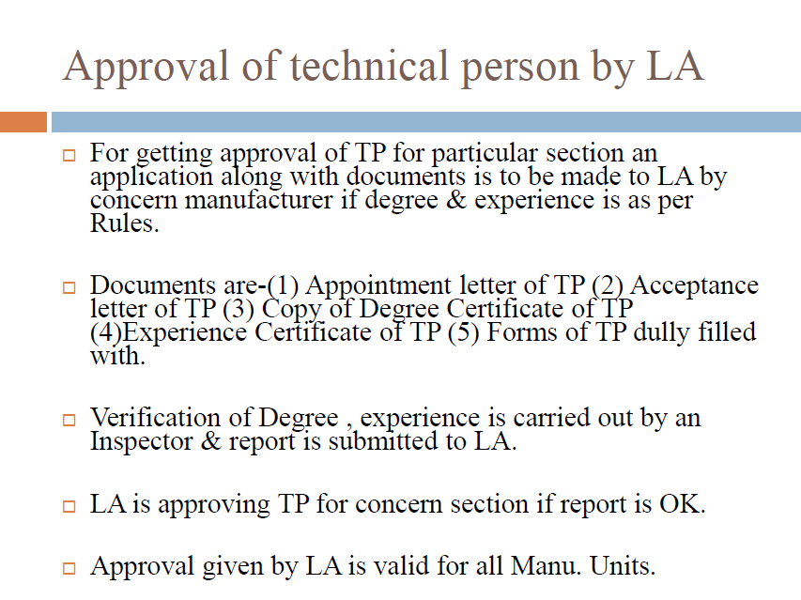

Slide 15
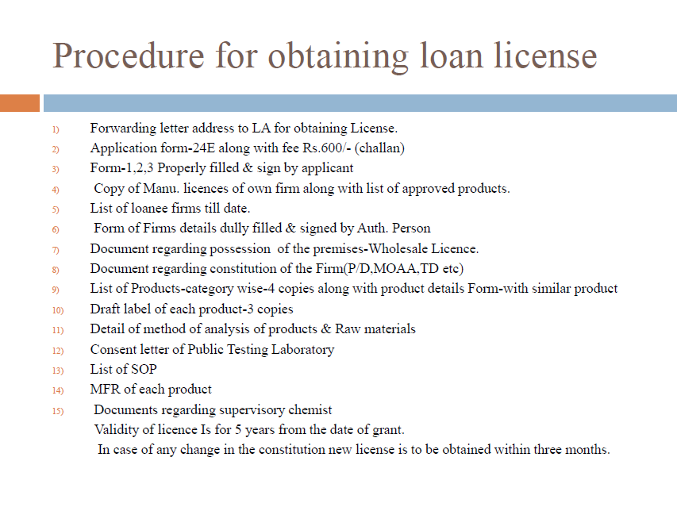

Slide 16
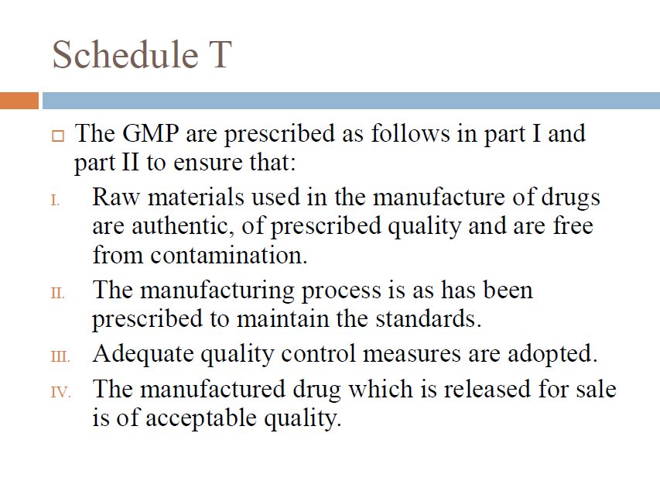

Slide 17
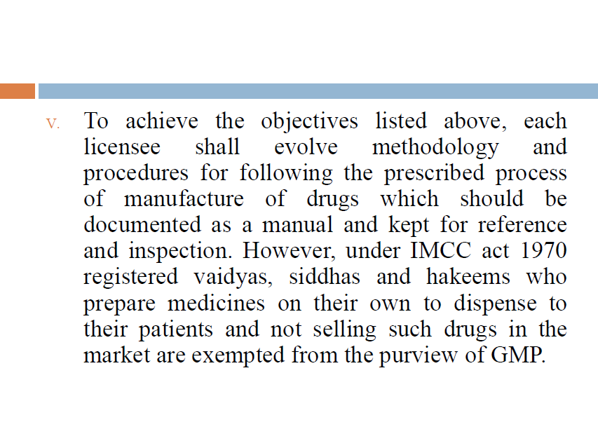

Slide 18
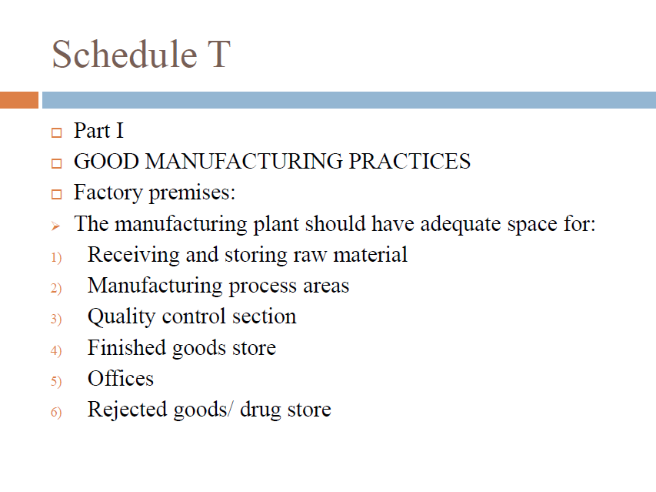

Slide 19
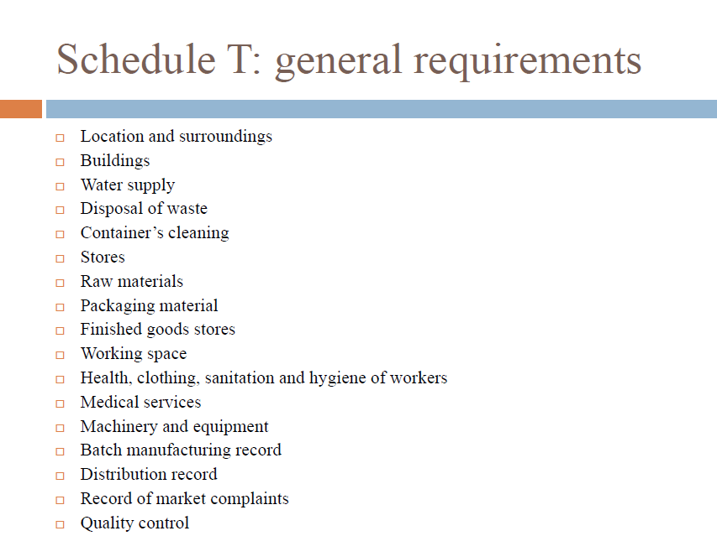

Slide 20
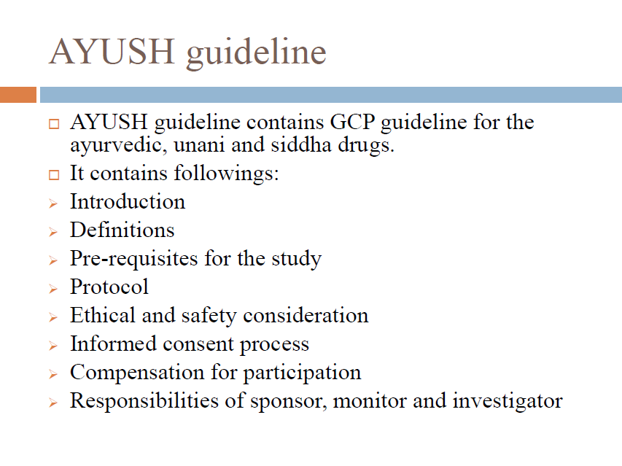

Slide 21
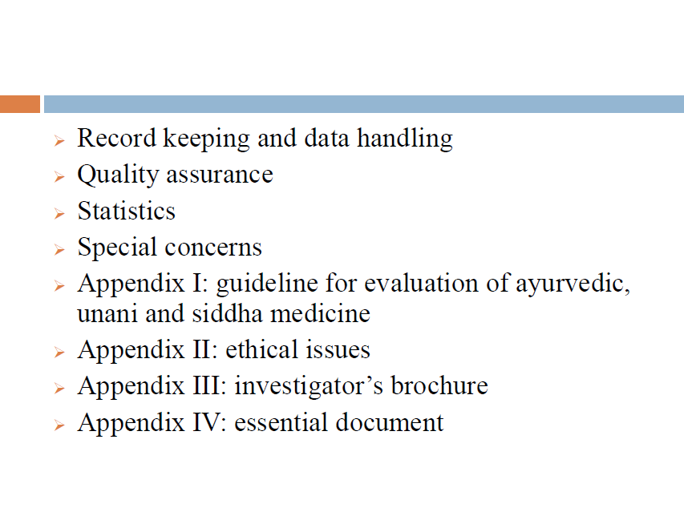

Slide 22
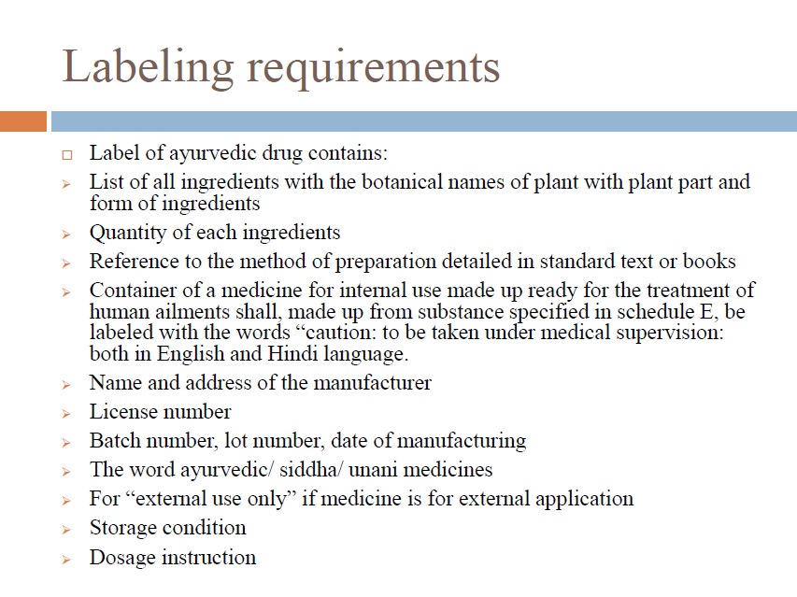

Slide 23
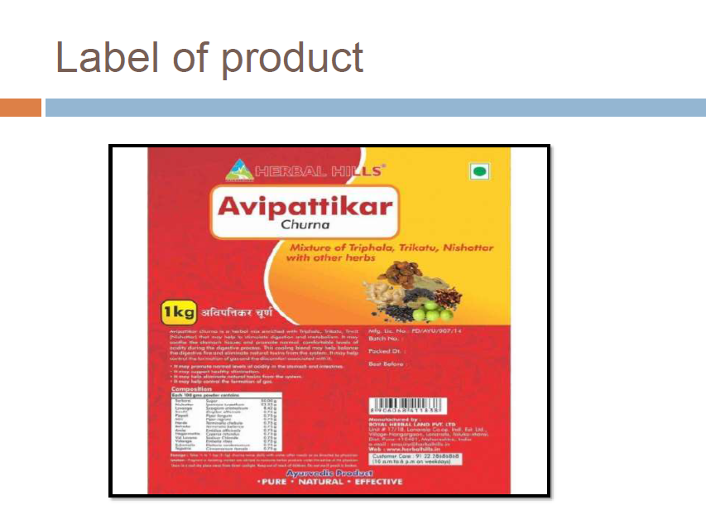

Slide 24
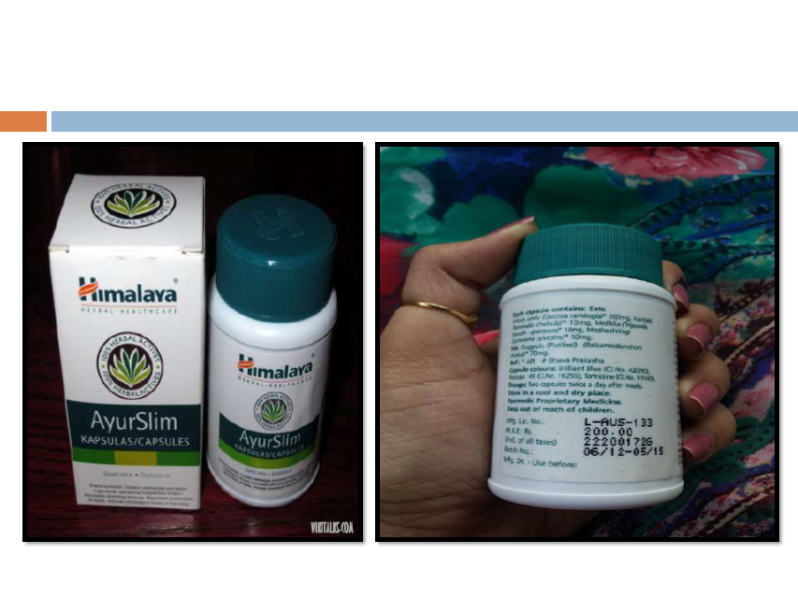

Slide 25
Infrastructural requirements-working space, storage area, machinery and equipments, SOP, Health & Hygiene

Slide 26
Factory Premises:
The manufacturing plant should have adequate space for:-
(i) Receiving and storing raw material;
(ii) Manufacturing process areas;
(iii) Quality control section;
(iv Finished goods store;
(v) Office;
(vi) Rejected goods/drugs store.

Slide 27
General Requirements:
(A) Location and surroundings- The factory building for manufacture of Ayurveda, Siddha and Unani medicines shall be so situated and shall have such construction as to avoid contamination from open sewerage, drain, public lavatory or any factory which produces disagreeable or obnoxious odour or fumes or excessive soot, dust or smoke.
(B) Buildings- The building used for factory shall be such as to permit production of drugs under hygienic conditions and should be free from cobwebs and insects/rodents. It should have adequate provision of light and ventilation. The floor and the walls should not be damp or moist. The premises used for manufacturing, processing, packaging and labelling will be in conformity with the provisions of the Factory Act.

Slide 28
Compatible with other manufacturing operations that may be carried out in the same or adjacent premises.
(ii) Adequately provided with working space to allow orderly and logical placement of equipment and materials to avoid the risk of mix-up between different drugs or components thereof and control the possibility of cross- contamination by other drugs or substances and avoid the risk of omission of any manufacturing or control step.
(iii) Designed, constructed and maintained to prevent entry of insects and rodents. Interior surface (walls, floors and ceilings) shall be smooth and free from cracks and permit easy cleaning and disinfection. The walls of the room in which the manufacturing operations are carried out shall be impervious to and be capable of being kept clean.
The flooring shall be smooth and even and shall be such as not to permit retention or accumulation of dust or waste products.

Slide 29
(iv) Provided with proper drainage system in the processing area. The sanitary fittings and electrical fixtures in the manufacturing area shall be proper and safe.
(v) Furnace/Bhatti section could be covered with tin roof and proper ventilation, but sufficient care should be taken to prevent flies and dust.
(vi) There should be fire safety measures and proper exits should be there.
(vii) Drying space- There should be separate space for drying of raw material, in process medicine or medicines which require drying before packing. This space will be protected from flies/insects/dusts, etc., by proper flooring, wire-mash window, glass pans or other material.

Slide 30
Water Supply-
The water used in manufacture shall be pure and of potable quality. Adequate provision of water for washing the premises shall be made.
Disposal of Waste-
From the manufacturing sections and laboratories the waste water and the residues which might be prejudicial to the workers or public health shall be disposed off after suitable treatment as per guidelines of pollution control authorities to render them harmless.
Containers’ Cleaning- In factories where operations involving the use of containers such as glass bottles, vials and jars are conducted, there shall be adequate arrangement separated from the manufacturing operations for washing, cleaning and drying of such containers.

Slide 31
Stores- Storage should have proper ventilation and shall be free from dampness. It should provide independent adequate space for storage of different types of material, such as raw material, packaging material and finished products.
Raw Materials- All raw materials procured for manufacturing will be stored in the raw materials store. The manufacture based on the experience and the characteristics of the particular raw material used in Ayurveda, Siddha and Unani system shall decide the use of appropriate containers which would protect the quality of the raw material as well
as prevent it from damage due to dampness, microbiological contamination or rodent and insect infestation, etc.
If certain raw materials require such controlled environmental conditions, the raw materials stores may be sub-divided with proper enclosures to provide such conditions by suitable cabinization.

Slide 32
While designing such containers, cabins or areas in the raw materials store, care may be taken to handle the following different categories of raw materials:-
(1) Raw material of metallic origin.
(2) Raw material of mineral origin.
(3) Raw material from animal source.
(4) Fresh Herbs.
(5) Dry Herbs or plant parts.
(6) Excipients, etc.
(7) Volatile oils/perfumes & flavours.
(8) Plant concentrates/extracts and exudates/resins.

Slide 33
Packaging Materials-
All packaging materials such as bottles, jars, capsules, etc. shall be stored properly. All containers and closures shall be adequately cleaned and dried before packing the products.
Finished Goods Stores-
The finished goods transferred from the production area after proper packaging shall be stored in the finished goods stores within an area marked “Quarantine”.
After the quality control laboratory and the experts have checked the correctness of finished goods with reference to its packing/labelling as well as the finished product quality as prescribed,, then it will be moved to ‘Approved Finished Goods Stock” area. Only approved finished goods shall be dispatched as per marketing requirements.
Distribution records shall be maintained as required. If any Ayurvedic, Siddha and Unani drug needs special storage conditions, finished goods store shall provide necessary environmental requirements.

Slide 34
Working Space-
The manufacturing area shall provide adequate space (manufacture and quality control) for orderly placement of equipment and material used in any of the operations for which these are employed so as to facilitate easy and safe working and to minimize or to eliminate any risk of mix-up between different drugs, raw materials and to prevent the possibility of cross-contamination of one drug by another drug that is manufactured, stored or handled in the same premises.
Health, Clothing, Sanitation and Hygiene of Workers-
All workers employed in the Factory shall be free from contagious diseases. The clothing of the workers shall consist of proper uniform suitable to the nature of work and the climate and shall be clean. The uniform shall also include cloth or synthetic covering for hands, feet and head wherever required. Adequate facilities for personal cleanliness such as clean towels, soap and scrubbing brushes shall be provided.

Slide 35
Separate provision shall be made for lavatories to be used by men and women, and such lavatories shall be located at places separated from the processing rooms. Workers will also be provided facilities for changing their clothes and to keep their personal belongings.
Medical Services- The manufacturer shall also provide:-
(i) Adequate facilities for first aid;
(ii) Medical examination of workers at the time of employment and periodical checkup thereafter by a physician once a year, with particular attention being devoted to freedom from infections. Records thereof shall be maintained.

Slide 36
Machinery and Equipments-
For carrying out manufacturing depending on the size of operation and the nature of product manufactured, suitable equipment either manually operated or operated semi-automatically (electrical or team based) or fully automatic machinery shall be made available.
These may include machines for use in the process of manufacture such as crushing, grinding, powdering, boiling, mashing, burning, roasting, filtering, drying, filling, labelling and packing, etc.
To ensure ease in movement of workers and orderliness in operations a suitably adequate space will be ensured between two machines or rows of machines. These machinery and equipments and machinery recommended is indicated in Part II-A.
Proper standard operational procedures (SOPs) for cleaning maintaining and performance of every machine should be laid down.

Slide 37
Batch Manufacturing Records-
The licensee shall maintain batch manufacturing record of each batch of Ayurvedic, Siddha and Unani drugs manufactured irrespective of the type of product manufactured (classical preparation or patent and proprietary medicines). Manufacturing records are required to provide and account of the list of raw materials and their quantities obtained from the store, tests conducted during the various stages of manufacture like taste, colour, physical characteristics and chemical tests as may be necessary or indicated in the approved books of Ayurveda, Siddha and Unani mentioned in the First Schedule of the Drugs and Cosmetics Act, 1940 (23 of 1940).

Slide 38
These tests may include any in-house or pharmacopoeial test adopted by the manufacturer in the raw material or in the process material and in the finished product. These records shall be duly signed by Production and Quality Control Personnel respectively. Details of transfer of manufactured drug to the finished products store including dates and quantity of drugs transferred along with record of testing of the finished product, if any, and packaging, records shall be maintained. Only after the manufactured drugs have been verified and accepted quality shall be allowed to be cleared for sale. It should be essential to maintain the record of date, manpower, machine and equipments used and to keep in process record of various shodhana, bhavana, burning in fire and specific grindings in terms of internal use.

Slide 39
Distribution Records-
Records of sale and distribution of each batch of Ayurveda, Siddha and Unani Drugs shall be maintained in order to facilitate prompt and complete recall of the batch, if necessary. The duration of record keeping should be the date of expiry of the batch, Certain categories of Ayurvedic, Siddha and Unani medicines like Bhasma, Rasa, Kupi- pakva, Parpati, Sindura, Karpu/Uppu/Puram, Kushta, Asava-arista, etc. do not have expiry date, in contrast their efficacy increases with the passage of time. Hence, records need to be maintained up to 5 years of the exhausting of stock.

Slide 40
Record of Market Complaints-
Manufacturers shall maintain a register to record all reports of market complaints received regarding the products sold in the market.
The manufacturer shall enter all data received on such market complaints, investigations carried out by the manufacturers regarding the complaint as well as any corrective action initiated to prevent recurrence of such market complaints shall also be recorded.
Once in a period of six months the manufacturer shall submit the record such complaints to the Licensing Authority.
The Register shall also be available for inspection during any inspection of the premises.

Slide 41
Reports of any adverse reaction resulting from the use of Ayurvedic, Siddha and Unani drugs shall also be maintained in a separate register by each manufacturer. The manufacturer shall investigate any of the adverse reaction to find if the same is due to any defect in the product, and whether such reactions are already reported in the literature or
it is a new observation.

Slide 42
Herbal Drug Patenting

Slide 43
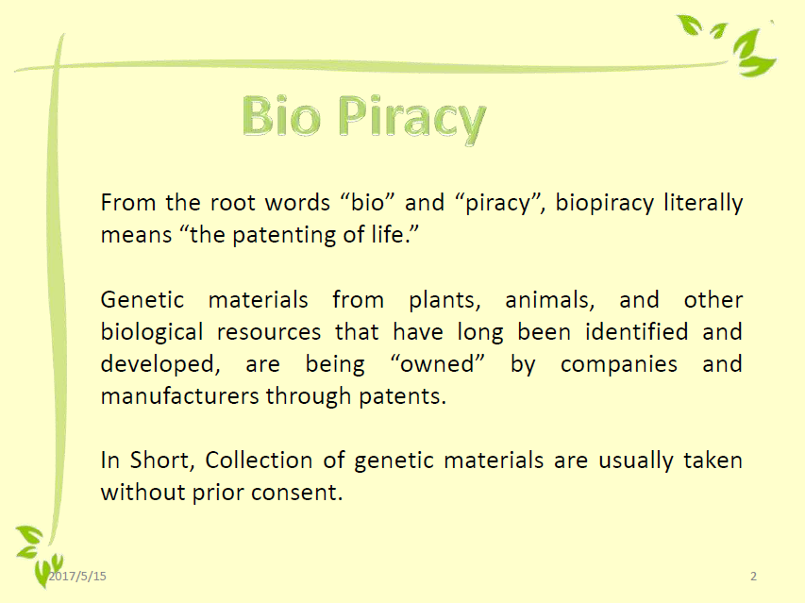

Slide 44


Slide 45


Slide 46


Slide 47


Slide 48


Slide 49


Slide 50


Slide 51


Slide 52


Slide 53


Slide 54


Slide 55


Slide 56


Slide 57
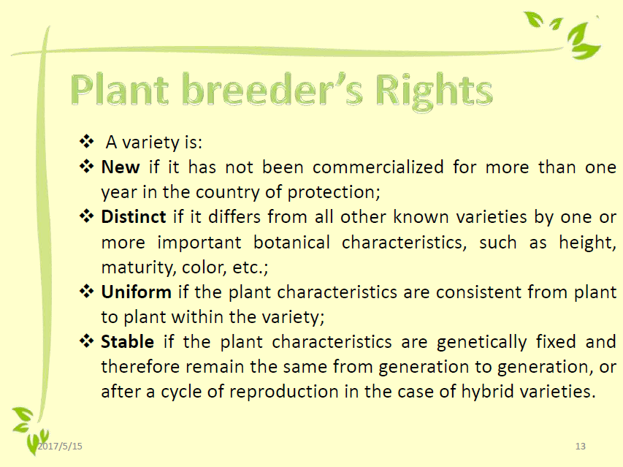

Slide 58


Slide 59
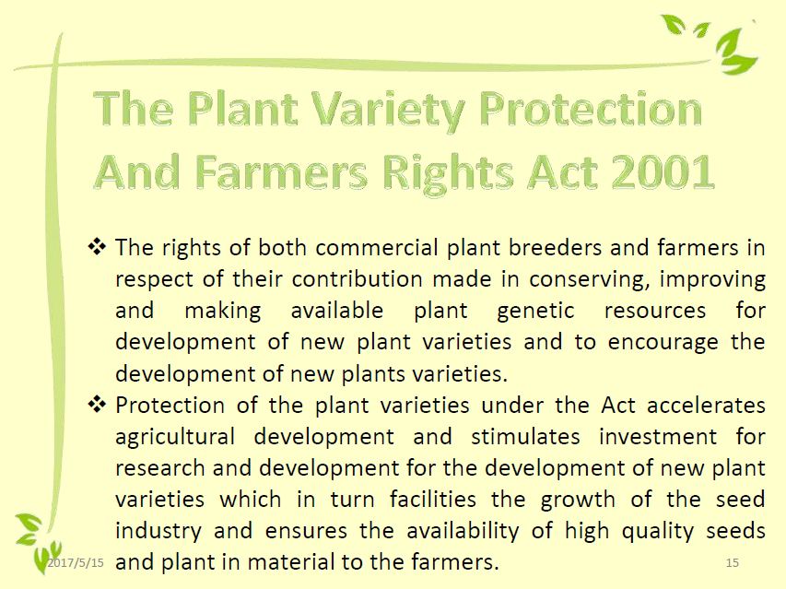

Slide 60
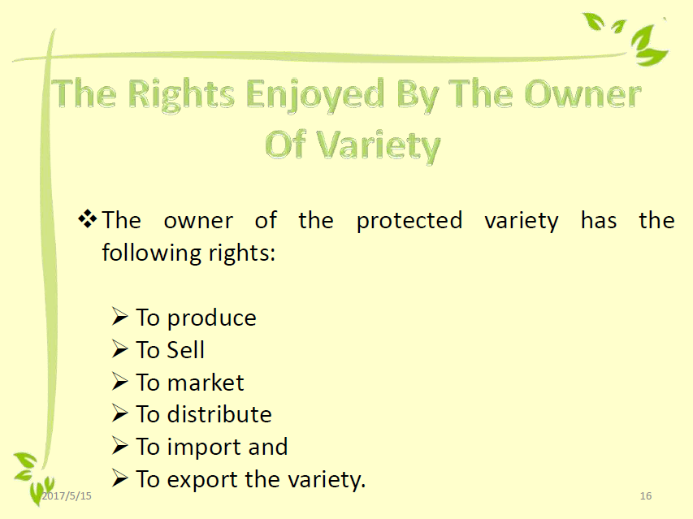

Slide 61
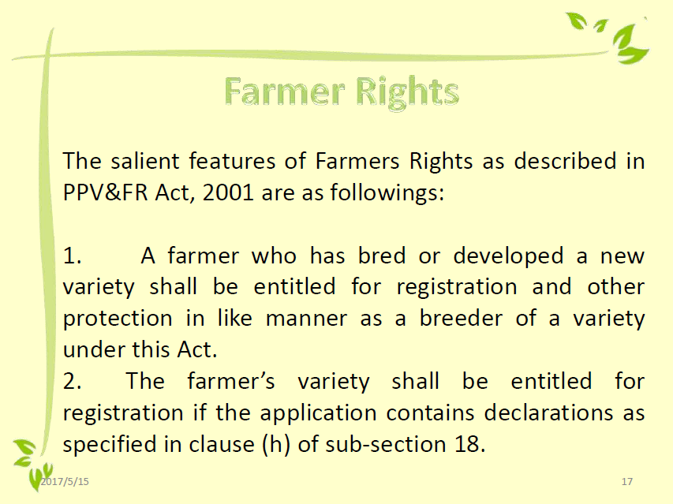

Slide 62
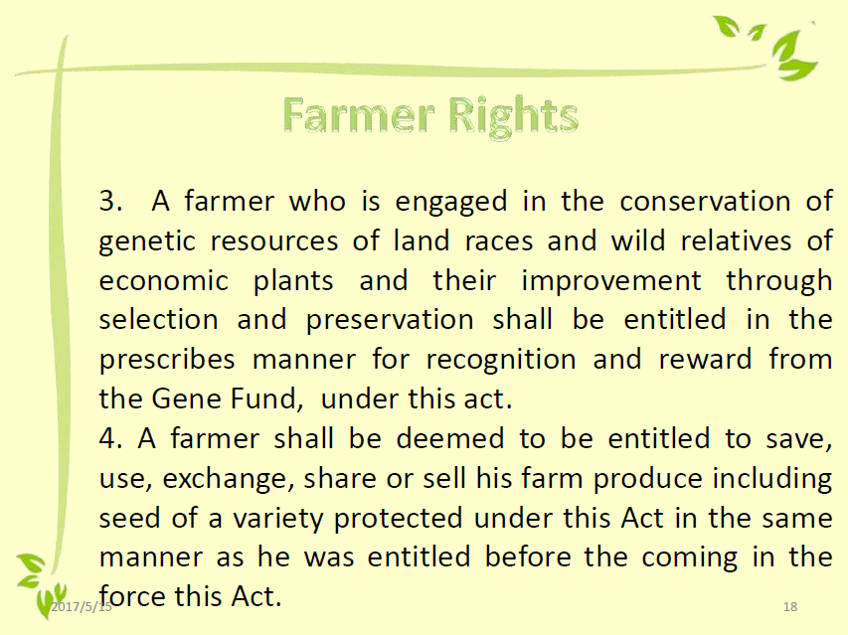

Slide 63
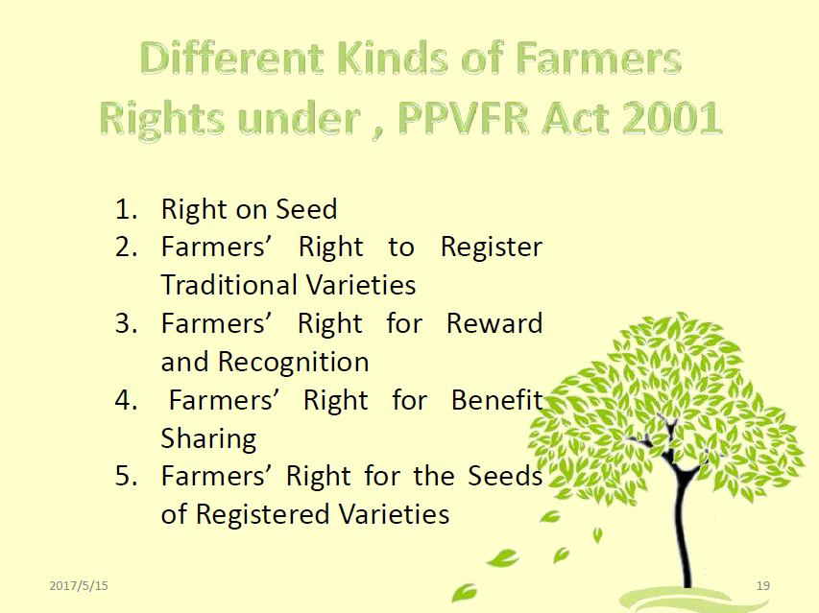

Slide 64


