Slide 1
Topic : Reactions of Benzene
UNIT I : Benzene & its derivatives
PART -II

Slide 2
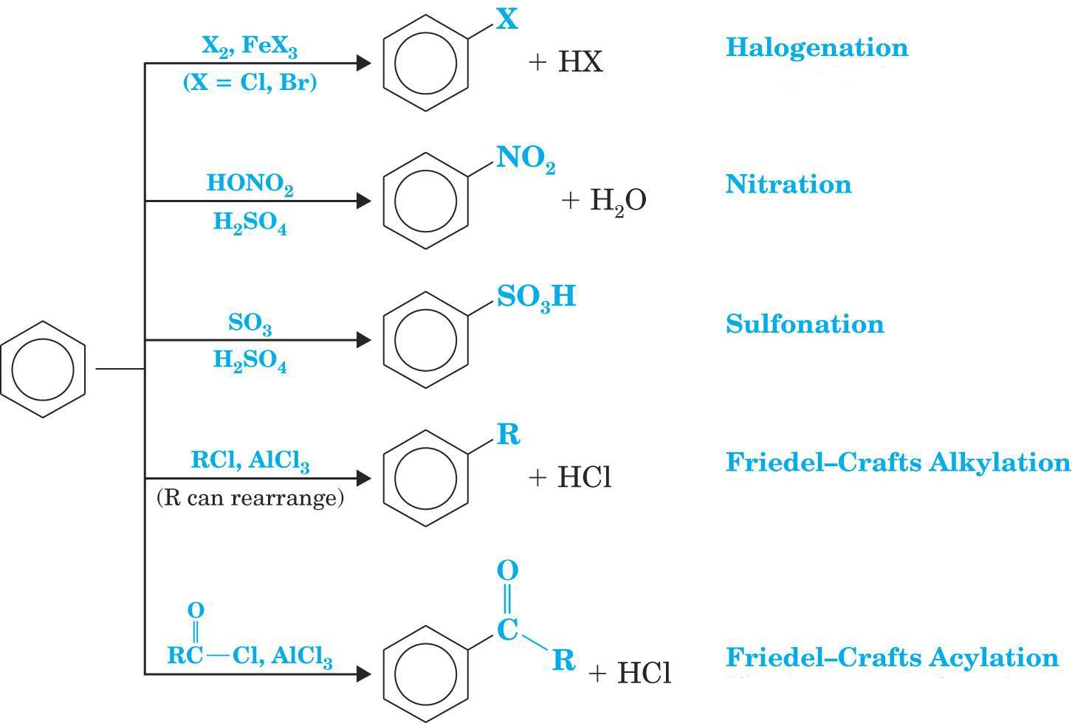
Benzene shows following reactions →

Slide 3
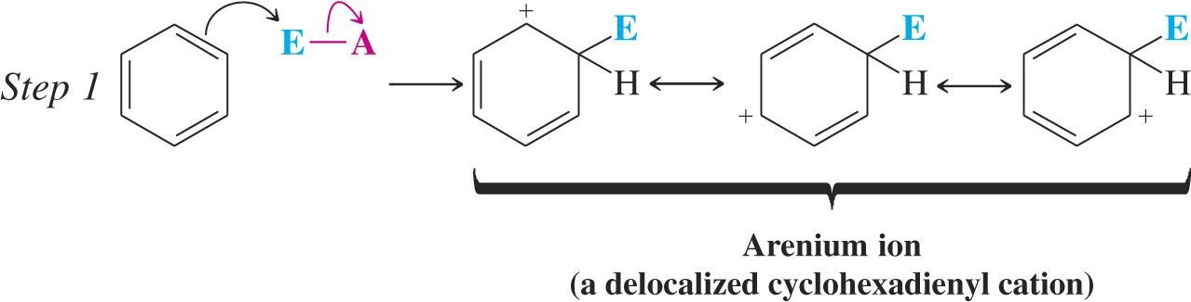
General Mechanism for ESR :
In step 1: the electrophile reacts with two p electrons from the aromatic ring
The arenium ion is stabilized by resonance which delocalizes the charge

Slide 4
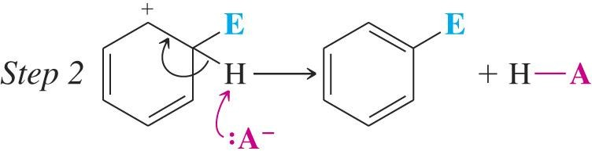
In step 2, a proton is removed and the aromatic system is regenerated.

Slide 5
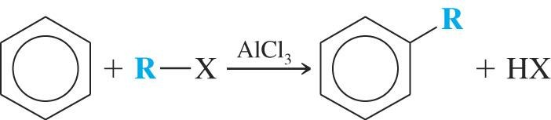
  4. Friedel-Crafts Alkylation:
  An aromatic ring can be alkylated by an alkyl halide in the presence of a Lewis acid.

Slide 6
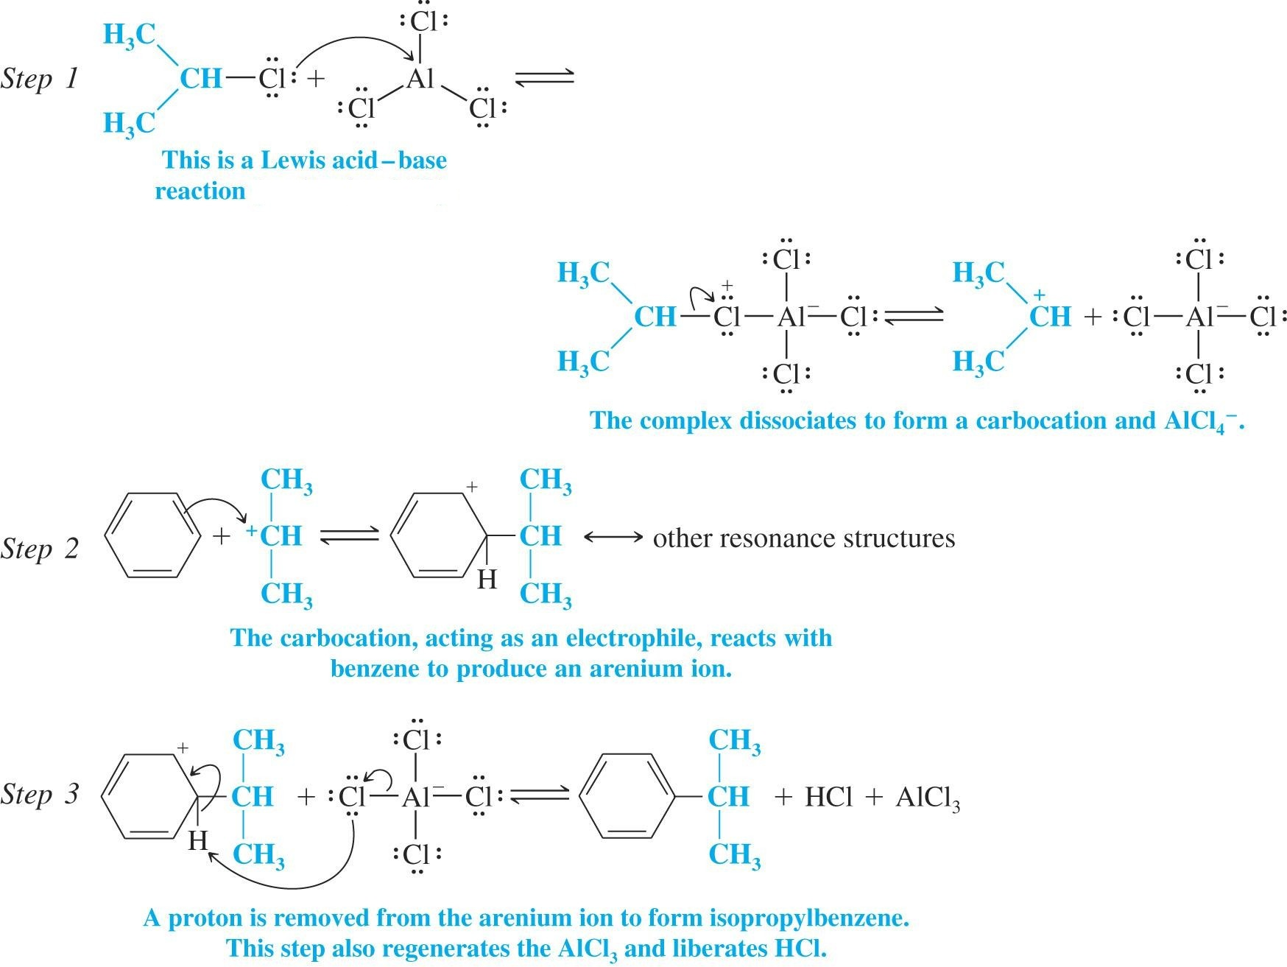
Mechanism :

Slide 7
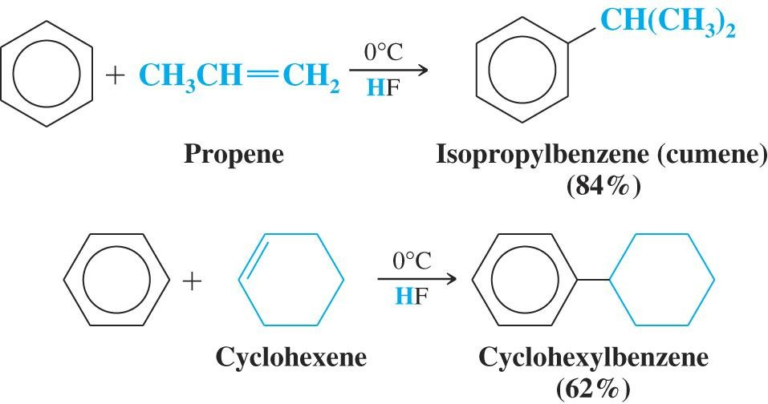
Any compound that can form a carbocation can be used to alkylate an aromatic ring

Slide 8
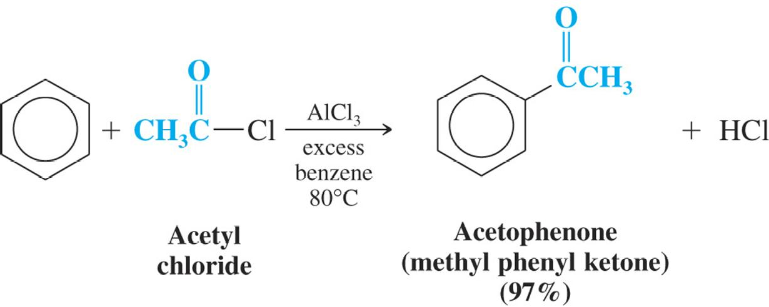
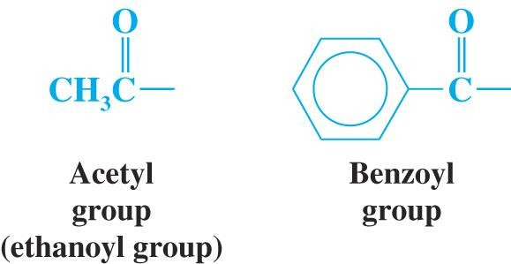
  5. Friedel-Crafts Acylation:
  Friedel-Crafts acylation requires reaction of an acid chloride or acid anhydride with a Lewis acid such as aluminium chloride.
An acyl group has a carbonyl attached to some R group

Slide 9
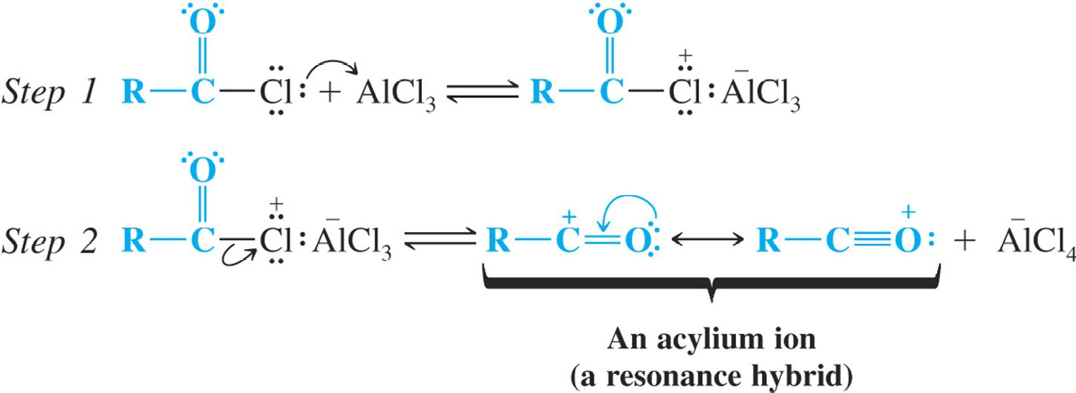
Mechanism :

Slide 10
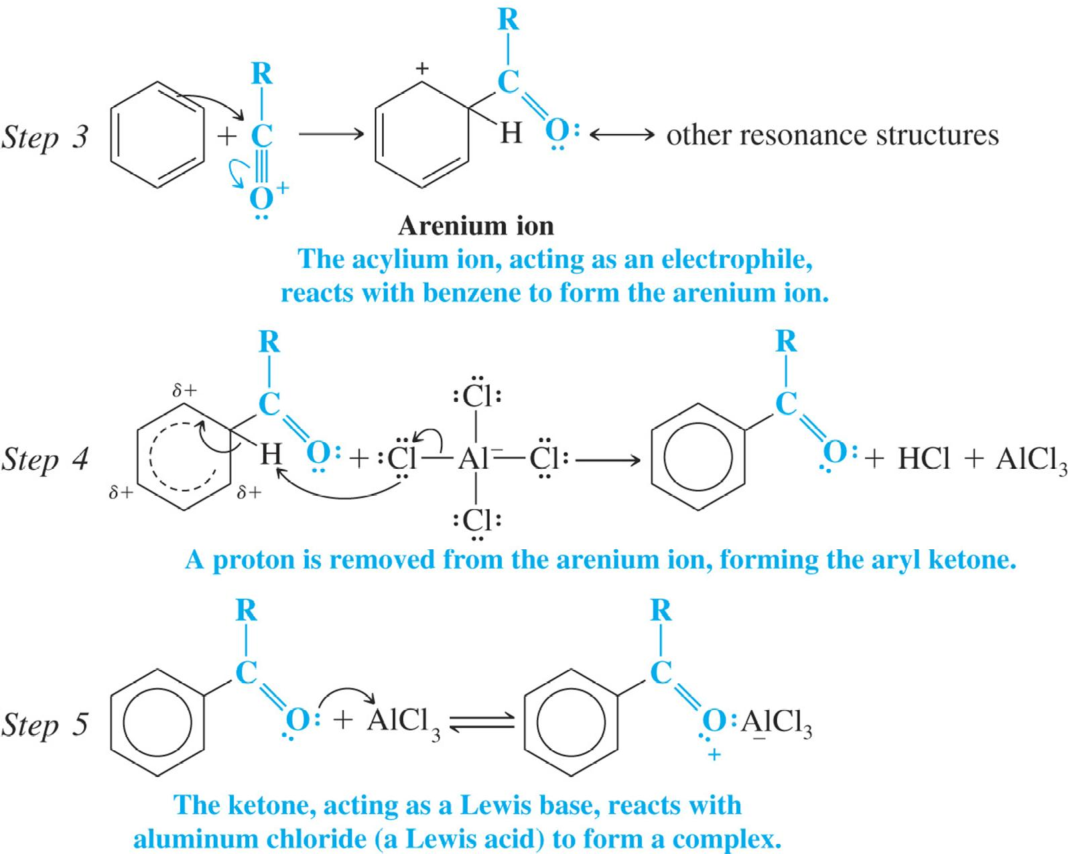
Mechanism (continued):

Slide 11
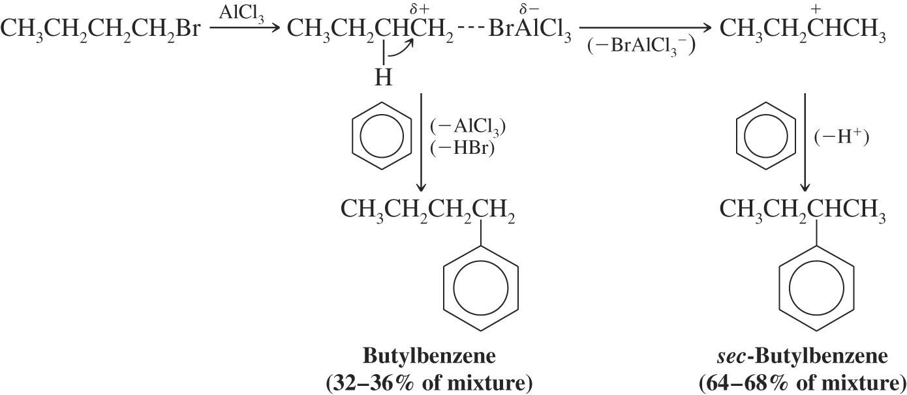
Limitations of Friedel-Crafts Reactions:
    1. In Friedel-Crafts alkylation, the alkyl carbocation intermediate may rearrange to a more stable carbocation prior to alkylation

Slide 12
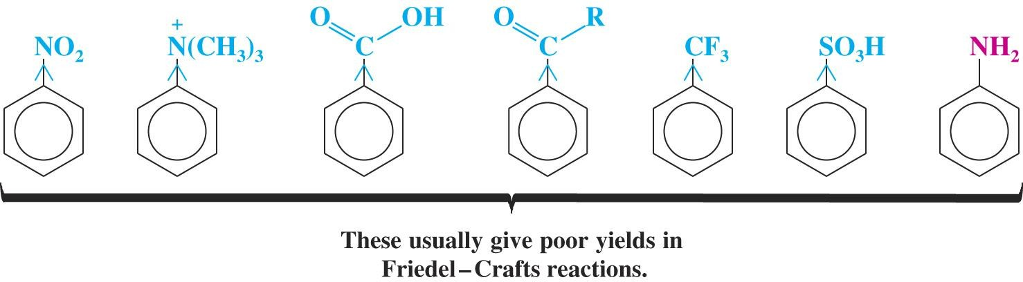
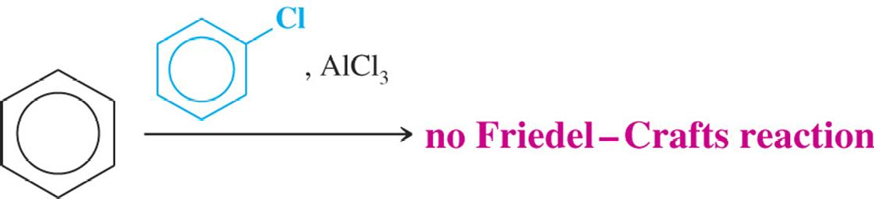
    2. Powerful electron-withdrawing groups make an aromatic ring much less reactive toward Friedel-Crafts alkylation or acylation.
3. Aryl and vinyl halides cannot be used in Friedel-Crafts reactions because they do not form carbocations readily,

Slide 13
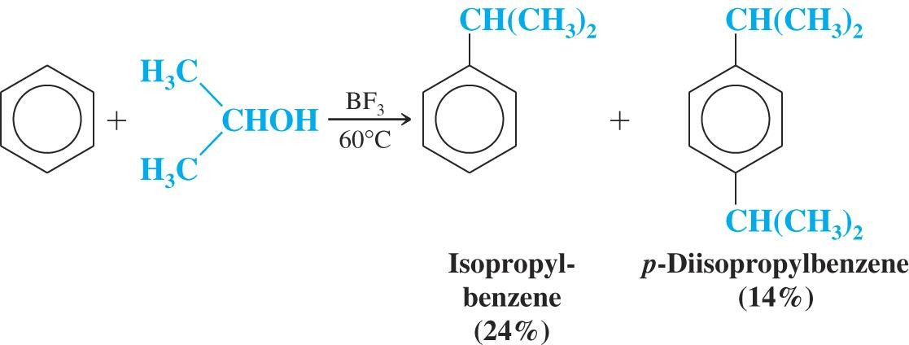
4. Polyalkylation occurs frequently with Friedel-Crafts alkylation because the first alkyl group introduced activates the ring toward further substitution. (Polyacylation does not occur because the acyl group deactivates the aromatic ring to further substitution)

Slide 14


