Slide 1
Topic : Reactions of Benzene
UNIT I : Benzene & its derivatives
PART -I

Slide 2
Electrophilic Aromatic Substitution Reactions
Aromatic compounds (Benzene) undergo electrophilic aromatic substitution (EAS).
Arene (Ar-H) is the generic term for an aromatic hydrocarbon.
The aryl group (Ar) is derived by removal of a H atom from an arene.

Slide 3
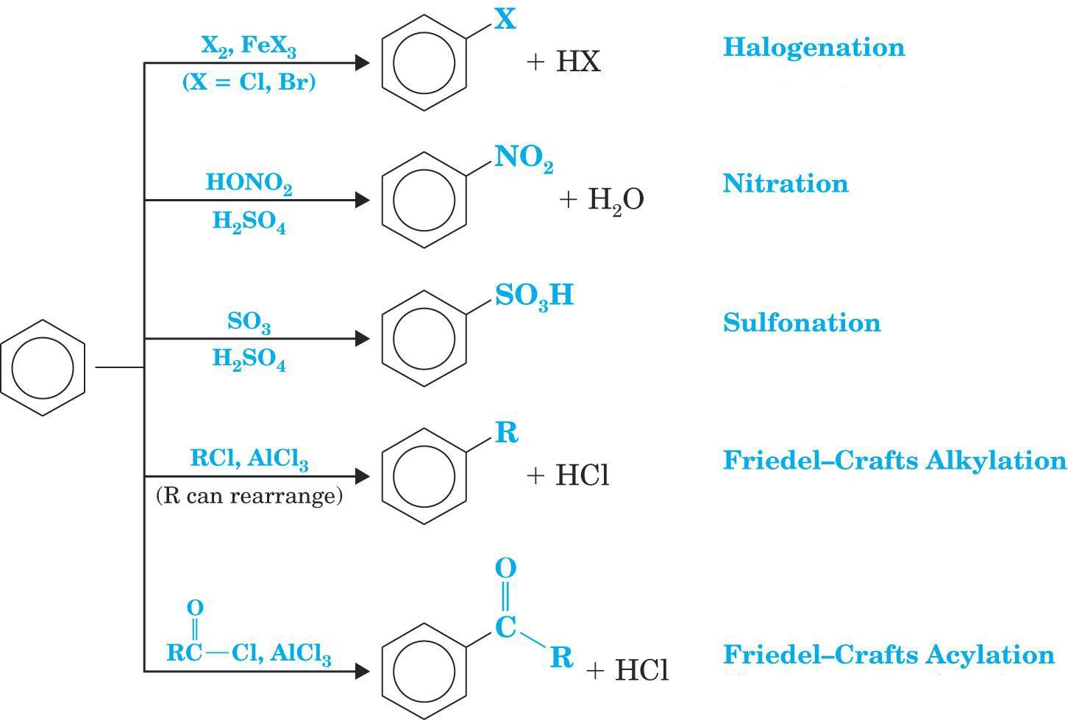
Benzene shows following reactions →

Slide 4
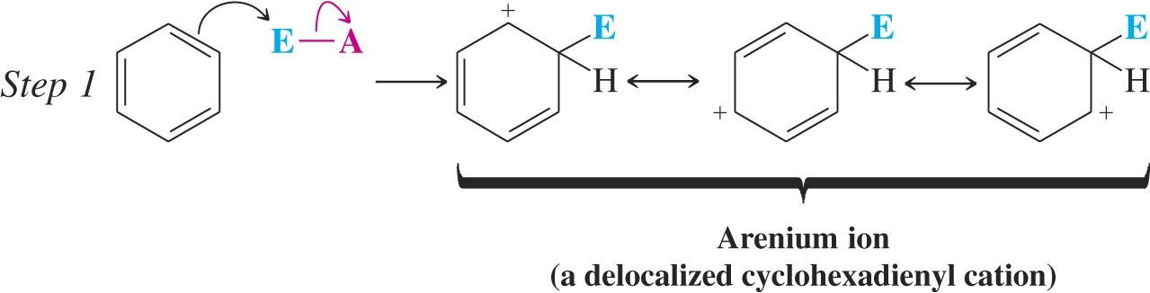
General Mechanism for ESR :
In step 1: the electrophile reacts with two p electrons from the aromatic ring
The arenium ion is stabilized by resonance which delocalizes the charge

Slide 5
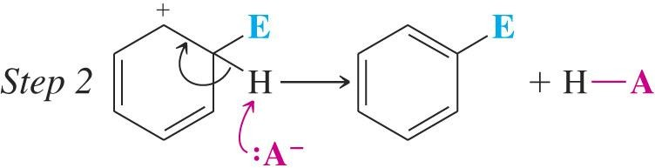
In step 2, a proton is removed and the aromatic system is regenerated.

Slide 6
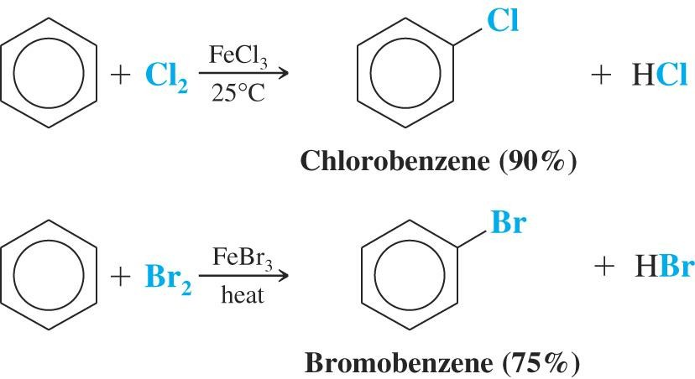
  1. Halogenation of Benzene:
  Benzene reacts with chlorine or bromine in an electrophilic substitution reaction, but only in the presence of a catalyst and gives halobenzene.

Slide 7
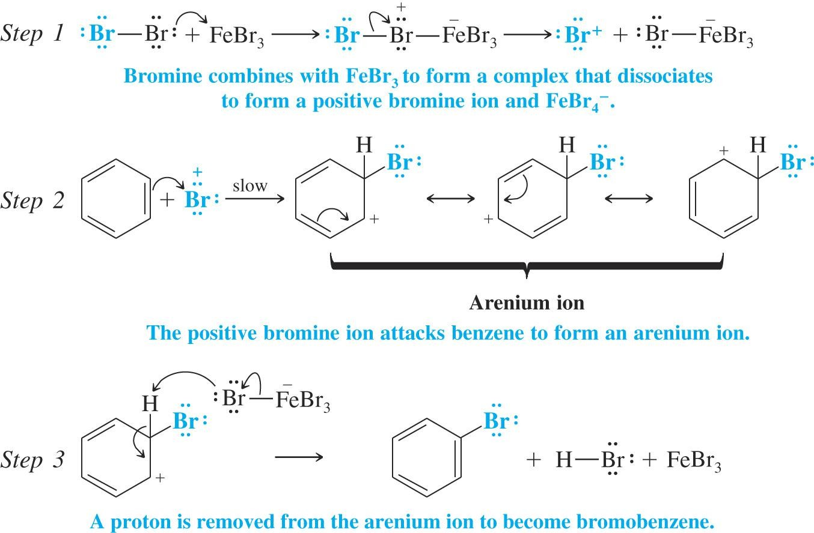
Mechanism :

Slide 8
We should know;
Halogenation of benzene requires the presence of a Lewis acid.
Fluorination occurs so rapidly it is hard to stop at mono- fluorination of the ring (A special apparatus is used to perform this reaction).
Iodine is so unreactive that an alternative method must be used.

Slide 9
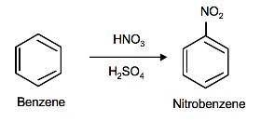
2. Nitration of Benzene :
Nitration of benzene occurs with a mixture of concentrated nitric and sulfuric acids.

Slide 10
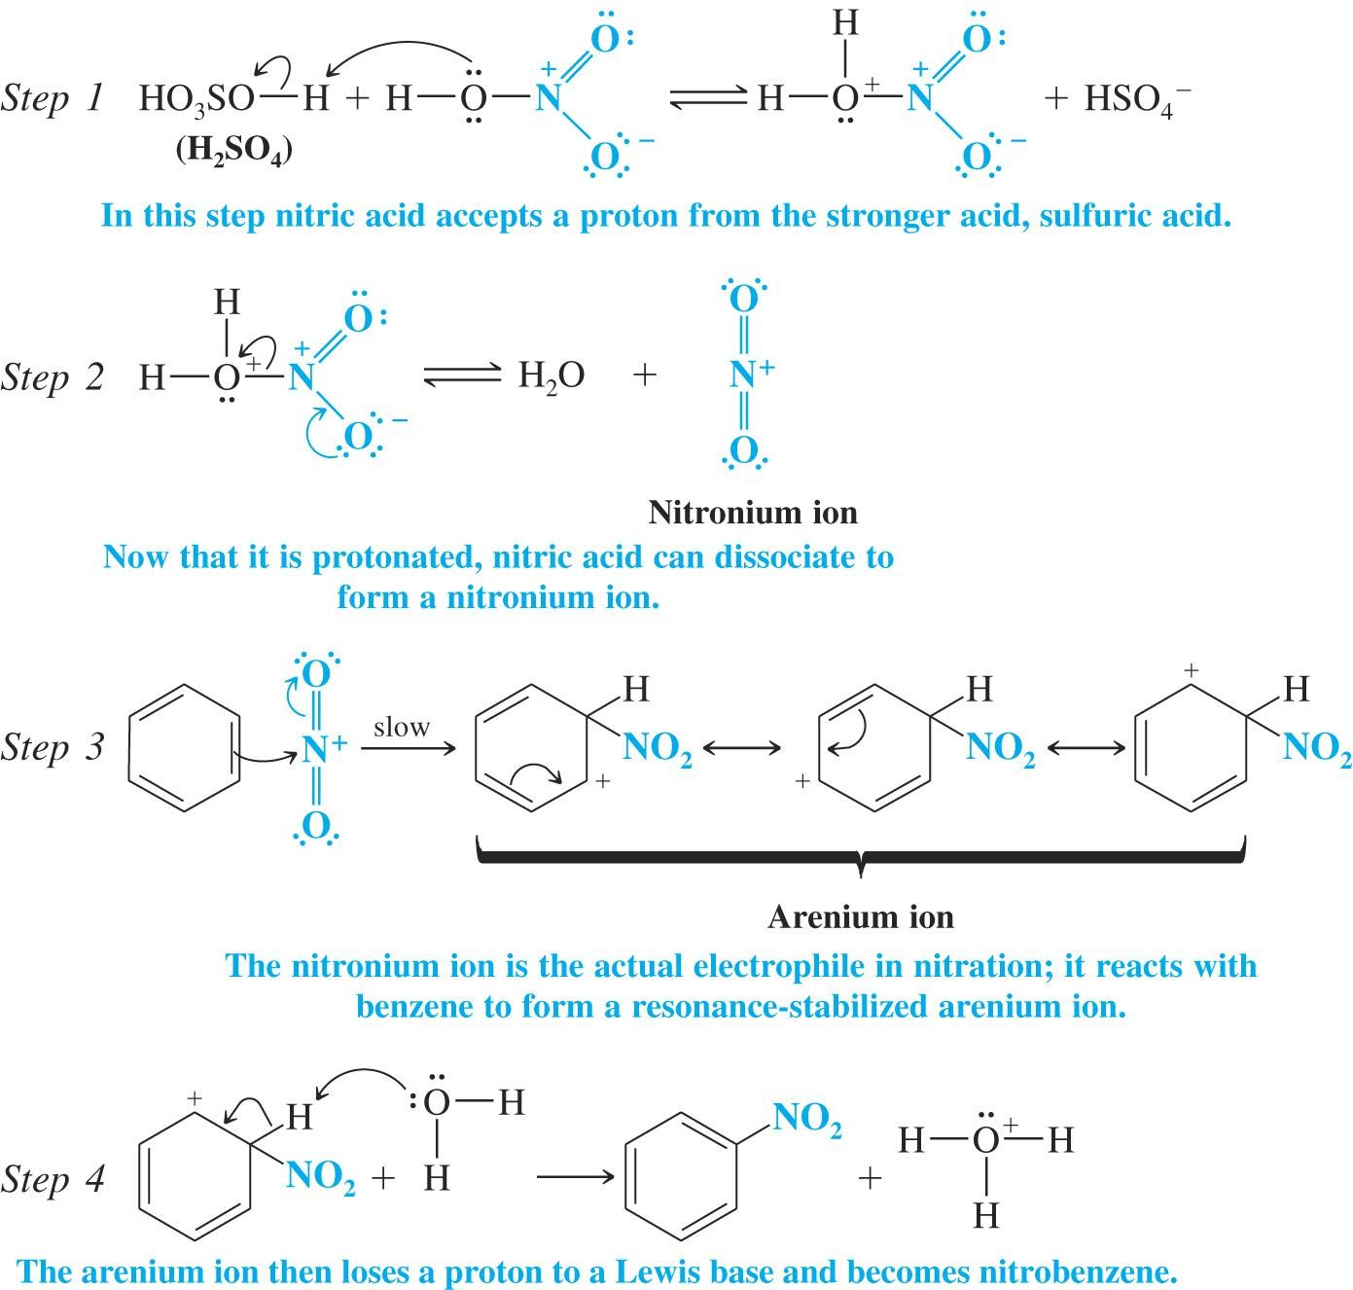
Mechanism :

Slide 11
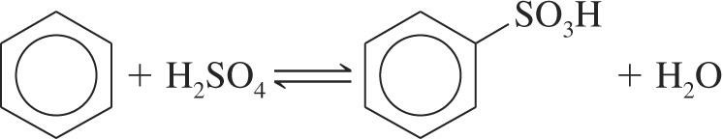
  3. Sulphonation of Benzene:
  Sulphonation occurs most rapidly using fuming sulfuric acid (concentrated sulfuric acid that contains SO₃)

Slide 12
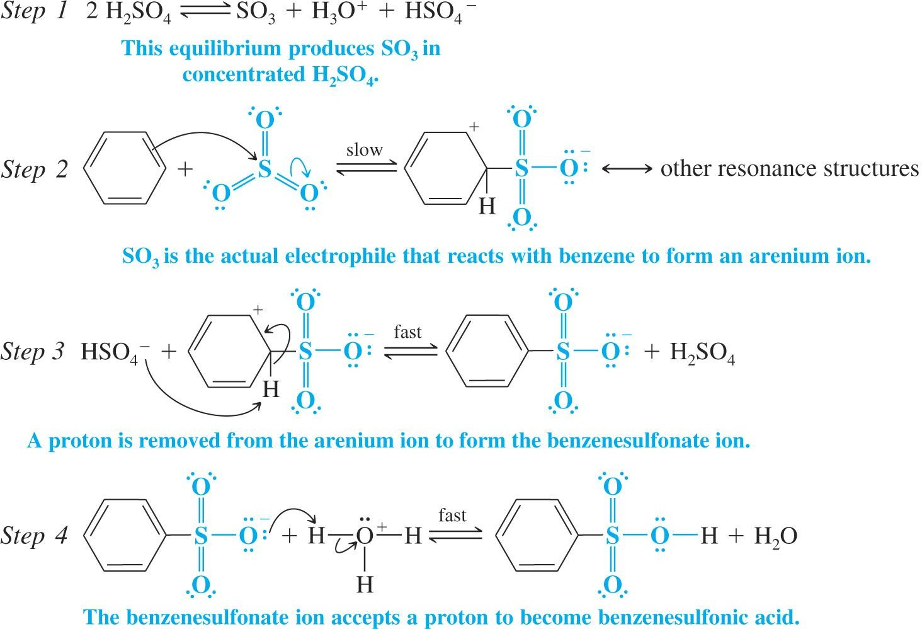
Mechanism :

Slide 13


