Slide 1
Overview of means & methods used in structural elucidation of natural products
Mrs. Bharati M. Sonawane
Department of Pharmacognosy
Loknete Dr. J. D. Pawar College of Pharmacy, Manur. Kalwan.

Slide 2
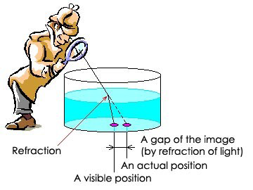
Physical methods of characterization:
1.REFRACTIVE INDEX & SPECIFIC OPTICAL ROTATION
Refractive index ???
• The refractive index or index of
refraction of a substance is a
measure of the speed of light in
that substance. It is expressed as
aratio of the speed of light in
vacuum relative to that in the
considered medium.
A simplified, mathematical description of refractive index is:
n = velocity of light in a vacuum / velocity of light in medium
Hence, the refractive index of water is 1.33, meaning that
light travels 1.33 times as fast in a vacuum than it does in
water.

Slide 3
Why Refractive index is Important ?
• The refractive index of a material medium is an important optical parameter since it exhibits the optical properties of the material.
• Its values are often required to interpret various types of spectroscopic data. Such as DOAS, ES, RPFTS, IRRS,PWMS.
• It is used to calculate the focusing power of lenses, and the dispersive power of prisms.
• The refractive index coefficients are important parameters in the design of a solid state laser.
• The adulteration problem is increasing day by day and hence simple, automatic and accurate measurement of the refractive index of materials is of great importance these days.

Slide 4
Refractive Index (RI) Detector is designed for high-performance
liquid chromatography (HPLC) applications. It provides
sensitivity, stability, and reproducibility for the analysis of
components with limited or no UV absorption
• Various methods and techniques for the measurement of
refractive indices of liquids, solids and gases. Sensitive
determination of the refractive indices of certain materials is
very important in many fields of research such as material
analysis and environmental pollution monitoring.
• Refractometric measurements are used for qualitative analysis
for different type of packaging material like glass, plastics,
rubber, silk etc.

Slide 5
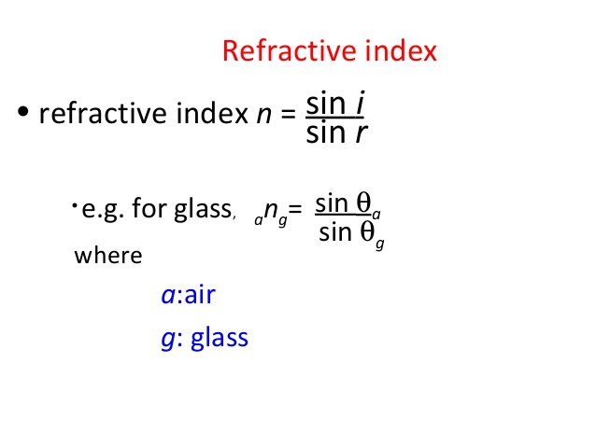

Slide 6
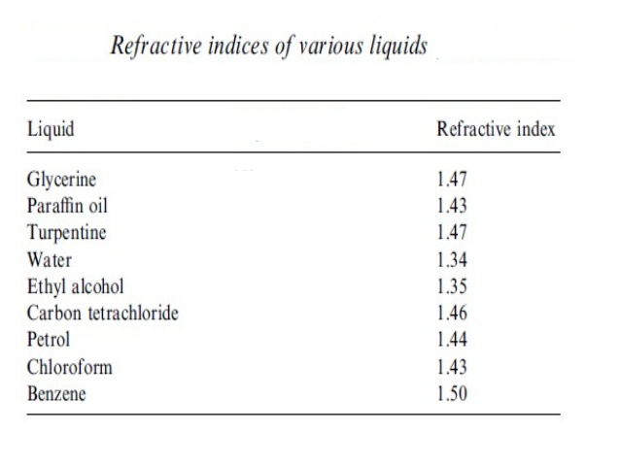

Slide 7
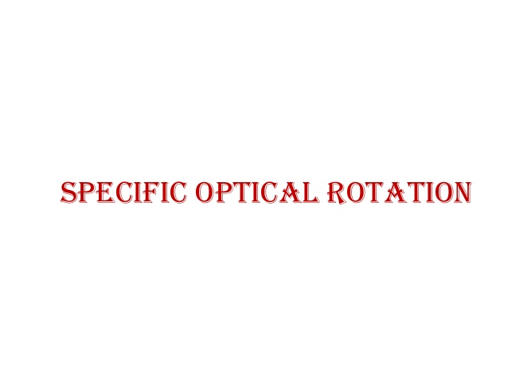

Slide 8
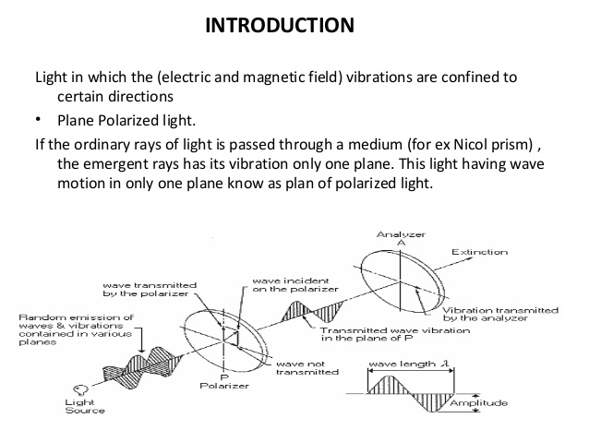

Slide 9
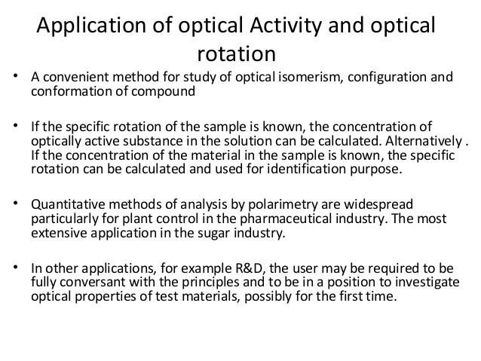

Slide 10
Thin layer chromatography (TLC)
Is a method for identifying substances and testing the purity of compounds.
TLC is a useful technique because it is relatively quick and requires small quantities of material.
Separations in TLC involve distributing a mixture of two or more substances between a stationary phase and a mobile phase.
The stationary phase: is a thin layer of adsorbent (usually silica gel or alumina) coated on a plate.
The mobile phase: is a developing liquid which travels up the stationary phase, carrying the samples with it.
Components of the samples will separate on the stationary phase according to how much they adsorb on the stationary phase versus how much they dissolve in the mobile phase.

Slide 11
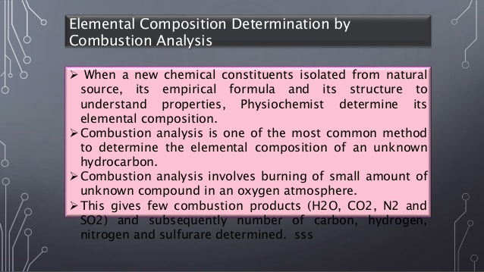
Analytical methods of characterization:

Slide 12
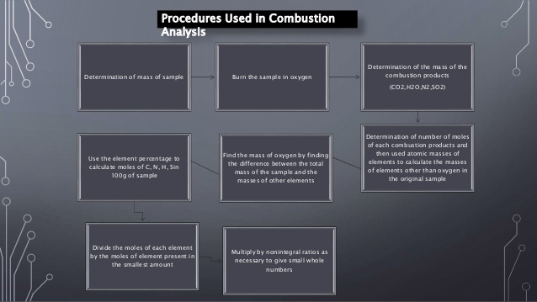

Slide 13
HPTLC
• HPTLC is the improved method of TLC which utilizes the conventional technique of TLC in more optimized way.
• It is also known as planar chromatography or Flatbed chromatography
Principle:
• Chromatography is a physical process of separation in which the components to be separated are distributed between two immiscible i.e. the principle of separation is adsorption.

Slide 14
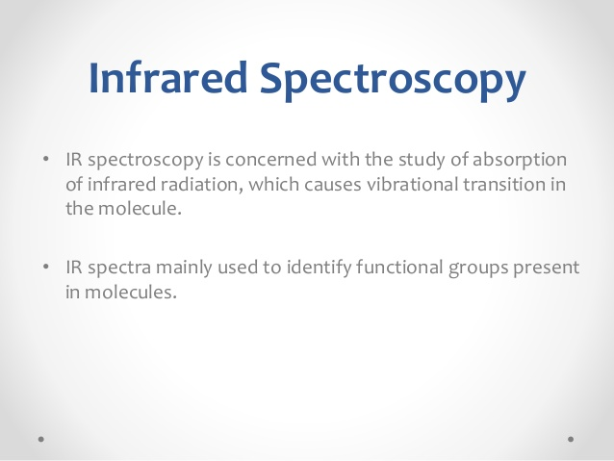
Spectroscopic methods of characterization:

Slide 15
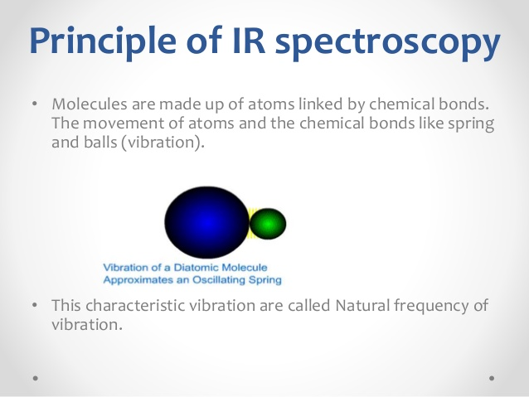

Slide 16
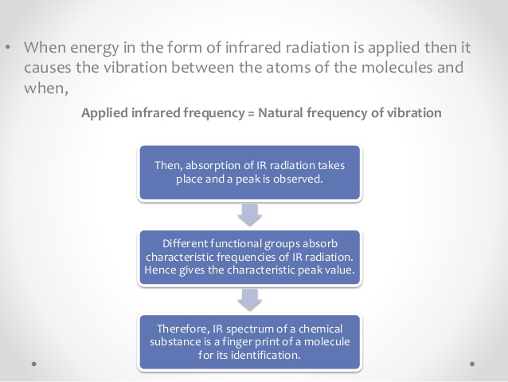

Slide 17
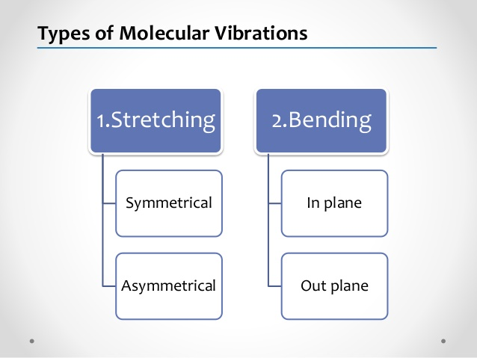

Slide 18
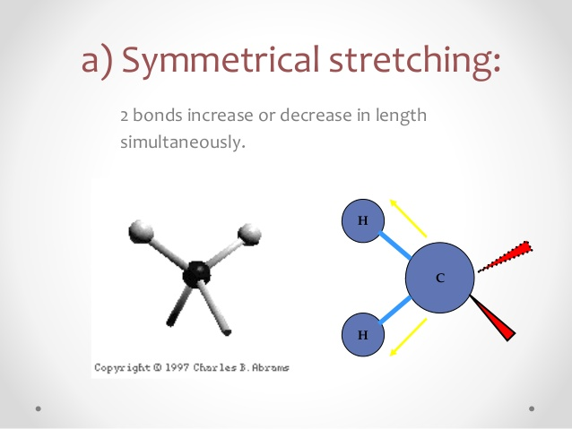

Slide 19
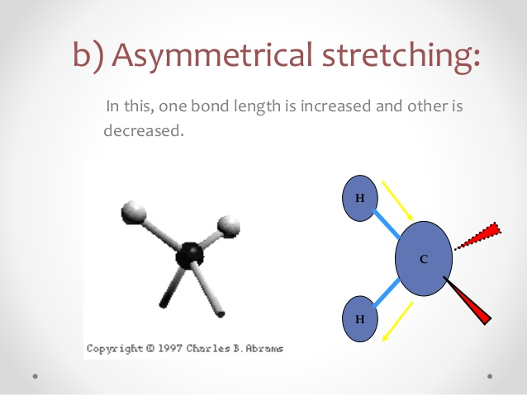

Slide 20
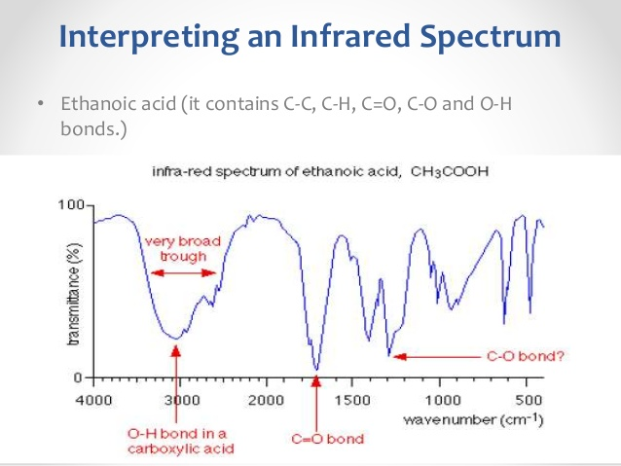

Slide 21
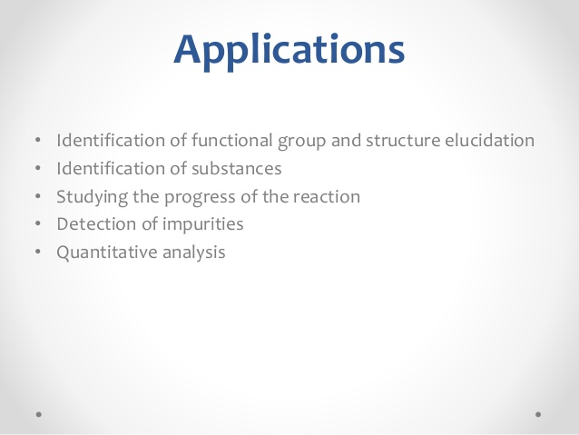

Slide 22
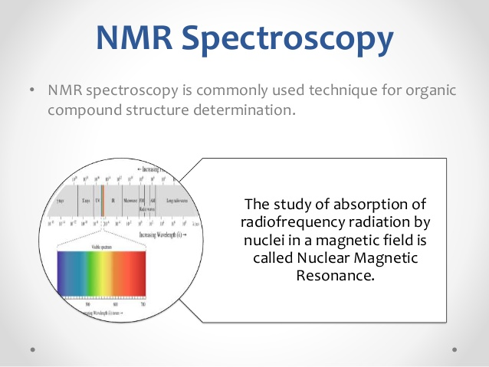

Slide 23
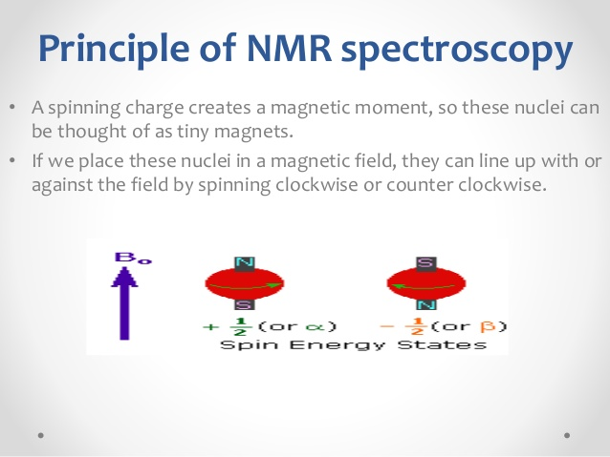

Slide 24
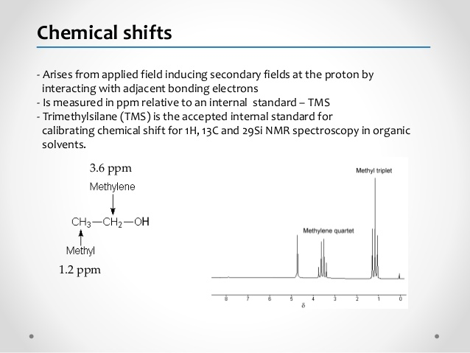

Slide 25
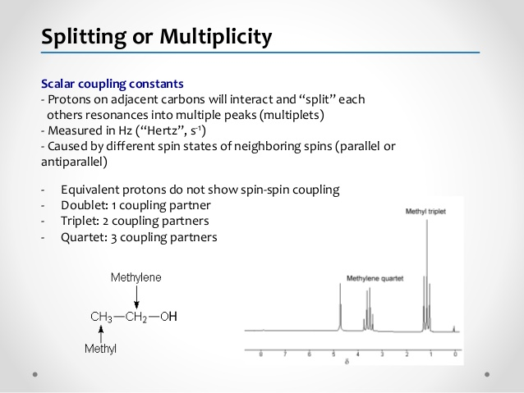

Slide 26
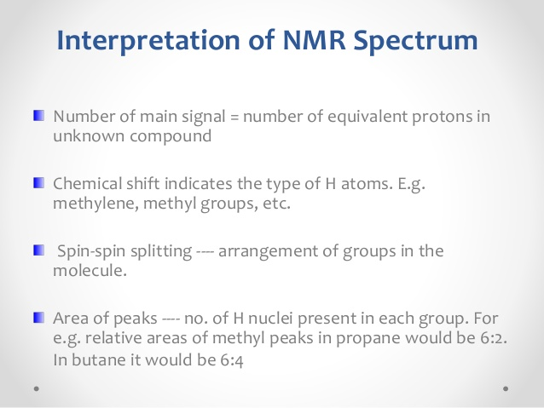

Slide 27
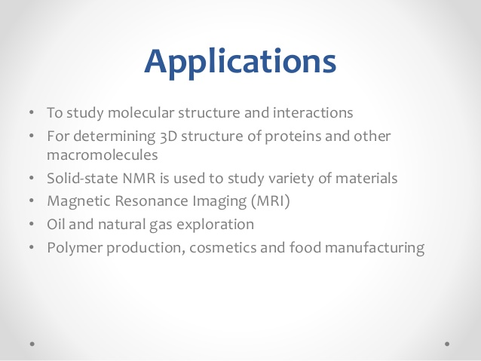

Slide 28


