Slide 1
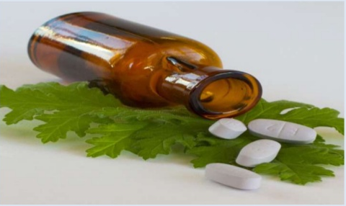
Toxicity in herbals and
their interaction
Mrs. Bharati M. Sonawane
Department of Pharmacognosy
Loknete Dr. J. D. Pawar College of Pharmacy, Manur. Kalwan.

Slide 2
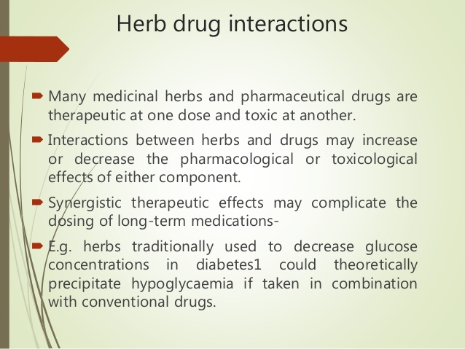

Slide 3
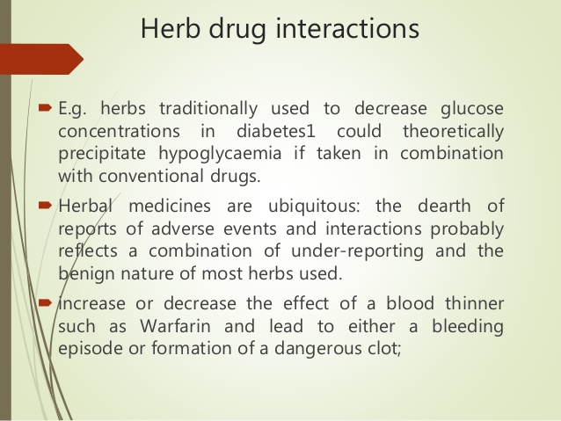

Slide 4
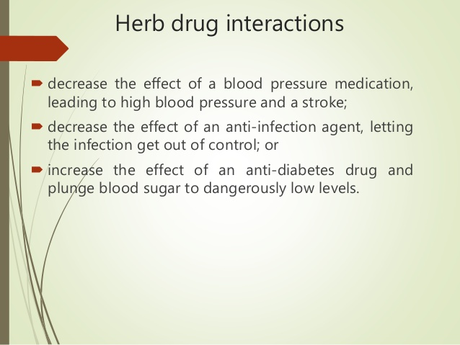

Slide 5
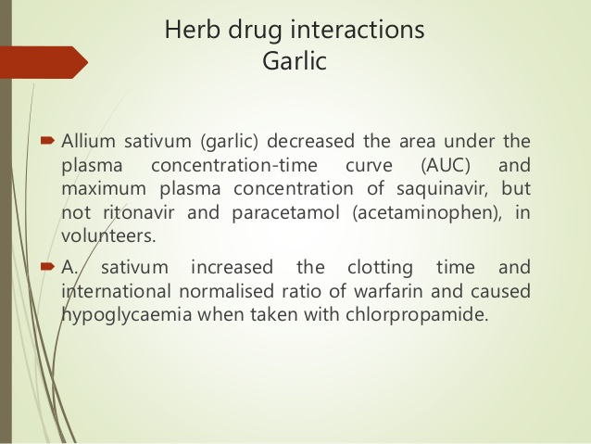

Slide 6
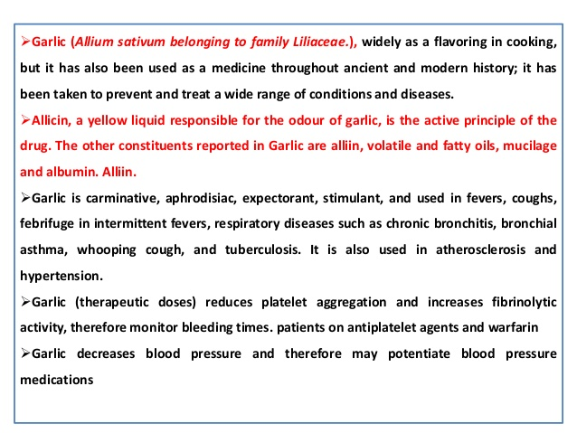

Slide 7
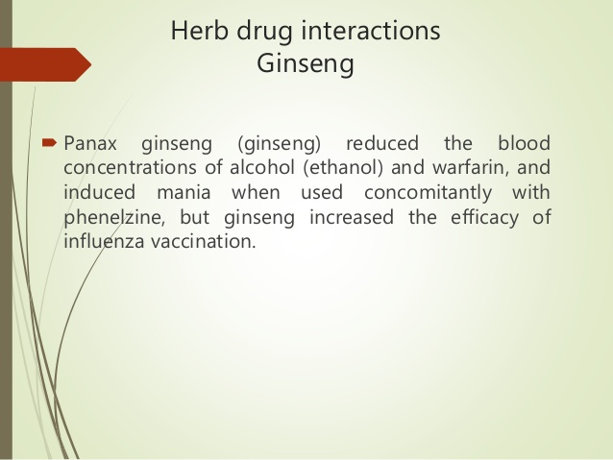

Slide 8
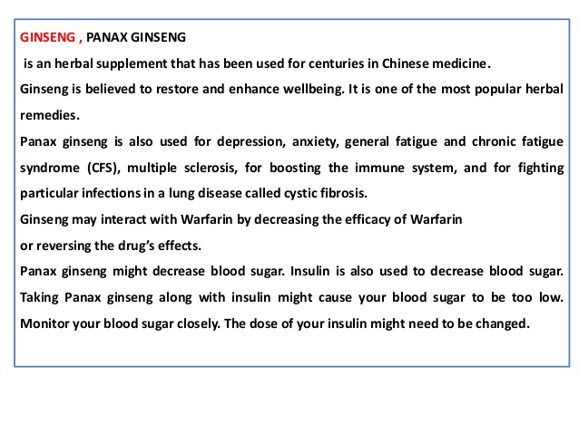

Slide 9
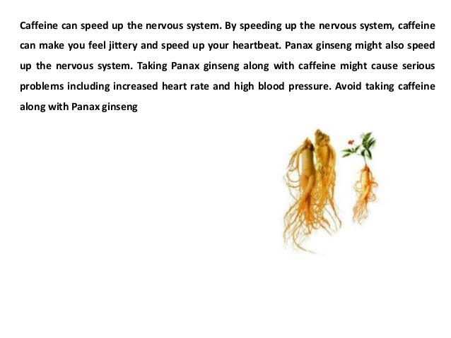

Slide 10
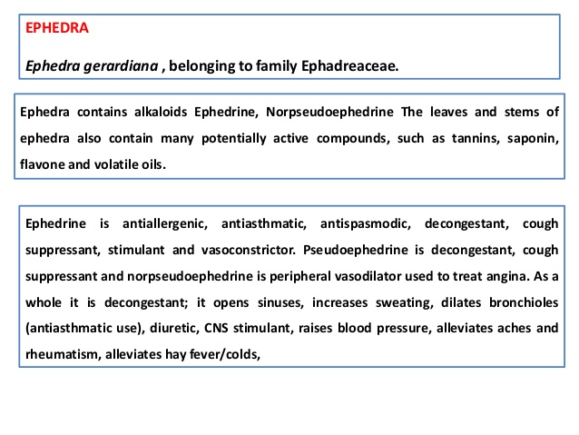

Slide 11
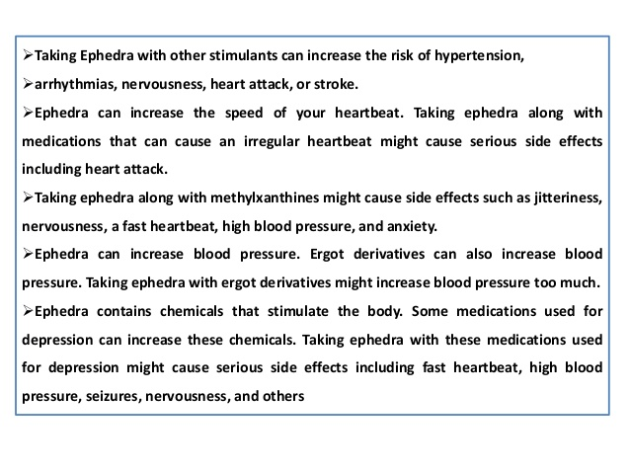

Slide 12
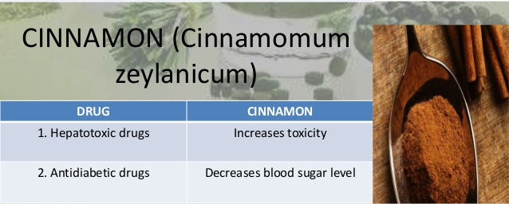

Slide 13
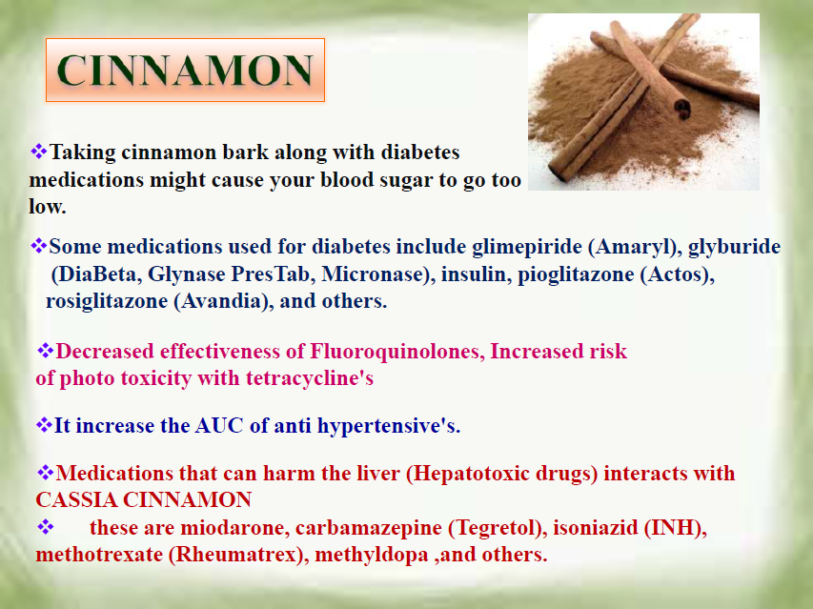

Slide 14
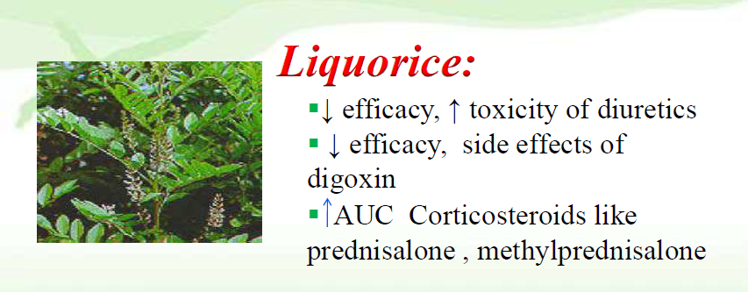
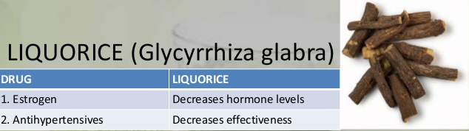

Slide 15
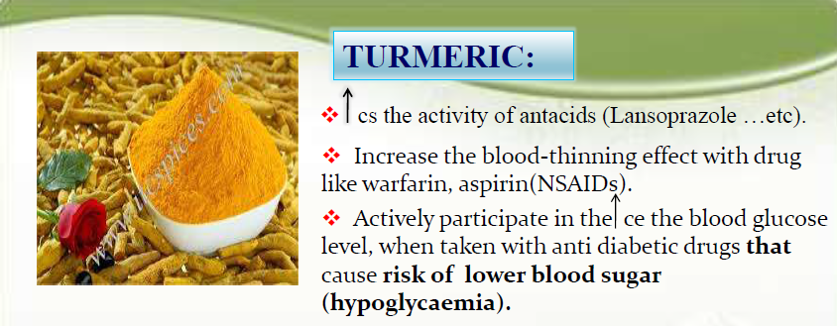

Slide 16
WHAT IS INDIAN GOOSEBERRY? (Amla)
Indian gooseberry is a tree that grows in India, the Middle East, and some southeast Asian countries. Indian gooseberry has been used in Ayurvedic medicine for thousands of years. Today people still use the fruit of the tree to make medicine.
Indian gooseberry is taken by mouth for high cholesterol, “hardening of the arteries” (atherosclerosis), diabetes, pain and swelling of the pancreas (pancreatitis), cancer, upset stomach, eye problems, joint pain, diarrhea, bloody diarrhea (dysentery), osteoarthritis, obesity, and “organ restoration.” It is also used to kill germs and reduce pain and swelling caused by the body's reaction to injury or illness (inflammation).

Slide 17
INSUFFICIENT EVIDENCE TO RATE EFFECTIVENESS FOR...
High cholesterol. Early research suggests that taking Indian gooseberry for 4 weeks decreases low-density lipoprotein (LDL, or “bad”) cholesterol in people with high cholesterol.
Osteoarthritis. Research shows that taking two capsules of an Ayurvedic formula containing Indian gooseberry and several other ingredients three times daily for 24 weeks is as beneficial as taking glucosamine sulfate or the drug celecoxib for reducing pain in people with knee osteoarthritis.
Hardening of the arteries (atherosclerosis).
Cancer.
Swelling of the pancreas.
Indigestion.
Eye problems.
Joint pain.
Diarrhea.
Bloody diarrhea (dysentery).
Obesity.
Diabetes.
Other conditions.

Slide 18
HOW DOES INDIAN GOOSEBERRY WORK?
Indian gooseberry seems to work by reducing total cholesterol levels, including the fatty acids called triglycerides, without affecting levels of the “good cholesterol” called high-density lipoprotein (HDL).
ARE THERE SAFETY CONCERNS?
Indian gooseberry seems LIKELY SAFE for most people when consumed in amounts found in foods. Ayurvedic formulations containing Indian gooseberry have been linked to liver damage. But, it's not clear if taking Indian gooseberry alone might have these effects.

Slide 19
Special Precautions & Warnings:
Pregnancy and breast-feeding: There is not enough reliable information about the safety of taking Indian gooseberry as medicine if you are pregnant or breast-feeding. Stay on the safe side and stick to food amounts.
Bleeding disorders: Indian gooseberry might increase the risk of bleeding or bruising in some people. If you have a bleeding disorder, use Indian gooseberry with caution.
Diabetes: Indian gooseberry might decrease blood sugar levels. Your diabetes medications might need to be adjusted by your healthcare provider.

Slide 20
Liver disease: In theory, taking Indian gooseberry with ginger, Tinospora cordifolia, and Indian frankincense might make liver function worse in people with liver disease. But it's not known if taking Indian gooseberry alone can have these effects.
Surgery: Indian gooseberry might increase the risk of bleeding during and after surgery. Stop taking Indian gooseberry at least 2 weeks before a scheduled surgery.

Slide 21
ARE THERE ANY INTERACTIONS WITH MEDICATIONS?
Medications for diabetes (Antidiabetes drugs)Interaction Rating: Moderate Be cautious with this combination.Talk with your health provider.Indian gooseberry might decrease blood sugar. Diabetes medications are also used to lower blood sugar. Taking Indian gooseberry along with diabetes medications might cause your blood sugar to go too low. Monitor your blood sugar closely.
Some medications used for diabetes include glimepiride (Amaryl), glyburide (DiaBeta, Glynase PresTab, Micronase), insulin, pioglitazone (Actos), rosiglitazone (Avandia), chlorpropamide (Diabinese), glipizide (Glucotrol), tolbutamide (Orinase), and others.

Slide 22
Medications that can harm the liver (Hepatotoxic drugs)
Interaction Rating: Moderate Be cautious with this combination. Talk with your health provider. Some Ayurvedic formulations that contain Indian gooseberry have been linked to liver damage. While it's not clear if Indian gooseberry or other ingredients in these formulations caused the liver damage, in theory, taking Indian gooseberry along with medication that might also harm the liver can increase the risk of liver damage.
Some medications that can harm the liver include acetaminophen (Tylenol), amiodarone (Cordarone), carbamazepine (Tegretol), isoniazid (INH), methotrexate (Rheumatrex), methyldopa (Aldomet), and many others.

Slide 23
Medications that slow blood clotting (Anticoagulant / Antiplatelet drugs)
Interaction Rating: Moderate Be cautious with this combination.T alk with your health provider. Indian gooseberry might slow blood clotting. Taking Indian gooseberry along with medications that also slow clotting might increase the chances of bruising and bleeding.
Some medications that slow blood clotting include aspirin, clopidogrel (Plavix), diclofenac (Voltaren, Cataflam, others), ibuprofen (Advil, Motrin, others), naproxen (Anaprox, Naprosyn, others), dalteparin (Fragmin), enoxaparin (Lovenox), heparin, warfarin (Coumadin), and others.

Slide 24
WHAT IS DIGOXIN AND HOW DOES IT WORK? (DIGITALIS)
Digoxin is used to treat heart failure, usually along with other medications. It is also used to treat a certain type of irregular heartbeat (chronic atrial fibrillation). Treating heart failure may help maintain your ability to walk and exercise and may improve the strength of your heart. Treating an irregular heartbeat can decrease the risk for blood clots, an effect that may reduce your risk for a heart attack or stroke.
Digoxin belongs to a class of medications called cardiac glycosides. It works by affecting certain minerals (sodium and potassium) inside heart cells. This reduces strain on the heart and helps it maintain a normal, steady, and strong heartbeat.
Digoxin is available under the following different brand names: Lanoxin.

Slide 25
Dosage of Digoxin:
Adult and Pediatric Dosage Forms and Strengths
Oral solution
0.05 mg/mL
Injectable solution
0.1 mg/mL
0.25 mg/mL
Tablet
0.0625 mg (Lanoxin only) (adult only)
0.125 mg
0.1875 mg (Lanoxin only) (adult only)
0.25 mg

Slide 26
Rapid digitalizing (loading-dose)
regimen Intravenous (IV): 8-12 mcg/kg (0.008-0.012 mg/kg) total loading dose; administer 50% initially; then may cautiously give 1/4 the loading dose every 6-8 hours twice; perform careful assessment of clinical response and toxicity before each dose
Oral: 10-15 mcg/kg total loading dose; administer 50% initially; then may cautiously give 1/4 the loading dose every 6-8 hours twice; perform careful assessment of clinical response and toxicity before each dose
Maintenance
Oral: 3.4-5.1 mcg/kg/day or 0.125-0.5 mg/day orally; may increase dose every 2 weeks based on clinical response, serum drug levels, and toxicity
Intravenous/intramuscular (IV/IM): 0.1-0.4 mg once/day; IM route not preferred due to severe injection site reaction

Slide 27
Heart Failure
As per ACCF/AHA guidelines, a loading dose to initiate digoxin therapy in patients with heart failure is not necessary
0.125-0.25 mg orally/IV once/day; higher doses including 0.375-0.5 mg/day rarely needed
Use lower end of dosing (0.125 mg/day) in patients with impaired renal function or low lean body mass
Heart Failure/Atrial Fibrillation, Pediatric
Use doses at the lower end of the spectrum when treating heart failure
Reduce dose by 20-25% when changing from oral formulation or intramuscular (IM) to intravenous (IV) therapy
Premature neonate
Oral: 1st loading dose, 10-15 mcg/kg; 2nd and 3rd loading doses, 5-7.5 mcg/kg every 6-8 hours for 2 doses; maintenance: 5-7.5 mcg/kg/day divided every 12 hours Intravenous/intramuscular (IV/IM): 1st loading dose, 7.5-12.5 mcg/kg; 2nd and 3rd loading doses, 3.75-6.25 mcg/kg every 6-8 hours for 2 doses; maintenance: 4-6 mcg/kg/day divided every 12 hours.

Slide 28
Dosing Modifications
Adjust maintenance dose by estimating renal clearance and measuring serum levels.
In heart failure, higher dosages have no additional benefit and may increase toxicity; decreased renal clearance may lead to increased toxicity.
In geriatric patients, use lean body weight to calculate dose
WHAT ARE SIDE EFFECTS ASSOCIATED WITH USING DIGOXIN?
Common Side effects of Digoxin include:
Dizziness
Mental disturbances
Diarrhea
Headache
Nausea
Vomiting
Red, bumpy rash

Slide 29
Less common side effects of digoxin include:
Loss of appetite
Irregular heartbeat
Arrhythmia in children (consider a toxicity)
Other side effects of digoxin include:
Visual disturbance (blurred or yellow vision)
Heart block (1°/2°/3°)
Cardiac arrest rhythm (asystole)
Fast heart rate

Slide 30
WHAT ARE WARNINGS AND PRECAUTIONS FOR DIGOXIN?
Warnings
This medication contains digoxin
Do not take Lanoxin if you are allergic to digoxin or any ingredients contained in this drug
Keep out of reach of children. In case of overdose, get medical help or contact a Poison Control Center immediately
Contraindications
Hypersensitivity
Ventricular fibrillation

Slide 31
Effects of Drug Abuse
No information available
Short-Term Effects
See "What Are Side Effects Associated with Using Digoxin?"
Long-Term Effects
See "What Are Side Effects Associated with Using Digoxin?"
Cautions
Use caution in chronic constrictive pericarditis, electrical cardioversion, severe bradycardia, severe heart failure, severe pulmonary disease, sick sinus syndrome, ventricular tachycardia, ventricular premature contractions,
Wolff-Parkinson-White syndrome, electrolyte imbalance, hypothyroidism or hyperthyroidism, hypoxia, idiopathic hypertrophic subaortic stenosis, renal disease, concomitant diuretics.

Slide 32
Not recommended in patients with acute myocardial infarction.
Avoid in patients with myocarditis.
Risk of advanced or complete heart block in patients with sinus node disease and AV block.
Very narrow margin between effective therapeutic and toxic dosages: Therapeutic range, 0.5-2 ng/mL (target 0.5-1 ng/mL); toxic range, greater than 2.5 ng/mL.
Generally avoid if left ventricular systolic function preserved, although may be used for ventricular rate control in subgroup with chronic atrial fibrillation.
Less effective in presence of hypokalemia or hypocalcemia; avoid hypercalcemia or hypomagnesemia, which may predispose to serious arrhythmias.
Heart failure patients with preserved ventricular function including acute cor pulmonale, amyloid heart disease, and constrictive pericarditis may be susceptible to digoxin toxicity.

Slide 33
Serum levels drawn within 6-8 hours of dose will be falsely high because of prolonged distribution phase.
Increased risk of estrogen-like effects in geriatric patients.
May cause false-positive ST-T changes during exercise testing.
Do not switch between different oral forms or between brand and generic forms of digoxin; bioavailability varies.
Pregnancy and Lactation:
Use digoxin with caution during pregnancy if benefits outweigh risks
Animal studies show risk and human studies are not available, or neither animal nor human studies were done
Digoxin enters breast milk; use with caution if breastfeeding (American Academy of Pediatrics committee states, "compatible with nursing")

Slide 34


