Slide 1

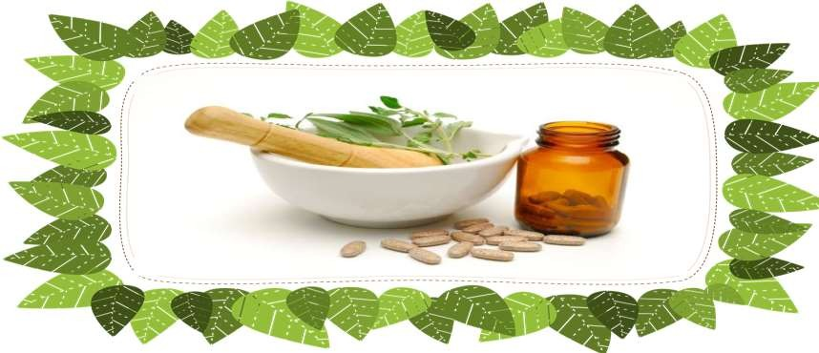
HERBAL COSMETICS
Prepared By- Ms. Jayshree S. Bhadane.
Designation- Assistant Professor.
Department – Pharmaceutics.
Course & Code - Cosmetic Science (BP809ET)
Class- Final Y.B.Pharm Semester- VIII

Slide 2
COSMETICS
According to D & C Act 1940 • Any article intended to be rubbed, poured, sprinkled or sprayed on or introduced to or applied to any part of human body for cleansing, beautifying, promoting, attractiveness or altering the appearance and includes any article intended for use as component of cosmetics.
Included in this definition are products such as skin moisturizers, perfumes, lipsticks, fingernail polishes, eye and facial makeup preparations, shampoos, permanent waves, hair colours, toothpastes, and deodorants, as well as any material intended for use as a component of a cosmetic product.

Slide 3
If the safety of a cosmetic product has not been
substantiated, the product's label must read:
WARNING: “The safety of this product has not been
determined.“

Slide 4

INTRODUCTION
Herbal products are safe because they are natural if consumed improperly or in excessive amounts.
can be harmful
Cosmeceuticals are cosmetic products with biologically active ingredients purporting to have medical or drug‐like benefits. They ingredient with medicinal properties that manifests beneficial topical actions and provides protection against degenerative skin conditions.
Cosmeceuticals improve appearance by delivering nutrients necessary for healthy skin.

Slide 5
ADVANTAGES OF HERBAL COSMETICS
They do not provoke allergic reaction & do not have negative side effects.
They are easily incorporated with skin and hair.
With small quantity they are very effective as compared to synthetic cosmetics.
Easily available & found in large variety & quantity.

Slide 6
DISADVANTAGES OF HERBAL COSMETICS
Herbal drugs have slower effects as compare to Allopathic dosage form. Also
it requires long term therapy.
They are difficult to hide taste and odour.
Manufacturing process are time consuming and complicated.
No pharmacopoeia defines any specific procedure or ingredients to be used in any of herbal cosmetics.

Slide 7
CURRENT CHALLENGES IN HERBAL FORMULATIONS
purification, concentration or fermentation.
Herbal preparations includes powdered substances, tinctures, extracts, essential oils, expressed juices and processed exudates.
Ayurvedic herbal formulations-
Solid dosage forms- Gutika and Churna
Semisolid – Avaleha and Ghrita
Liquid – Asava, Arishta, Taila
Herbal preparations
are
obtained
by subjecting
herbal substances to
treatments such as
extraction,
distillation,
expression,
fractionation,

Slide 8
Herbal
Other herbal formulations includes Tablets, Capsules,
creams, lotions, pastes, shampoos, conditioners, Herbal Tea etc.
Gels,
Novel formulations like- polymeric nanoparticles, nanocapsules, liposomes,
phytosomes, nanoemulsions, transferosomes, microsphere and ethosomes
etc.
Global market of herbal industry shares about US $62 billion per annum.
Herb drug production of India is about US $10 billion per annum with annual export of US $ 1.1 billion while China is worth US $48 billion with export of US $ 3.6 billion per annum.

Slide 9
India is having just 2% global herbal market share.
India is lagging behind because of these major factors-
Lack of scientific validation and standardization.
Lack of Quality and regulatory aspects.
Limited evidence based studies on efficacy and safety.
Lack of pharmacokinetic studies of bioactive molecules.

Slide 10
LACK OF SCIENTIFIC VALIDATION AND STANDARDIZATION
Standardisation: The process of evaluating the quality and purity of
crude drugs by means of various parameters like morphological,
microscopical, physical, chemical and biological observations.
Accuracy of plant identification, evaluation, and isolation of active ingredients is key challenge.

Slide 11
Active ingredients in precautions, because a constituents.
plants are
in complex form
and needs special
single medicinal plant consist of hundreds of
Medicinal plant properties are influenced by the time of collection, area of
plant origin and environmental conditions.
Hence scientific validation and technological standardization of herbal medicines is needed for the future advancement of herbal formulation.

Slide 12
LACK OF QUALITY AND REGULATORY ASPECTS
Quality control(QC) of herbal formulations is required for its safety and efficacy .
QC assures quality products that reduce the risks associated with herbal medicine.
Regulation and legislation of herbal medicines has been enacted in very few
countries.
Most countries do not have any proper regulation of botanicals and quality of
herbal products sold is generally not guaranteed.

Slide 13
European countries- regulated by the European
Directive on Traditional Herbal medicinal products.
UK- MHRA (Medicines and Healthcare products Regulatory agency).
India- AYUSH

Slide 14
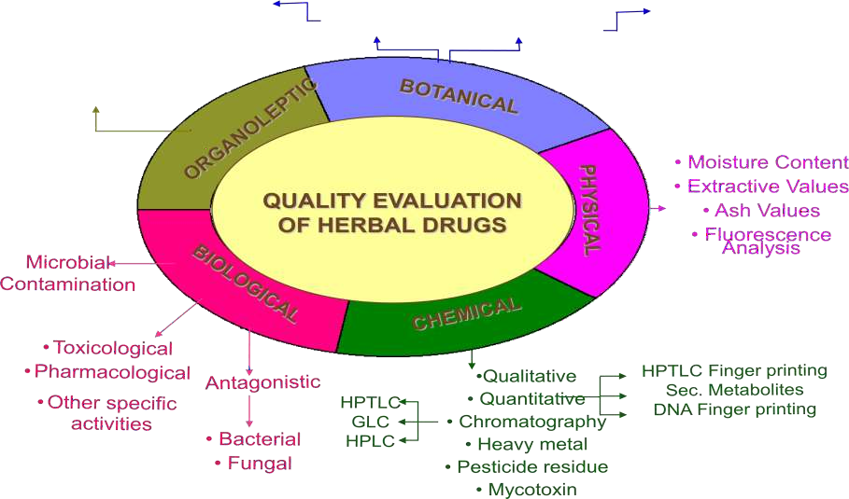
QUALITY EVALUATION OF HERBAL DRUGS
Colour
Odour
Taste
Texture
Shape
External
Qualitative
Quantitative
SEM studies
Powder studies
Macroscopic
Microscopic

Slide 15
LACK OF PHARMACOKINETIC STUDIES OF BIOACTIVE MOLECULES
Efficacy of drug depends upon its composition as herbal products have
complex composition.
In vitro assays are cheap and easy, but in herbal preparations sufficient
concentration of active constituents at the site of action is difficult.
Herbal formulations because of which lack data on their disposition, and biological fate in humans.

Slide 16
Pharmacokinetics are vital
Drug development process of understanding ADME.
To know herbal-drug interaction.
Elucidation of metabolic pathways which yields potentially new active compounds and assessment of elimination route and their kinetics.

Slide 17
INITIATIVES TAKEN SO FAR ……
In 2000 GMP came for Ayurvedic, Siddha and Unani.
Monographs on herbs and herbal products got included in Indian Pharmacopeia (IP) - 59 monographs in 2007 IP - 89 monographs in 2010 IP
In 2005, Ayurvedic Pharmacopeia of India included 258 different drugs and the Indian Herbal pharmacopeia included 52 monographs.
About USD 158 million (INR 775 crore) has been allocated to the AYUSH Department during 10th five year plan.

Slide 18
In 2000 The National Medicinal Plants Board (NMPB) was set up has taken many schemes for conservation of rare, endangered species with outlay of USD 65.2 million.
The Traditional Knowledge Digital Library (TKDL) is the first Indian effort and is a proprietary and original database of traditional knowledge based on medicinal plants.
The TKDL incorporates about 212,000 medicinal formulations from 148 books available in public domain has signed and TDKL database access is approved to International Patent offices.

Slide 19
CATEGORIES OF HERBAL COSMETICS
The herbal cosmetics can be grouped in to following categories :
For enhancing the appearance of the facial skin
For hair growth and care
For skin care ( acne, pimples, sustaining)
Shampoos, soap, powders and perfumery etc
Miscellaneous products

Slide 20
CLSSIFICATION OF HERBAL COSMETICS
Herbal cosmetics can be classified on the basis of :
Dosage form
Part of the body to be applied for

Slide 21
DOSAGE FORMS
Emulsion:
Powders:
Cakes:
Oils :
Mucilage :
Jellies :
Suspension :
Paste :
Soaps :
Cold cream, vanishing cream, liquid cream Face powder, Talcum powder, Tooth powder Rouge compacts, make-up cake
Hair oils Hand lotion
Hand jelly, wave set jelly, brilliantine jelly Cosmetic stockings
Tooth paste, deodorant paste
Shampoo soap, shaving soap, toilet soap
After shave lotions, hair set solutions and lotions
j. Solutions :

Slide 22
Parts or organ of the body to be applied for
Herbal cosmetics for Hairs
Shampoos Tonics
Hair dressing
Hair waving preparations Beard softeners
Shaving media
Depilatories (hair removers)
Herbal cosmetics for Skin
Powders
Creams
Lotions
Deodorants
Bath and cleansing products
Make-up preparations
Suntan preparation

Slide 23
Herbal cosmetics for Nails
Nail polishes
Manicure preparations
Herbal cosmetics for Teeth and mouth
Tooth powders
Dentifrices
Mouth washes

Slide 24
HERBAL COSMETICS FOR SKIN
The herbal approach of proper skin care is principally based on three essential
steps.
Cleanse
Nourish
Moisture
Whatever may be the type of skin; these three steps are external care of the skin to protect from the constant effect of environment, stress and skins natural process of cell degradation decay

Slide 25
Therefore in order to help the skin look young and radiant.
Exfoliation to remove dead skin cells.
Epidermal stimulation for new cell growth.
Antioxidant properties for cellular rejuvenation and repair.
Improve capillary blood flow.
Penetrating moisture and nutrients to replenish all layers of skin.

Slide 26
HERBAL COSMETICS FOR VARIOUS TYPES OF SKIN
FOR DRY SKIN
Example of Herbs:
Rubia Cardifolia (Manjista), Triphla, Tulsi, Glycerihza glabra in sesame oil.
Fruit face mask: Banana or avocado pulp.
FOR SENSITIVE SKIN
Example of Herbs:
curcuma longa, triphala, azadircta indica mustaka, nimba in coconut oil.
Fruit face mask: Banana or pineapple pulp.

Slide 27
FOR OILY SKIN
Example of Herbs:
Tulsi, idhora, jatiphata, nimba, terminalia arjuna, Triphla, curcuma longa, mustaka in musterd oil , milk, sour milk, cream and butter milk are used as gentle natural cleanser.
Fruit face mask: Strawberry or papaya pulp.

Slide 28
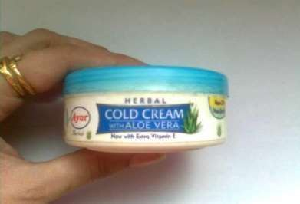
TYPES OF HERBAL CREAMS
COLD CREAMS:
It is an emulsion in which the fat predominates, but the cooling effect produced when it is applied to the skin is due to skin evaporation of the water contained.
Formula:
Almond oil 550 parts White wax 145 parts Borax 10 parts
Water 290 parts Rose water 5 parts

Slide 29
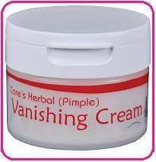
VANISHING CREAMS:
Vanishing creams are also called foundation creams because they disappears when rubbed into skins.
Formula:
Stearic acid 130 parts
Borax crystals 28 parts Sodium carbonate 12 parts Water 740 parts
Rose oil 9 parts

Slide 30
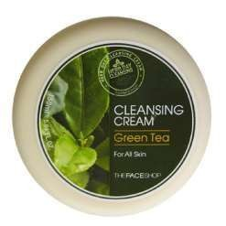
CLEANSING CREAMS:
A satisfactory cleansing cream is water in oil emulsion that melts at temperature of body and spreads readily over the skin.
Formula: Chamomile cleansing creams
Chamomile flower Distilled water Lemon juice Sodium benzoate
50 parts
500 parts
5 parts
2 parts

Slide 31
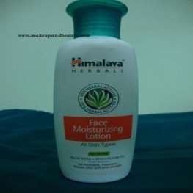
TYPES OF HERBAL LOTIONS
FACE LOTION:
These also called the bleaching lotions actually mask, rather than lighten, the color of skin. Like the whitening creams.
Formula:
Alum 10 parts
Zinc sulfate 1 parts Glycerin 1 parts
Tincture of benzoin 1 parts Essence of rose 30 dropsa

Slide 32
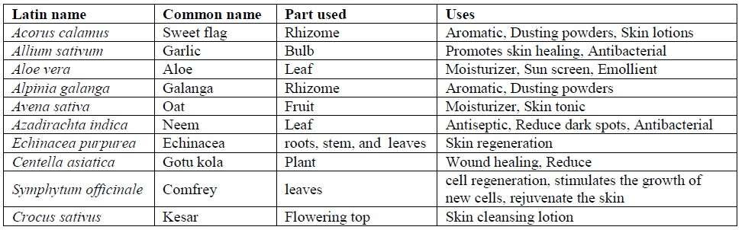
HERBS FOR SKIN

Slide 33
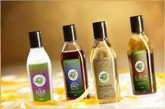
TYPES OF HERBAL HAIR CARE
HAIR OIL: ^{PRODUCTS}
The hail oils used for dressings and nourishing the hairs and grace to appearance of hairs.
This preparations is generally used to increase the growth of hair and remains healthy. Hair oil should have following properties:
They should give lustre to the hair.
Retain them soft and flowing.
Invigorate their growth.
Keep the brain cool.
Should not be sticky.

Slide 34
QUALITIES OF AN IDEAL HAIR PRODUCT
Protect the hair cuticle.
Cleans without stripping natural oils.
Replace lost protein, moisture, and nutrients.
Condition without weighing down the hair.
Even without porosity and prevent moisture loss.
Smooth abraded cuticle scales.
Prevent intense drying from environment.

Slide 35
HAIR LOTION:
Hair lotion has a stimulating effect upon the hair follicles. They are generally perfumed with oil of rosemary and others ascenes as it posses a good stimulating property.
HAIR COLORANTS:
These are preparations which are used for the coloring of hthe hairs. They enhances the attractiveness of gray hair. They are applied externally on the hair with help of brush.

Slide 36
SHAMPOO:
Herbal shampoos are the cosmetic preparations that with the use of traditional ayurvedic herbs are meant for cleansing the hair and scalp.
They are used for remove surface grease, dirt, and environmental pollutions etc.

Slide 37
FUNCTIONS
Lubrication
Conditioning
Hair Growth
Maintenance of hair colour
Medication

Slide 38
ADVANTAGES OF HERBAL SHAMPOOS
Pure and organic ingredients
Free from side effects
No surfactants (Sodium Laural Sulphate)
No synthetic additives
No animal testing
Earth and skin friendly
No petroleum based ingredients

Slide 39
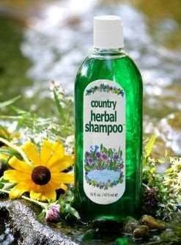
Lime Shampoo
Formula for Lime shampoo
1. Amla | 105 gm
2. Shikakai | 180 gm
3. Khus | 105 gm
4. Char | 100 gm
5. Charilla | 100 gm
6. Reetha | 100 gm
7. Glycerine | 165gm
8. Lime juice | 75ml
9. Sodium Benzoate | 2 gm
10. Water | Q.S. to make 2.50 lit.

Slide 40
REETHA ( SOAPNUT)
Benefits of Reetha
Reetha is a very effective cleansing agent that keeps the scalp gentle and removes any microorganism that may cause infections.
Its natural cleansing agents are more beneficial than other
chemical cleansing agents as they cause no irritation to the scalp.
Its various active components nourish the hair and keep it healthy and smooth.
Reetha adds shine to the hair and brings back the natural texture.
Because of the cleansing properties, you can also get rid of dandruff and lice by using Reetha on a regular basis.

Slide 41
HERBAL HAIR CONDITIONERS
Conditioners that adds shine to the hair and make it tangle free.
After shampooing it’s important to use hair conditioners to give increased manageability to our hair, leaving it soft it soft and shiny.
Conditioning is needed especially for dry, brittle hair and dandruff treatment.
The first and foremost purpose of conditioners is to moisturize the hair and scalp.

Slide 42
HAIR DARKENERS
It is the preparations which are used to colour hairs.
So many synthetic preparations available in the market, but it has various side effects like skin irritation.
With the use of herbal hair darkeners we can produced desirable colour having no side effects.
Various herbal preparations are available in the market which darkens the hairs.
The herbal preparations not only darkens the hair but it act as the hair tonic
which make hairs healthy and shiny.
Various natural products used for this like Henna, Amla, Reetha etc.
This herbal products is also used in the combinations.

Slide 43
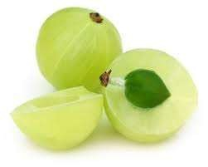
AMLA
It is a fresh and dried fruit of Emblica Officinalis belonging to family
Euphorbiaceae.
It is deciduous tree found in deciduous forest.
In India often cultivated in UP, Gujrat, Rajasthan and Maharashtra.
It is tri-carpellary globose drupe with fleshly edible.(seed inside the fruit)
Its colour is green when unripe but turns yellow on ripening.
The surface of fruit is smooth and shiny
with six vertical furrows.
The taste is sour and astringent.

Slide 44
CHEMICAL CONSTITUENTS
Amla contains about 5-6 % Tannins (gallic acid, ellagic acid and phyllembelin).
It is rich source of natural Vitamin C.
It is destroyed on heating and drying in sun.
It is also reach source of pectin and minerals like phosphorus, iron and calcium.

Slide 45
USES
Amla has various uses like,
Antifungal
Antibacterial
Antiviral
Antioxidants
It is used in the herbal preparations like
Hair dyes
Hair conditioners
Hair Shampoos
Hair Tonic
1. • Amla is used in the form of fresh juice of the pulp, aqueous extract as well as its oil.

Slide 46
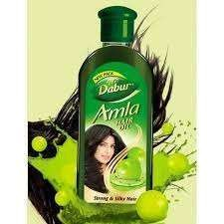

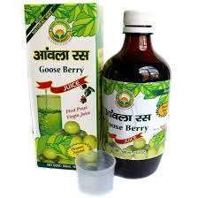
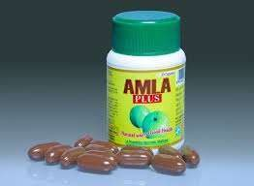
Marketed Preparations
Amla Hair oil
Amla Candy
Amla Juice
Amla Capsule

Slide 47
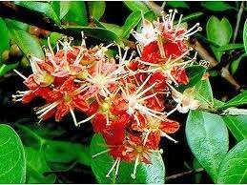
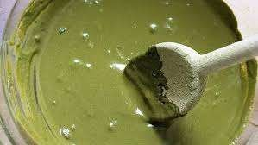
HENNA
Henna is consist of dried leaves of Lawsonia inermis
belonging to family Lythraceae
It is cultivated as garden plant throughout the India.
Flowers are numerous, small with rose coloured fragrance.

Slide 48
CHEMICAL CONSTITUENTS
The leaves contains soluble matter lawsone.
This quinone dissolves in alkaline solution to give an intence red colour.
Henn leaf also contains flavonoids, coumarins and xanthones.

Slide 49
COSMETIC USE
It is used in cosmetic preparation in many ways as colouring and cosmetic ingredients.
It has been used as a hair colour, nail colour and decoration purpose.
The drug is widely used in cosmetology for its dyeing properties due to strong binding property of lawsone to hairs.
It is also used in the form of shampoo and hair lotions.
Henna is used in ayurvedic preparation for the treatment of skin ailments, burns and wounds.

Slide 50
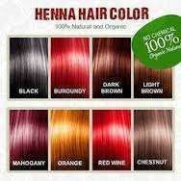
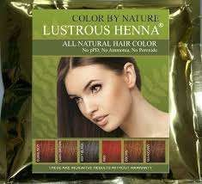
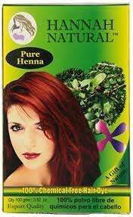
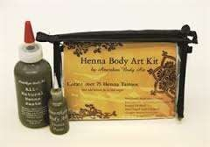
MARKETED PREPARATIONS

Slide 51
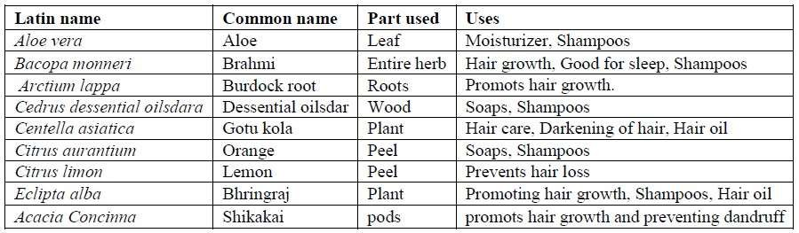
HERBS FOR HAIR

Slide 52
HERBALS USED IN DENTIFRICE
Definition:
Dentifrice are the preparations intended for use with a toothbrush for the purpose of cleaning the accessible surfaces of teeth.
They have been prepared in paste, powder and to a lesser extent in liquid and block form.

Slide 53
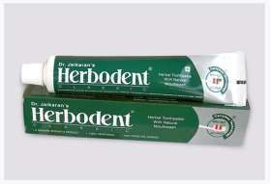
Formula:
Soap powder 7.2 parts Saccharin 0.24 parts Amaranth (solution) 1.0 parts Oil of cinnamon 0.6 parts
Oil of peppermint 0.6 parts Oil of clove 1.2 parts Alcohol 90 parts
Distilled water 120 parts

Slide 54
Characteristics of dentifrices:
It reduces the incidence of tooth decay.
Helps to maintaining the gingivae.
Reduces the intensity of mouth odours.
Good dental health increases the possibility of good general health, leading secondary result of
cleaning teeth.

Slide 55
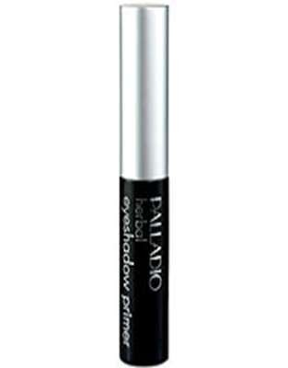
HERBAL EYE SHADOW
Eye shadows are used to give a background of colour to
the eye.
Various shades of eye shadows are available in market e.g. blue, green, brown.
Eye shadows may be either in solid form or in liquid paste form.

Slide 56
Quality characteristics of eye shadow are:
They should have good skin adhesion and should be easy to apply.
They should not show oily luster after application.
They should be non-irritant and safe.
Formula:
Parsley Vegetable oil
1 parts
4 parts

Slide 57
GUIDELINES FOR USING HERBS
Stop taking an herb if any side effect develops such as allergy,
stomach upset, skin rash or headache.
Purchase standardized herbal products.
Herbal products are not recommended for:
Pregnant or lactating women
Infants or children under 05 years of age

Slide 58
EVALUTIONS OF THE FINISHED PRODUCT
The finished product should be standardized in terms of:
Shelf life
Colour
Toxicity studies
Biological assay
Skin irritation test
Sensitization test
Patch test

Slide 59
STORAGE OF HERBS
Herbs should be stored in cool and dry place.
Moisture can damage the herbs.
Also moisture promotes bacterial and fungal growth.
Dried herbs should be stored in air tight container.
Herbs should not be stored in direct sunlight.

Slide 60
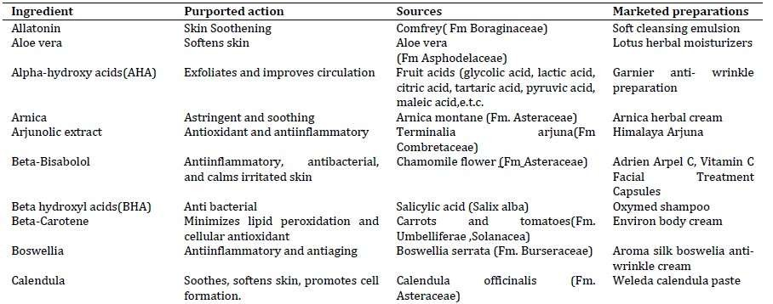
SELECTED HERBAL ACTIVE INGREDIENTS

Slide 61
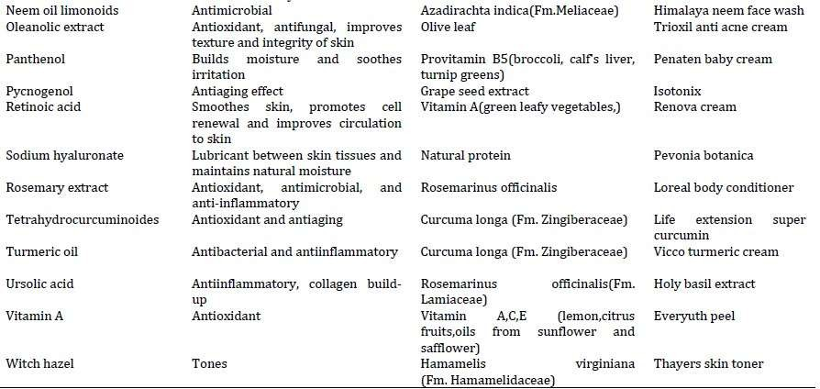

Slide 62
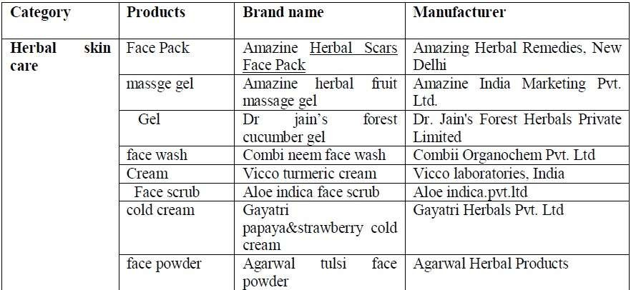
SOME MARKETED HERBAL PRODUCTS

Slide 63
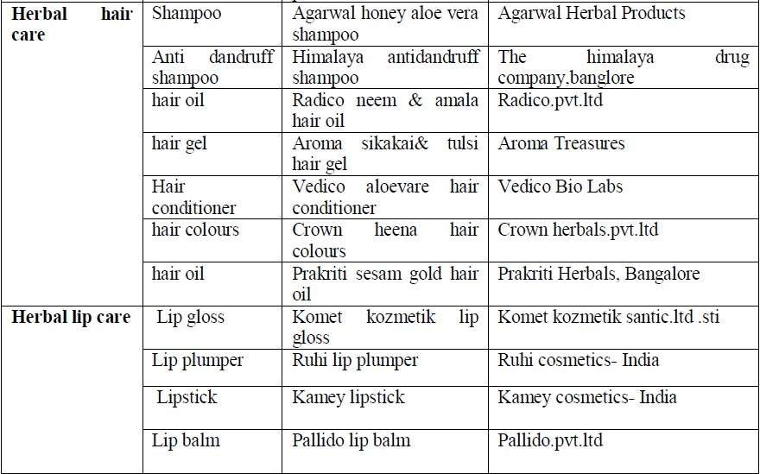

Slide 64
REVIEW OF GUIDELINES FOR HERBAL COSMETICS BY PRIVATE BODIES LIKE COSMOS.
With respect to preservatives, emollients, foaming agents, emulsifiers and rheology modifiers.

Slide 65
COSMOS - INTRODUCTION
COSMetics Organic and natural Standard
Sets certification requirements for organic and natural cosmetics products in Europe.
The standard is recognized globally by the cosmetics industry.

Slide 66
In 2002 five European organisations responsible for setting organic and natural cosmetics standards met at a trade show to share ideas for broader standards to be used globally.
These five COSMOS members are:
BDIH (Germany)
Cosmebio (France)
Ecocert Greenlife SAS (France)
ICEA (Italy)
Soil Association (Great Britain)

Slide 67
To stimulate processes for sustainable production and consumption, the organic and natural cosmetics sector is using some simple rules governed by the principles of prevention and safety at all levels of the chain from production of raw materials to the distribution of finished products.
These rules are:
promoting the use of products from organic agriculture, and respecting biodiversity.
using natural resources responsibly, and respecting the environment.
using processing and manufacturing that are clean and respectful of human health and the environment.
integrating and developing the concept of "Green Chemistry".

Slide 68
THE DOCUMENTS PUBLISHED WITH THE STANDARD INCLUDE:
The Control Manual: Describes how the control
systems works
The Labelling Rules: Explains how to use COSMOS labels
The Technical Guide: Additional information

Slide 69
This Standard applies to cosmetic products marketed as organic or natural and cosmetic ingredients with organic content. To be certified these products must comply with the defined criteria on:
Origin and processing of ingredients
Composition of total product
Storage, manufacturing and packaging
Environmental management
Labelling and communication
Inspection, certification and control.

Slide 70
ORIGIN AND PROCESSING OF INGREDIENTS
Ingredients
Water
Minerals and ingredients of mineral origin
Physically processed agro-ingredients
Chemically processed agro-ingredients
Other ingredients.
Calculation rules for natural origin percentage
% natural origin of total = [weight of total product – weight of non- natural origin ingredients (appendix V.1) – weight of petrochemical moieties (appendix V.3) / weight of all ingredients] x 100.

Slide 71
INSPECTION, CERTIFICATION AND CONTROL
To be certified for cosmetic ingredients or for cosmetic ingredients or cosmetic products under natural or organic certification according to this Standard, it is required to:
Have subjected the manufacturing operation and the ingredients or products to inspection and certification by an authorized certification body; this includes any subcontracted manufacturing plants that are used to process the ingredients or products.
Hold a valid operational certificate from that body.

Slide 72
3. undergo an on-site annual inspection cycle which may include possible unannounced inspections and other additional inspections, and
4. allow the certification body to take samples and carry out analysis using laboratories conforming to ISO/IEC 17025 for ingredients or contaminants either on a random basis or in case of suspicion.

Slide 73
APPROVAL OF INGREDIENTS
To be certified for cosmetic ingredients or cosmetic products under natural or organic certification according to this Standard, it is required to:
have subjected the manufacturing operation and the ingredients or products to inspection and certification by an authorised certification body; this includes any sub- contracted manufacturing plants that are used to process the ingredients or products hold a valid operational certificate from that body.

Slide 74
undergo an on-site annual inspection cycle which may include possible unannounced inspections and other additional inspections, and
x allow the certification body to take samples and carry out analysis using laboratories conforming to ISO/IEC 17025 for ingredients or contaminants either on a random basis or in case of suspicion.

Slide 75
Certification bodies Bodies certifying to this Standard must:
› be (associate) members of the COSMOS-standard AISBL.
› be accredited to ISO/IEC Guide 65 (for any scope).
› be authorised according to the requirements set out in the COSMOS standard Control Manual.
› submit to annual authorisation according to the COSMOS- standard
Control Manual including any investigations that may be undertaken
in case of complaint or suspicion.

Slide 76
GUIDELINES WITH RESPECT TO PRESERVATIVES:
› Cosmetic preservatives allowed by Ecocert and COSMOSare considered more skin friendly than some traditional preservatives.
› Most are naturally occurring in botanicals and so are considered by the certifying bodies to be suitable for products marketed as natural.
According to the latest Ecocert and COSMOS standards the following preservatives are allowed in cosmetic products certified as Natural and Organic.

Slide 77
REGULATIONS FOR EMOLLIENT
Commericial Name / Non Commercial 1,3-Butylene glycol Acai oil
Acide stearique tp18/55 Acitire
Activonol -3 akogel
Adeps lanae type sp PHEur
Aecosil
Emollient Examples
Decyl glcoside
Eutrepe oleracea fruit oil Palmitic and stearic acid Jojoba esters
propanediol
Hydrogenated vegetable oil Lanolin
Glyceryl olivate Estolides

Slide 78
GUIDELINES FOR FOAMING AGENT:
Commercial name
PALMEROL 1299 - Lauryl Alcohol – RSPO SCC Mass Balance (MB)
PALMEROL 1299 - Lauryl Alcohol
PALMEROL 1498 - Myristyl Alcohol – RSPO SCC Mass Balance (MB)
PALMEROL 1498*
Chemical name
Lauryl Alcohol
Lauryl Alcohol Myristyl Alcohol
Myristyl Alcohol

Slide 79
REGULATIONS FOR EMULSIFYNG AGENTS
COMMERICAL NAME/ NON COMMERICAL
EMULSIFIER
Akoline PGPR ALBIWAX
Cholestrol BP
Cosphaderm GMUD undecylenate
CremerGLYC Refined glycerine.99.75%
Axol C62 pellet
citrate
Dermofeel NC citrate0
Cholestrol EP
Cetearyl alochol Prunus armeniaca Chloestrol Glyceryl
Glycerin
Glyceryl stearate
Glyceryl stearate
Cholestrol

Slide 80
THANK
YOU

