Slide 1
DNA
DO Now:
  What is DNA?
  What is it used for?
  Why do we need it?

Slide 2
WHAT IS IT?
DNA = Makes up genes for all living things.
What are genes??
  Blueprints for us!!
Genes are parts of DNA that code for particular traits or proteins.

Slide 3
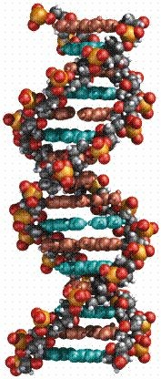
□ Deoxyribonucleic Acid (DNA)
DNA
□ Dee-oxy-ribo + nuke-lay-ick +Acid

Slide 4

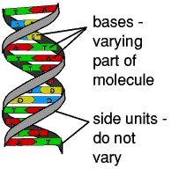
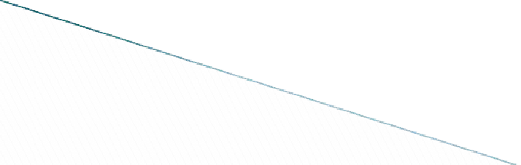
DNA Structure
□ “Double Helix” shape

Slide 5
DNA is made up of Nucleotides
Nucleotides are the basic units of DNA
Recognize the similarities between the terms:
  Nucleotide
  Deoxyribonucleic acid
  nucleus.

Slide 6
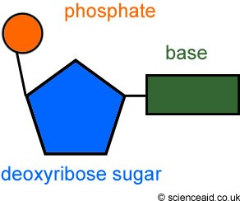
Structure of a nucleotide
A nucleotide is made of 3 components:
A Phosphate
A Nitrogen Base
A Sugar
  The sugar in DNA is deoxyribose.
    (Deoxyribonucleic acid)

Slide 7
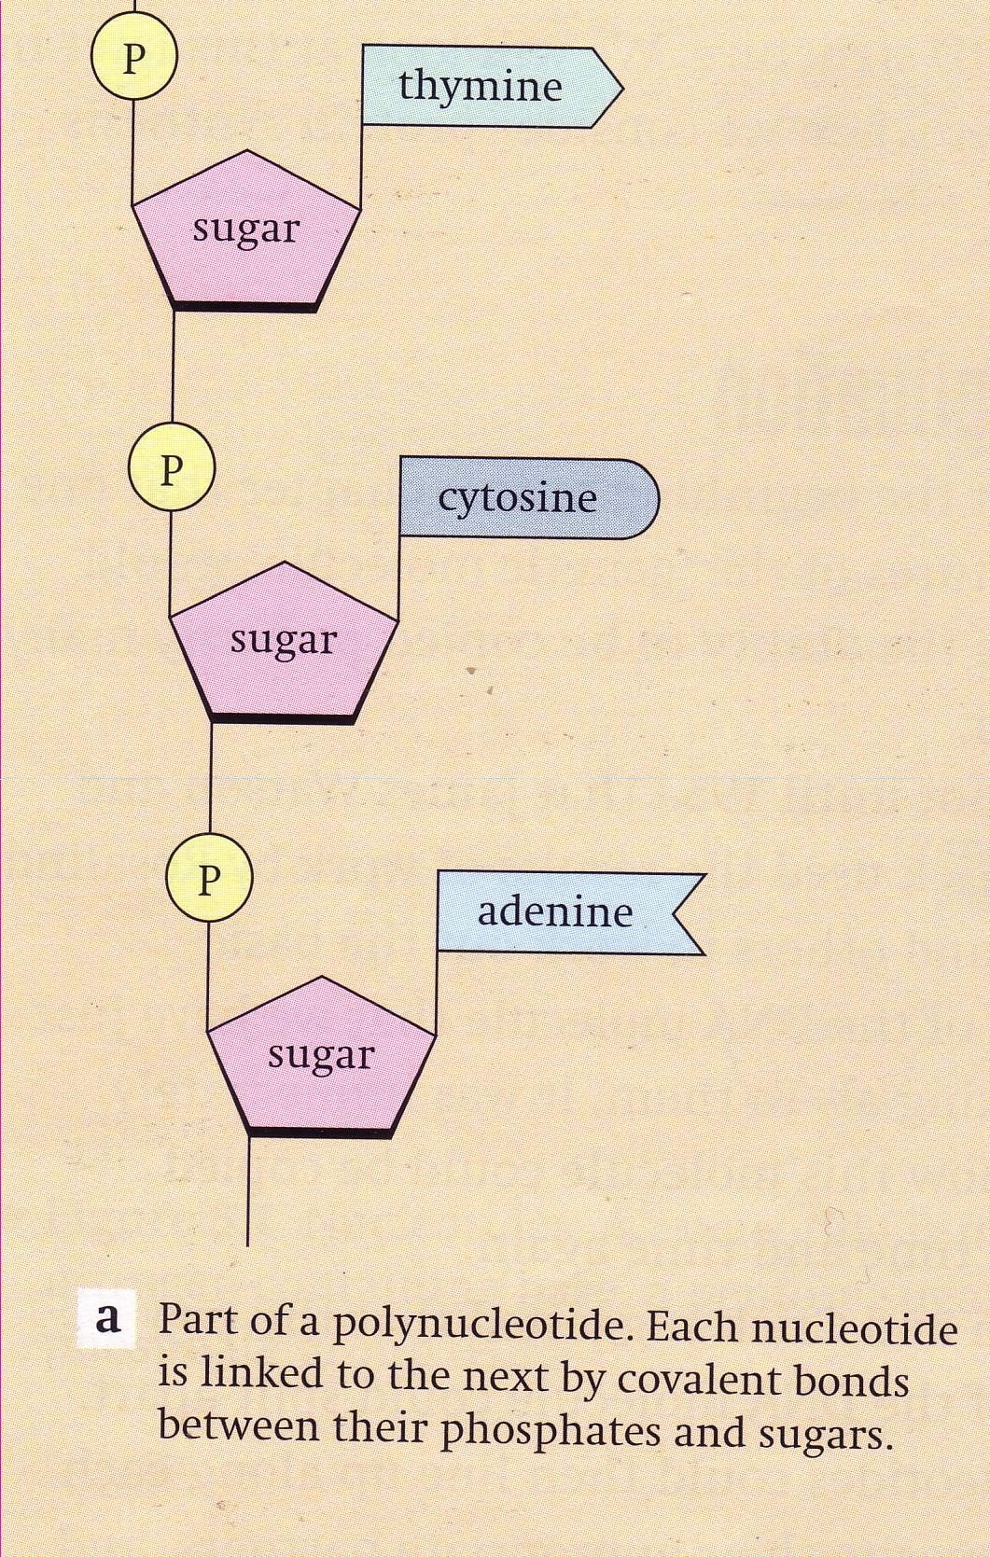
DNA NITROGEN BASES
Four bases are:
  Thymine
  Adenine
  Cytosine
  Guanine

Slide 8
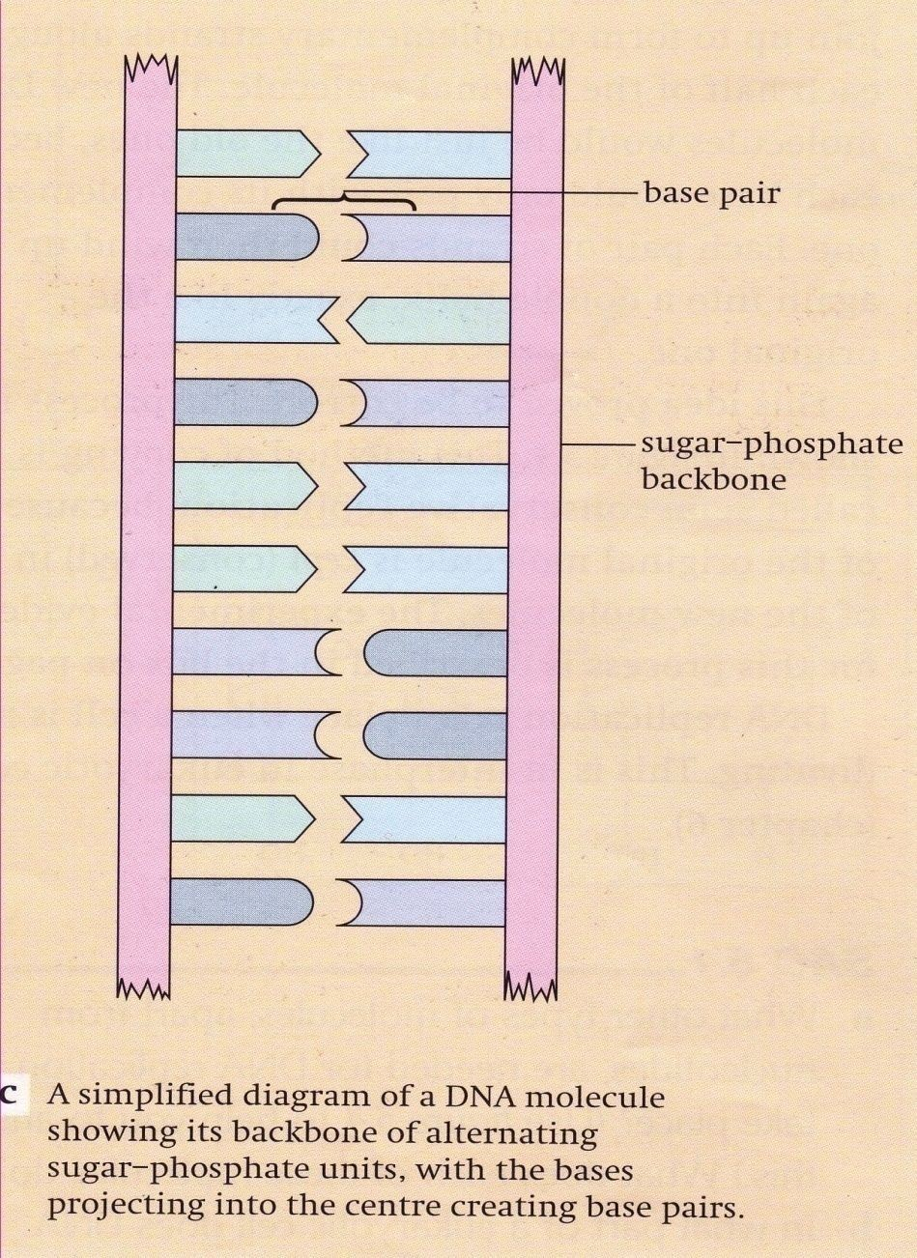
Base pairing
The Bases pair up with bases on another strand
A group of 3 bases is called a “codon.” Codons code for amino acids.

Slide 9
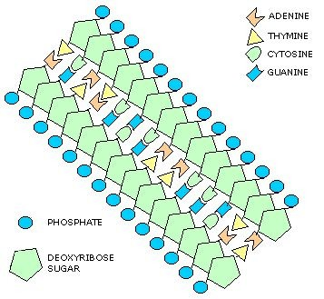
The Rule:
Adenine (A) always pairs with Thymine (T)
Cytosine (C) always pairs with Guanine (G)

Slide 10
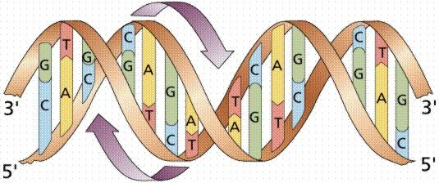

Slide 11
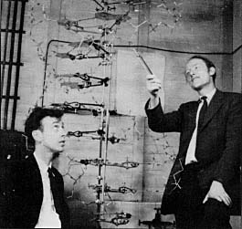
James Watson (L) and Francis Crick (R), and the model they built of the structure of DNA

Slide 12
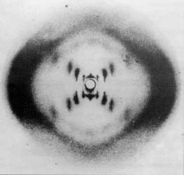
X-ray diffraction photograph of the DNA double helix

Slide 13
Review of DNA
What is the general structure of DNA?
  Double Helix
What composes the DNA “backbone” or side pieces?
  Deoxyribose (sugar) & Phosphate
What is the name of the 3-part unit of DNA called?
  Nucleotide
What is each nucleotide made of?
  Sugar (Deoxyribose)
  Phosphate
  Nitrogen Base
What are the bases?
  Adanine, Thyamine, Cytosine, Guanine
What bases pair with each other?
  A+T
  C+G
What is a Codon?
  A group of 3 bases (codes for an amino acid)

Slide 14
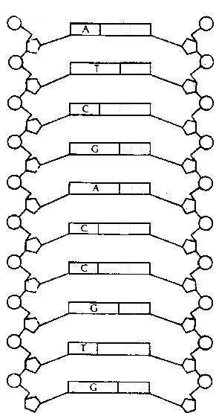

Slide 15

RNA

Slide 16
What is RNA?
□ Ribonucleic Acid

Slide 17
Structure
Created from DNA replication
Single-strand
Uracil base instead of Thyamine base
Ribonucleic acid
  Uses ribose instead of deoxyribose

Slide 18
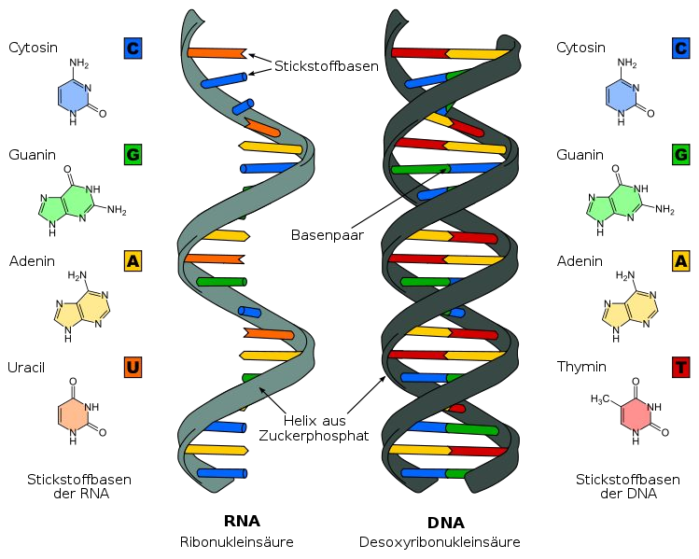

Slide 19
What is RNA used for?
□ Protein Synthesis

Slide 20
Types: mRNA & tRNA
“Messenger” RNA is used to send messages from DNA to be used elsewhere (e.g. create proteins for hormones, repair cells, help the immune system, etc.)
“Transfer” RNA uses “anticodons” to put amino acids in the correct order of mRNA codons

Slide 21
Protein Synthesis using RNA?
Protein Synthesis = Making proteins
Examples include: Hormones, Enzymes, Cell parts, Immune response, etc.
Two steps are involved: Transcription & Translation

Slide 22
Transcription and Translation
What does it mean to Transcribe?
  Hint: Trans + Scribe “To re-write” or “To copy”
What does it mean to Translate?
  Hint: Trans + Late
“To determine” or “to decipher”

Slide 23
Transcription vs. Translation
The majority of genes are expressed as the proteins they encode. The process occurs in two steps:
  Transcription = DNA → RNA
  Translation = RNA → protein

Slide 24
Transcription
DNA> RNA
  DNA is “unzipped” and new nucleotides are added to one side (creates mRNA)
This is the template to be read later
Occurs in the nucleus

Slide 25
Steps of Transcription
Enzymes unzip the DNA molecule
Free RNA nucleotides pair with their complimentary DNA base pairs
  If a DNA sequence were AGC TAA CCG, the RNA bases would be UCG AUU GGC
When base pairing is complete, the mRNA molecule breaks away
the DNA strand rejoins
mRNA leaves the nucleus and goes to the ribosome.

Slide 26
Translation: mRNA → Protein
Occurs in the Ribosome
Codons from mRNA code for different amino acids and are “read” to create and assemble the protein
  tRNA uses “anticodons” to deposit the amino acids in the correct order
Amino Acids are the building blocks of Proteins
*See handout for codons and AA’s

Slide 27
Start/Stop Codons
Not all codons code for an amino acid. Some contain instructions instead (start/stop)
Stop codon: indicates that protein production stops at that point
  UAG, UAA, and UGA

Slide 28
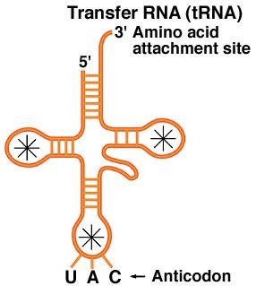
tRNA (legos)
□ tRNA brings the appropriate amino acid to the mRNA
□ Anticodon: a series of 3 nucleotides that are the compliment of the codon
Each anticodon has its specific amino acid
  See chart

Slide 29
Translation
1) mRNA enters the Ribosome
2) tRNA attempts to bind to to complimentary codon on the mRNA
  If it “fits” the tRNA’s protein is deposited and the tRNA leaves

Slide 30
Translation continued..
4) Strands of deposited amino acids create a protein
5) When the “stop” codon is reached (UAG) the process is finished.

Slide 31
Protein Synthesis Summary
Requires mRNA & tRNA
Transcription= DNA>RNA
  mRNA leaves the nucleus and travels to a ribosome
Translation= RNA>Protein
  A Ribosome “reads” the mRNA codons (groups of 3 bases) and pairs the codons with anti-codons (complimentory codons) with amino acids attached
The amino acids are linked to form a protein

Slide 32
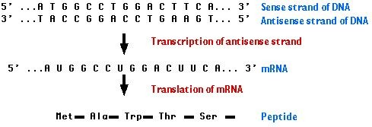
Here is an overview.

Slide 33
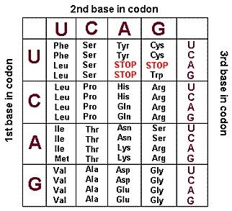
□

Slide 34
Recall differences of RNA and DNA
RNA is single stranded while DNA is double
RNA sugar is ribose. DNA sugar is deoxyribose
RNA contains the nitrogen base uracil (U) in place of DNA’s thymine (T)

Slide 35
DNA REPLICATION

Slide 36
REPLICTION OF DNA Chromosomes
Occurs when cells multiply
Copies the entire DNA strand

Slide 37
Partial or complete replication?
Replication of a portion of DNA= protein Synthesis
Replication of an entire strand of DNA= replication of Chromosomes

Slide 38
Replication Steps
DNA “unzips” like in the first step of transcription
As the DNA unzips, the nucleotides are exposed
Free nucleotides base pair with the exposed nucleotides
  If a nucleotide on the strand is a thymine, the free nucleotide that pairs with it would be adenine

Slide 39
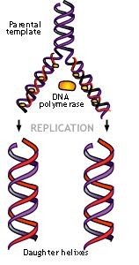
Replication Cont.
Results in two molecules of DNA.
New DNA consists of:
  One original strand
  One new strand

Slide 40




DNA Replication
http://youtu.be/hfZ8o9D1tus

Slide 41
DNA Replication…to be continued…..
Why would cells need to replicate?
What kind of cells would need to be produced for YOU to survive AND reproduce?

