Slide 1
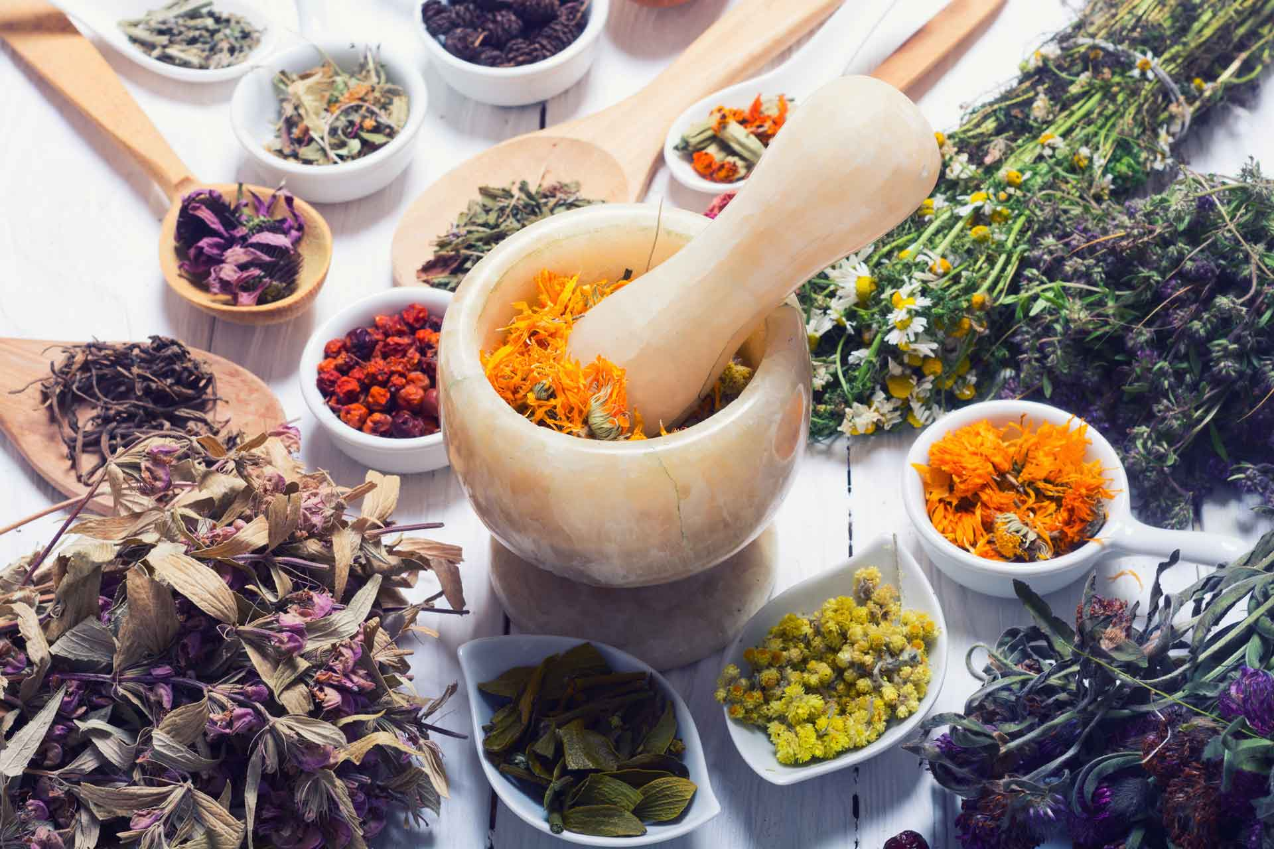
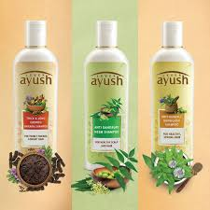
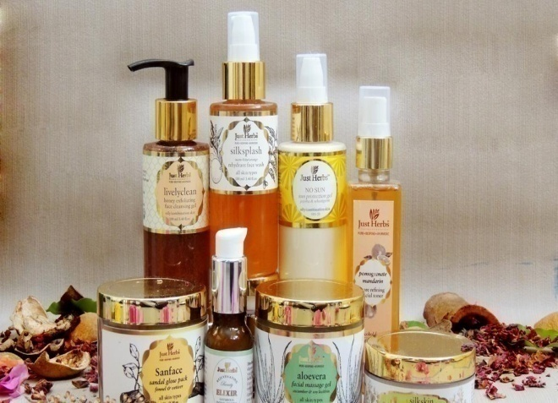
Cosmecuiticals
Mrs. Bharati M. Sonawane
Department of Pharmacognosy
Loknete Dr. J. D. Pawar College of Pharmacy, Manur. Kalwan.

Slide 2
Introduction:
The concept of beauty and cosmetics is as ancient as mankind and civilization. Women are obsessed with looking beautiful. So, they use various beauty products that have herbs to look charming and young. Indian herbs and its significance are popular worldwide. An herbal cosmetic have growing demand in the world market and is an invaluable gift of nature.
Herbal formulations always have attracted considerable attention because of their good activity and comparatively lesser or nil side effects with synthetic drugs. Herbs and spices have been used in maintaining and enhancing human beauty. Indian women have long used herbs such as Sandalwood and Turmeric for skin care, Henna to color the hair, palms and soles; and natural oils to perfume their bodies.

Slide 3
Tulsi (Ocimum sanctum)
Holy basil, called Tulsi in India, is ubiquitous in Hindu tradition. Perhaps its role as a healing herb was instrumental in its "sacred" implication.
Ghritkumari (Aloe vera)
It is a most ingenious mixture of an antibiotic, an astringent coagulating agent, a pain inhibitor and a growth stimulator (also called a "wound hormone"), whose function is to accelerate the healing of injured surfaces .
It is used for pain relief and healing of 'hemorrhoids, applied externally and internally it is also used for sunburn, scratch and a cleansing purge for the body or skin.

Slide 4
Multani Mitts (Fullers Earth)
Clay was one of the earliest substances to be used as a beauty mask to draw oils from the skin, natural moisturizers for hairs, teeth, gums and hair. To remove pimple marks, treating sunburn, helps unclog pores, to cleanse the skin of flakes and dirt.
Almond Oil
The almond oil is obtained from Prunus dulcis. Basically it contains about 78% of this fat. This oil contains very small amounts of super-unsaturated Omega-3 essential fatty acids. It proves to be very nourishing, and softens and strengthens the hair. The almond oil also proves to be a very good cleansing agent. Almond oil has been used for many centuries, even before it's spread as a commercial agro-product.

Slide 5
Henna
Henna comes from the plant, Lawsonia inermis family Lythraceae, which contain a dye molecule called Lawsone, which when processed becomes Henna powder. Henna has a natural affinity with the proteins in our hair, making it able to “stain” the colour onto the hair shaft.
Turmeric
Turmeric, Curcuma longa is a rhizomatous perennial plant of the ginger family Zingiberaceae. Turmeric is used in many celebrations of Hindus. Traditionally women rub turmeric on their cheeks ton produce a natural golden glow.

Slide 6
Advantages of Herbal Cosmetics over Synthetic:
Herbal cosmetics are the modern trend in the field of beauty and fashion.
These agents are gaining popularity as nowadays most women prefer natural products over chemicals for their personal care to enhance their beauty as these products supply the body with nutrients and enhance health and provide satisfaction as these are free from synthetic chemicals and have relatively less side-effects compared to the synthetic cosmetics.
Safe to use : Compared to other beauty products, natural cosmetics are safe to use. They are hypo-allergenic and tested and proven by dermatologists to be safe to use anytime, anywhere. Since they are made of natural ingredients, people don’t have to worry about getting skin rashes or experience skin itchiness.

Slide 7
Compatible with all skin types: Natural cosmetics are suitable for all skin types.
Wide selection to choose from: Natural cosmetics may still be a new type in the beauty industry but they already offer a variety of beauty products for all make up crazy people out there to choose from.
Fits your budget: Natural cosmetics are not that expensive. In fact, some of these products are more affordable than synthetic ones. An estimate of WHO demonstrates about 80% of world population depends on natural products for their health care, because of side effects inflicted and rising cost of modern medicine.

Slide 8
Cosmecuiticals
Mrs. Bharati M. Sonawane
Department of Pharmacognosy
Loknete Dr. J. D. Pawar College of Pharmacy, Manur. Kalwan.

Slide 9
COLD CREAM:
Cold cream produces cooling effect because slow evaporation of water present in the emulsion.
In olden days the cold cream was prepared from animal fats & vegetable oils but
Vegetable oils: rancid so replaced by mineral oils which gives more stable product.
Mechanism of action on skin:
o/w type of emulsion but after application on skin, sufficient water evaporates to permit phase inversion to w/o type.

Slide 10
Formulation:
Formula 1
•Bees wax ---- 5%
•Liquid paraffin ---- 45%
•White soft paraffin----10%
•Hard paraffin---- 7%
•Borax---- 0.2%
•Water---- 32.8%
•Perfume---- q.s
Formula 2
•Bees wax ---- 16%
•Liquid paraffin ---- 50%
•Borax---- 0.8%
•Water---- 33.2%
•Perfume---- q.s

Slide 11
General procedure
Weigh all ingredients in required qty.
Melt the wax and other things in their decreasing order of m.p. on water bath.
Dissolve borax in water at 70-750C.
Add both phase together i.e. oil & water.
Add required qty of preservative & perfume.
Transfer the cream to container while hot.
•Storage:
–Stored in a well closed container at a temperature not exceeds 250C.
–Stored in a cool place.

Slide 12
Evaluation parameters
–Consistency (viscosity)
–Skin irritation test
–Net content in the container
–Test for microbial growth
–Rancidity
–Color & physical appearance test
Marketed Products
Pond’s cold cream
Ayur herbal cold cream
Emani cold cream
Aloe vera cold cream

Slide 13
VANISHING CREAMS:
Creams spread easily & seem to disappear rapidly when rubbed on skin are termed as vanishing creams.
These are an o/w type of emulsions which when applied to the skin leave an almost invisible layer on it so called vanishing creams.
These creams can be quickly washed off with water due to the presence of o/w emulsifiers.
These creams are prepared by emulsification of stearic acid & water by means of alkalies like NaOH, KOH, borax, triethanolamine etc..
Synonym: greaseless cream
An oil-in-water emulsion containing potassium, ammonium, or sodium stearate with water and holding in emulsified form more or less free stearic acid.

Slide 14
Formulation:
Stearic acid ---- 20%
Cetyl alcohol ---- 0.5%
Triethanolamine ----1.2%
NaOH ---- 0.36%
Glycerin ---- 8%
Water ---- 69.94%
Preservative ---- q.s.
Perfume ---- q.s.
Procedure:
–Weigh all ingredients & heat or melt Istpart ingredients (from 1to 3) in a container
–Heat or melt IIndpart ingredients in a beaker
–Add IIndpart mixture to Istpart with continuous stirring
–Cool with continuous stirring
–Add perfume when tempt. is about 350C.
–Mill it (uniform mixing)

Slide 15
Storage:
–Stored in a well closed container at a temperature not exceeds 250C.
–Stored in a cool place.
Evaluation of vanishing creams:
–Rheology or viscosity
–Skin sensitivity or patch test
–Net content
Marketed Products:
–Lakme,
–Max-factor,
–Ponds,
–Charmis.

Slide 16
Anti-wrinkle cream:
Formulation:
Green Tea extract A.P.I 4ml
Neem Oil A.P.I 4ml
Eucalyptus Oil A.P.I 4ml
Jamul Powder A.P.I 2gm
Glycerine Moisturizer 2ml
Propylene Glycol Moisturizer + Binder 2ml
Zinc Oxide Skin Whitener 1gm
Micro Crystalline Cellulose Polymer - - 4gm
Bees Wax Base 2gm
Sodium Benzoate Preservative 2gm
Olive Oil Vitamin-A Source 2ml
Lemon grass oil Flavouring Agent 4ml
Purified water Vehicle Q.S

Slide 17
Procedure:
Binders and polymers is added to glycerine, water mixture in porcelain dish.
This forms liquid dispersion and shows slightly swelling property.
This liquid dispersion added to green tea extract and jamul powder.
Melt oils along with base in different china dish.
To this mixture green tea extract mixture is added.
Finally skin whitener and preservatives are added.
Triturate all above ingredients.
Herbal anti wrinkle cream in required consistency is formed.

Slide 18
Cosmecuiticals
Mrs. Bharati M. Sonawane
Department of Pharmacognosy
Loknete Dr. J. D. Pawar College of Pharmacy, Manur. Kalwan.

Slide 19
Evaluation of Herbal Creams:
Organoleptic evaluation: The cream thus obtained was evaluated for its organoleptic properties like color, odor, and state.
Test for microbial growth in formulated creams: The formulated creams were inoculated on the plates of agar media by the streak plate method and a control was prepared by omitting the cream. The plates were placed into the incubator and are incubated at 37 0C for 24 hours. After the incubation period, plates were taken out and check the microbial growth by comparing it with the control.
Stability studies: To assess the drug and formulation stability, stability studies were done according to ICH guidelines. The stability studies were carried out as per ICH guidelines. The cream filled with bottle and kept in humidity chamber maintained at 30 ± 2 °C/ 65 ± 5 % RH and 40 ± 2 °C / 75 ± 5 % RH for two months. At the end of studies, samples were analyzed for the physical properties and viscosity.

Slide 20
pH of the Cream: The pH meter was calibrated using standard buffer solution. About 0.5 g of the cream was weighed and dissolved in 50.0 ml of distilled water and its pH was measured.
Spreadability: It is expressed in terms of time in seconds taken by two slides to slip off from the formulation, placed between, under the application of a certain load. Lesser the time taken for the separation of the two, better the spreadability.
Spreadability = m×l /T
m = weight tied to the upper slide (30g),
l =length of glass slide (5cm),
t =time taken in seconds.
Viscosity: Viscosity of the formulation was determined by Brookfield Viscometer. The viscosity measurements were done using Brookfield DV-II + Viscometer using LV4spindle. The developed formulation was poured into the adaptor of the viscometer and the angular velocity increased gradually from 0.5 to 20 rpm

Slide 21
Microbial Test: When formulation was tested for growth of microbes, it was found that there is growth of microbes within the prescribed limit. So these formulations are safe to use for skin.
Stability Studies: When formulation was subjected for long term stability studies, i.e. for about a period of 2 months, it was found that there is no change in properties of cream like pH, color and viscosity.
Irritancy test: Mark an area (1sq.cm) on the left hand dorsal surface. The cream was applied to the specified area and time was noted. Irritancy, erythematic, edema, was checked if any for regular intervals up to 24 hrs.
Appearance: When formulation was kept for a long time, it was found that there is no change in organoleptic properties of cream.

Slide 22
Bleeding test: This test is specially done for semisolid preparations. Preparation is kept alternatively in fridge and at room temperature. If there is bleeding the liquid phase comes out of preparation then it is not stable. If there is no bleeding in preparation then it called as stable at climatic conditions.
Patch test: It is also called as sensitivity test. Product is applied on rabbit skin. If there is no inflammation or rashes then it is free from sensitivity.

Slide 23
Cosmecuiticals
Mrs. Bharati M. Sonawane
Department of Pharmacognosy
Loknete Dr. J. D. Pawar College of Pharmacy, Manur. Kalwan.

Slide 24
Lipstick:
Formulation:
1.Bees wax 1gm
2.Coconut oil 1.5ml
3.Olive oil 1ml
4.Castor oil 1gm
5.Edible colouring matter 2gm
like cinnamon bark powder,
coca powder, turmeric powder
6. Vanilla essence 5-6drops
7. Rose essence 3drops
8. Lemon juice 2ml

Slide 25
Procedure:
The herbal lipstick was formulated as per general method of lipstick formulation.
In this formulation, white bees wax, butter, coconut oil, olive oil, were melted in porcelain dish on water bath with decreasing order of their melting point.
Edible coloring matter like Cinnamon bark powder, turmeric powder, cocoa powder mixed with Castor oil and heated.
Both phases were mixed at same temperature.
Vanilla & rose essence and lemon juice were added at 35°C.
Then mixture was poured into lipstick mould in excess amount and mould was kept on ice bath.
After solidification surplus amount was scrapped with blade. Lipsticks were removed from mould and flamed.
Prepared Lipsticks were fitted in Lipstick container and used for further evaluation.

Slide 26
Evaluation of Herbal Lipstick:
Colour and Texture: Formulated lipsticks were checked for colour, glossy and smooth texture.
pH: The pH of formulated herbal lipsticks was determined using digital pH meter (Herbal lipstick pH 6.3)
Melting Point: Determination of melting point is an important parameter for lipstick formulation; as it is an indication of the limit of safe storage. The melting point of formulated lipstick was determined by capillary tube method. Approximately 50 mg of lipstick sample was taken and melted and filled into glass capillary tube opened at both ends. Capillary was cooled with ice for 2h and fastened with thermometer. Thermometer with capillary was deep in the beaker containing full of water which was placed on heating plate with magnetic stirrer. Heating and stirring was started slowly at fixed speed. The temperature at which material moves along the capillary tube was considered as melting point.

Slide 27
Breaking Point: This test was carried out to find out the value of maximum load that lipstick can withstand before it break. This test gives strength of lipstick. Prepared herbal lipstick was held horizontally in a socket inch away from the edge of support. The weight was gradually increased by a specific value (10 gm) at specific interval of 30 second and weight at which breaks was considered as the breaking point.
Softening Point: Lipstick should be able to withstand range of conditions to which it will be subjected in the consumer’s handbag. It should be resistant to varying temperature conditions and be just as easy to apply in hot and as in cold weather. Softening point of lipstick was determined by Ring and Ball method.

Slide 28
Ring and Ball method: A ring or support orifice is taken and prepared herbal lipstick was inserted into it. Extra mass above and below the orifice was removed using a sharp blade leaving a tablet of lipstick fitted into the ring. This was placed in refrigerator (6°C) for about 10 min.
Ring was tied onto a stand. A beaker containing 500 mL water at room temperature is placed on a hot plate with magnetic stirrer. A steel ball was delicately placed on the lipstick tablet.
The bar with support was then inserted into the beaker till it submerged into it. Heating and slow agitation was then begun. Temperature was monitored using a thermometer.
The temperature at which the lipstick mass and steel balls were loosed and falls to the bottom of the beaker was noted as softening point of lipstick.

Slide 29
Surface anomalies: This was studied by the surface defects, such as formation of crystals on surface, contamination by moulds, fungi, formation of wrinkles, exudation of liquid substances and of solid fatty substances, etc.
Aging stability: Prepared herbal lipsticks were stored at refrigerator temperature (4oC), room temperature (20-25oC) and high temperature (30-40oC) for 1h. Various parameters such as bleeding, streaking, catering and blooming were observed.
Perfume stability: The prepared herbal lipsticks were tested after 30 days, to record fragrance.

Slide 30
Cosmecuiticals
Mrs. Bharati M. Sonawane
Department of Pharmacognosy
Loknete Dr. J. D. Pawar College of Pharmacy, Manur. Kalwan.

Slide 31
Lip Balm:
Formulation:
Beeswax 5% Impart Glossiness and hardness
Ghee 2 % Moisturizer
Castor oil 15% Emulsifier
Honey 5% Lighten up the darker lips
Vanillin 0.08% Flavouring agent
Vitamin E 5% Antioxidant, maintain the stability

Slide 32
Procedure:
Weigh all the excipients.
Add ghee, beeswax, castor oil and sunflower oil in beaker and melt it in water bath at 55-600C.
Add honey and vitamin E into beaker and mix vigorously so that honey will not clump.
Add vanillin flavour. Pour the content into the lipstick moulds. Before pouring the mixture in lipstick moulds; on the mould applying glycerine with the help of cotton.
Put the filled moulds into ice bath for 10 min.
Evaluation Parameters:
Melting point: The melting point apparatus used to determine melting point of lip balm.
Organoleptic properties: The lip balm was studied for organoleptic characters such as colour, odour, taste and appearance.

Slide 33
Spreadability: The test of spreadability consisted of applying the product (at room temperature) repeatedly onto a glass slide to visually observe the uniformity in the formation of the protective layer and whether the stick fragmented, deformed or broke during application.
pH: The pH of lip balm was determined in order to investigate the possibility of any side effect. As an acidic or alkaline pH may cause irritation of lips, it was determined to keep the pH of tablet as close to neutral as possible. The pH study was carried out by dissolving 1 gm of sample into 100 ml water. The pH measurement was done using pH meter.
Stability studies: Prepared lip balm was placed for accelerated stability studies at room temperature (25.0 ± 3.0 ºC), refrigeration (4± 2.0 ºC) and oven temperature (40.0 ± 2.0 ºC) for 30 days. After 30 days, it was characterized for organoleptic properties, melting point, spreadability, and pH.

Slide 34
sunscreen lotion:
Formulation:
Distilled water 58% 2.90 gm
Arabic gum 5% 0.25 gm Water phase
Glycerine 5% 0.25 gm
paraffin oil 20% 1.00 gm Oil phase
Beeswax foundation 8% 0.40 gm Emulsifier
ZnO 3.5% 0.18 gm Sunscreen
citric acid 0.5% 0.03 gm Preservative

Slide 35
Procedure:
Both of the water phase and the oil phase are heated separately to 70 °C for 15 minutes. This will destroy any bacteria that may be present in both phases.
ii. The water phase is gradually added to the oil phase with the stirring. Then the solar blocker and the preservative are added with good mixing using vortex.
After cooling the cream pour into a box and close well and covered with a white tissue until the measurement of SPF.
The pH of any cream or lotion can be tested and then pH level will be adjusted with adding citric acid to be pH 6 to 6.5, which is the appropriate pH level for adult skin .

Slide 36
Evaluation Parameter:
Solubility of sunscreen cream: To obtain the best solubility of the prepared samples, a different mixtures of ethanol (polar solvent) and hexane (non-polar solvent) were used. In brief, the best solubility of sunscreen cream is obtained using equal proportions of hexane and ethanol.
pH: The acidity of some samples can be attributed to the use of citric acid as a preservative in the preparative method. Acidification can be adjusted with the addition of a small percentage of sodium bicarbonate while, the basicity can be adjusted with the addition of small amounts of citric acid.
SPF measurements:

Slide 37
Preparation of sunscreen sample for SPF measurements:
200 mg of each sample was weighed, transferred to a 100 mL volumetric flask, diluted to volume with 50% hexane in ethanol and followed by vigorous vortexing. Then, it is filtered through filter paper, rejecting the first 10 mL. A 5.0 mL aliquot was transferred to 50 mL volumetric flask and diluted to volume with 50% hexane in ethanol.
Then a 5.0 mL aliquot was transferred to a 50 mL volumetric flask and the volume completed with 50% hexane in ethanol. The final concentration of each diluted sample is 20 ppm in 50% hexane in ethanol.
The absorption spectra of samples in solution were obtained in the range of 290 to 320 nm using 1 cm quartz cell, and 50% hexane in ethanol as a blank. The absorption data were obtained in the range of 290 to 320 (the range of UVB) every 5 nm.

Slide 38
Calculations of solar protection factor (SPF):
The absorbance of prepared solutions (20 ppm in 50% hexane in ethanol) is measured in the range of 290-320 nm, each time the wavelength range is changed by 5 nm in each measurement. The Mansur mathematical equation is used to calculate the SPF values of the sample.
320nm
SPF = CF * Ʃ EE(λ) * I (λ) *ABS (λ)
290nm
Where: CF is the correction factor (=10); ―EE the erythemal effect of radiation at wavelength λ; ―I the intensity of the solar spectrum; and ―ABS the absorbance at wavelengths 290-320 nm. ―EE, ―I, and ―ABS are values obtained or applied for every wavelength (λ).

Slide 39
Cosmecuiticals
Mrs. Bharati M. Sonawane
Department of Pharmacognosy
Loknete Dr. J. D. Pawar College of Pharmacy, Manur. Kalwan.

Slide 40
Hair care products:
Hair is an integrated system with a peculiar chemical and physical behavior. It is a complex structure of several morphological components that act as a unit. The hair shaft of mammals is divided into three main regions: Cuticle, cortex and medulla. The medulla is present in coarser hair like grey hair, thick hair and beard hair, and it is absent in fine hair of children.
The medulla may be involved in the splitting of hairs since it provides an area of weakness.
The cuticle is a chemically resistant region and consists of flap overlapping scales (keratinocytes) like shingles on the roof. The shape and orientation of the cuticle cells are responsible for the differential friction effect in hair.
The cortex constitutes the major part of the mass of the human hair, and it is formed by elongated, fusiform cells connected by a CMC (cell membrane complex ) and contains protein and melanin granules.

Slide 41
SHAMPOOS:
Shampoos are not only scalp cleaners, but indubitably act as preventing the hair shaft damage. Many scalp diseases are also treated by active ingredients that are added to the shampoo's formulations.
It is desirable that whatever may the disease or condition be (dermatitis, seborrhea, alopecia, psoriasis), the hair strands are kept aesthetically presentable, preserving its softness, combability and shine while treating the scalp.
Shampoos are typically composed of 10–30 ingredients although products with as few as four ingredients are available.
The products are grouped into: Cleansing agents; additives that contribute to the stability and comfort of the product; conditioning agents, intended to impart softness and gloss, to reduce flyaway and to enhance disentangling facility, and special care ingredients, designated to treat specific problems, such as dandruff and greasy hair.

Slide 42
CONDITIONERS:
Conditioners are used to decrease friction, detangle the hair, minimize frizz and improve combability.
Conditioners act by neutralizing the electrical negative charge of the hair fiber by adding positive charges and by lubricating the cuticle that reduces fiber hydrophilicity.
They contain anti-static and lubricating substances that are divided into 5 main groups: Polymers, oils, waxes, hydrolyzed aminoacids and cationic molecules.
Functions of the conditioners are:
Improve combability
Mimetize the hair natural lipid outer layer: 18-MEA
Restore hydrophobicity
Seal the cuticle
Avoid or minimize frizz, friction: Neutralize the negative charged net
Enhance shine, smoothness and manageability.

Slide 43
HAIR DYES:
There are many types of hair dyes classified according to the penetration of the dye to the surface or to deep parts of the hair shaft. In this chapter, we will approach the two most used types of hair dyes: Semi-permanent and permanent dyes.
Permanent hair colors are the most commonly used hair colors, because of their longevity, and ability to lighten the original darker color. These are also superior for gray or white cover.
The pigmentation is permanent and the white hair that shows after 10-15 days after the application is not due to removal of the dye by shampoo but, instead, it is due to new hair growth.
The permanent dyeing is an oxidation reaction that allows the pigments to get inside the cortex.

Slide 44
Semi-permanent dyes do not contain ammonia or ethanolamine and for this reason are gentler on the hair than the permanent colors.
They also contain hydrogen peroxide, resorcinol and para-dyes. The concentration of hydrogen peroxide is lower (2%) as compared to permanent hair dyes (6%).
They are not as effective in covering gray or white hair because they only reach the cuticle. They do not lighten the hair shade. Sometimes are used as products to add shine and to turn the natural hair color into a more vibrate one.
Semi-permanent hair color fadeaway after 10–15 shampoos, or even earlier.

Slide 45
Herbal Shampoo:
Formulation:
Soap nut extract 0.5 g
Amla extract 0.5 g
Shikakai extract 0.5 g
Hibiscus 0.5 g
Bhringraj extract 0.5 g
Senna extract 0.5 g
Aloe vera 1 g
Gelatin q.s
Lemon juice q.s
Rose oil q.s

Slide 46
Preparation of extract
About 100 g of each powdered plant materials, namely Soap nut, Amla, Shikakai, Hibiscus, Bhringraj, Senna, were homogenized. The powdered material was extracted with distilled water by boiling for 4 h. The extract of each plant material was separated and evaporated.
Formulation of herbal shampoo
Formulation of the herbal shampoo was done as per the given formula. To the gelatin solution (10%), added the herbal extract and mixed by shaking continuously at the time interval of 20 min. 1 ml of lemon juice was also added with constant stirring. To improve aroma in the formulation, sufficient quantity of essential oil (rose oil) was added and made up the volume to 100 ml with gelatin.

Slide 47
Evaluation of herbal shampoo:
Visual assessment
The prepared formulation was assessed for color, clarity, odor, and froth content.
pH determination
The pH of the prepared herbal shampoo in distilled water (10% v/v) was evaluated by means of pH analyzer at room temperature.
Determination of solid content percentage
The percentage of solid substance was determined by weighing about 4 g of shampoo in a dry, clean, and evaporating dish. To confirm the result, the procedure was repeated again. The liquid portion of the shampoo was evaporated in a dish by placing on hot plate. The percentage and the weight of the solid contents present in the shampoo were calculated after drying completely.

Slide 48
Foam stability test:
The stability of the foam was determined using cylinder shake method. About 50 ml of formulated shampoo (1%) solution was taken in a graduated cylinder of 250 ml capacity and shaken for 10 times vigorously. Foam stability was measured by recording the foam volume of shake test after 1 min and 4 min, respectively. The total foam volume was measured after 1 min of shaking.
Cleansing power of shampoo:
5gm of soiled human hair sample is kept in 200 ml of water containing 1% of shampoo. Wash the hair sample by shaking the flask. Dry and weigh the hair to calculate the amount of soil cleaned by shampoo.

Slide 49
Cosmecuiticals
Mrs. Bharati M. Sonawane
Department of Pharmacognosy
Loknete Dr. J. D. Pawar College of Pharmacy, Manur. Kalwan.

Slide 50
Eye irritation test for shampoo:
This test is carried out by using rabbits. Drop of 0.1 ml of shampoo is placed on to the conjunctiva sac of one eye of rabbit while other eye is considered as control.
Three groups of animal are done; first group of animals without any washing, second washing with water after two seconds and third washing is after instillation. It is observe for seven days for any irritation.
Conditioning performance evaluation
An artificial hair tress of Indian women was received from a salon and divided into two swatches of length 10 cm approximately, weighing 5 g. The control swatch was the one without washing and the test swatch using the formulated shampoo was washed with. Each tress was added for 2 min to the combination of shampoo in water in the proportion 10:15 taken in a conical flask and washed using 50 ml of distilled water. Each tress was air dried at room temperature and the procedure was repeated for maximum of 10 times. The conditioning effect of the prepared shampoo in terms of softness and smoothness was determined using a blind touch test using volunteers.

Slide 51
Hair Dye
Formulation
HENNA 25g
INDIGO 10g
ALOE VERA 2g
FEENU 2g
BHIRINGRAJ 2g
AMLA 2g
GUAV 2g
BLACK CATECHU 5g
TULSI 3g
LOHA BHASMA 2g
WATER q.s

Slide 52
STEP: I
Collection of plant materials from medicinal plant garden and authenticated
STEP: II
Evaluation of purity and quality of raw materials by morphological, physical and chemical techniques, toxicological studies were performed
STEP: III
All the drugs were made into powder weighed according to the formula mentioned
STEP: IV
Prepared herbal hair dye formulas
STEP: V
Human white hairs were collected from human voluntaries
STEP: VI
The formulated dye pastes were kept a side for 1h for imbibition and then the white hair samples were kept in the above paste for 30 min, 1 hr ,and 2 hrs then washed with water and observed for its dyeing effect (colour grade),safety parameters, for all formulations.

Slide 53
Evaluation parameters:
DYEING EFFECT:
Physical Appearances: checked for any damage was occurred to hairs and scalp.
Duration of exposure: The time period is recorded after application in intervals.
pH

Slide 54
Cosmecuiticals
Mrs. Bharati M. Sonawane
Department of Pharmacognosy
Loknete Dr. J. D. Pawar College of Pharmacy, Manur. Kalwan.

Slide 55
Herbal Styling Gel:
Formulation:
Carbapol 934 1 gm
Methyl Paraben 0.5gm
Propyl Paraben 0.2gm
Propylene Glycol 0.1 ml
Henna 5 gm
Black Catechu 3gm
Black Tea 1gm Plant Extracts
Aloe Vera 1gm
Triethanolamine 1.2ml
Distilled water Q.S. ml

Slide 56
Preparation of Plant Extracts:
Procedure for extraction of Henna:
10 gm of dried henna powder was soaked in mixture of 200ml of methanol and 200ml water for overnight in a rotary shaker. Extract was filtered through Whatman No.41 filter paper. Extract was concentrated by evaporating of solvent.
Procedure for Extraction of Black Tea:
50 gm of dried powder sample soaked in 125ml of methanol for 16 hrs in a rotary shaker. What man No.1 filter paper was used to separate the extract of the plant.
Procedure for Extraction of Black Catechu:
50gm of dried powder sample soaked in 125ml of ethanol for 16hrs in a rotary shaker. Whatman No.1 filter paper was used to separate the extract of the plant.
Procedure for extraction of Aloe Vera:
Take 20 matured aloe Vera leaves were taken and washed it with water to to remove dirt. The upper green layer was removed by using knife. With the help of spoon, inner transparent sticky material was taken and allowed to dry to get the powder form.

Slide 57
Method of Preparation of Gel containing extracts:
The required quantity of Carbopol 934 was slowly sprinkled into weighed amount of purified water with constant stirring to get uniform dispersion and then kept overnight for hydration.
The accurately weighed amounts of dried extracts along with other additives were poured into the fixed amount of hydrated Carbopol dispersion with constant stirring.
The composition of Herbal gel prepared from various extract of Henna, Black Catechu, Black tea, Aloe Vera as formulated.

Slide 58
Evaluation parameters:
Dye Study:
The formulated gel was applied to the white hair. After 15, 30, 45, 60 minutes the hair were washed and the colour of hair was observed.
Morphological Observations:
colour, odour and taste ( bitter, astringent etc.) were observed.
Chemical Studies:
Study of constituents present in extracts by performing chemical/identification test.

